Slide 1

Hate Crime and Reporting
RITA DATTANI (EDI Advisor)
SGT CLAIRE CONNICK (Hate Crime & Prevent Officer)
NICK BENDY (CPS Community Engagement Manager)

Slide 2



AIMS OF THE SESSION:
What is a Hate Crime and Hate Incident
How to report
Why reporting is important
Support available

Slide 3
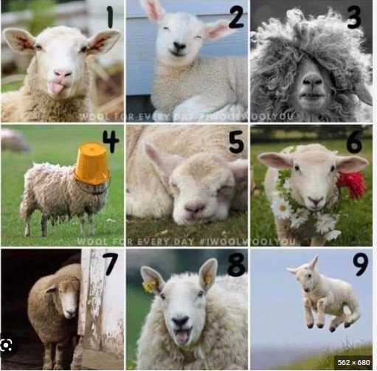

Ice Breaker
How are you feeling today? How are you feeling about this training?

Slide 4

Norfolk and Suffolk Police
What we do
First point of Call
Investigate
Keep victims informed
Build the case for the CPS

Slide 5


What we do
The Crown Prosecution Service prosecutes criminal cases.
    We advise the police on complex investigations
    We review evidence to decide which cases should be prosecuted
    We prepare cases and present them at court
    We use our experience to improve how the criminal justice system works
Highlight and promote successful hate crime prosecutions across all of our channels
How we work:
We're independent
We make sure that the right person is prosecuted for the right offence

Slide 6
What is hate crime?
Any crime can be prosecuted as a hate crime if the offender has either:
demonstrated hostility based on race, religion, disability, sexual orientation and/or transgender identity
Or
been motivated by hostility based on race, religion, disability, sexual orientation and/or transgender identity
Someone can be a victim of more than one type of hate crime.

Slide 7





The law recognises five types of hate crime on the basis of:
Sexual orientation
Race
Disability
Religion
Transgender identity

Slide 8

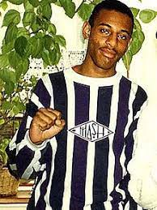
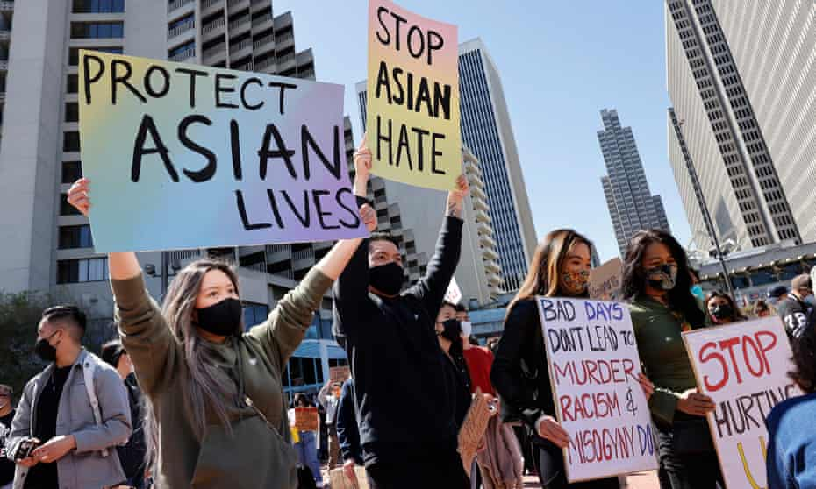
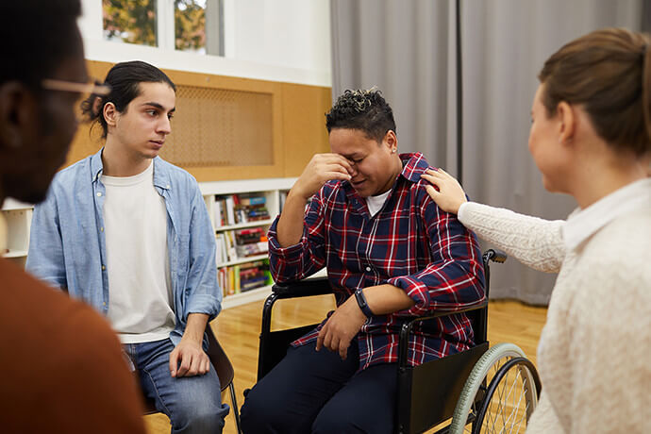
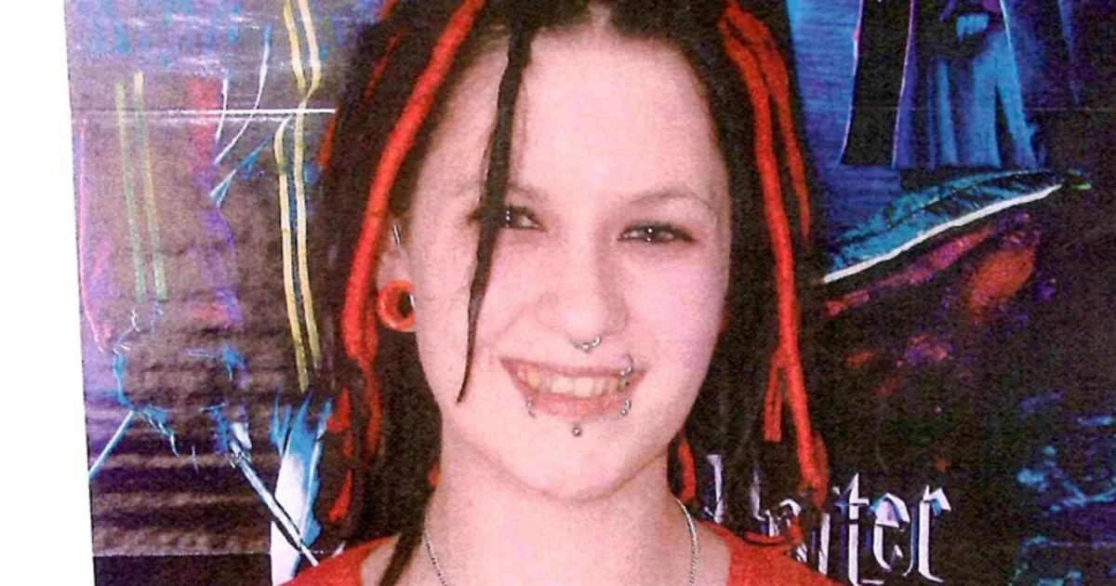
What is Hate?
Notes:
Incidents - non crime – no entry in club due to skin colour
Laughing at homophobic jokes
Refusing to sit next to someone with a disability
Pushing in front of a que
Not serving you in a restaurant
Crimes
Threats
Verbal abuse
Physical attack
Criminal damage
Perception – If they think it is, IT IS!!!
Your opinion is relevant
AFRO CUNT example
Why is it important to record both?

Slide 9
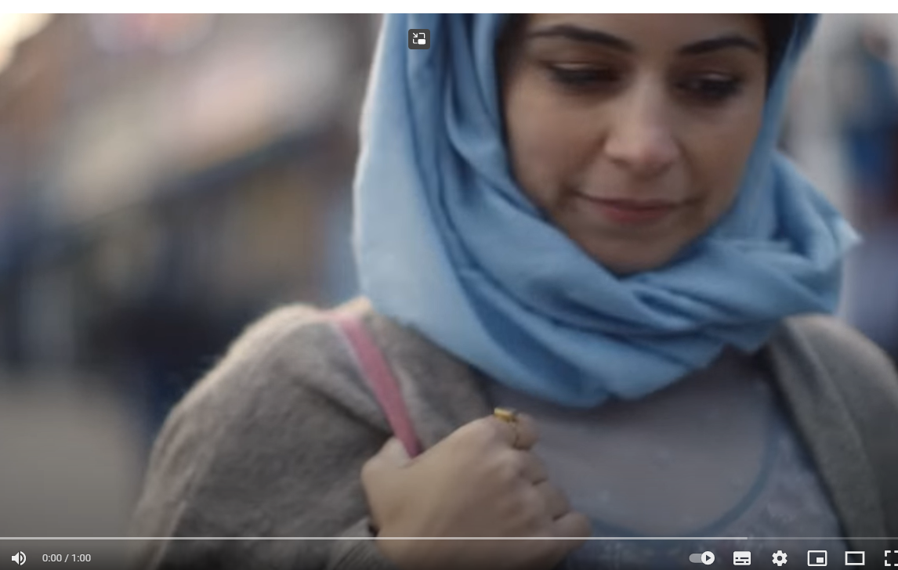
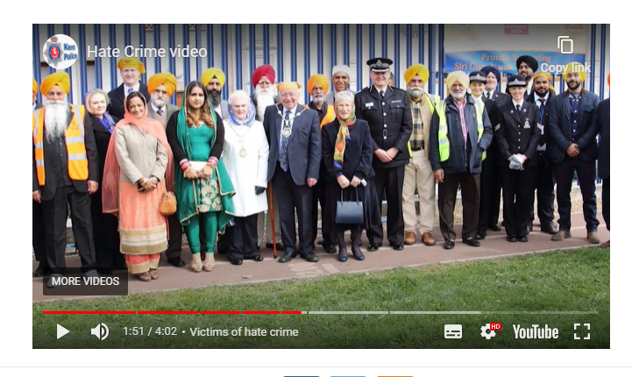
Examples – Hate Crimes
A hate crime is defined as 'Any criminal offence which is perceived by the victim or any other person, to be motivated by hostility or prejudice based on a person's race or perceived race; religion or perceived religion; sexual orientation or perceived sexual orientation; disability or perceived disability and any crime motivated by hostility or prejudice against a person who is transgender or perceived to be transgender.'

Slide 10
Examples – Hate incidences
A hate incident is any incident which the victim, or anyone else, thinks is based on someone’s prejudice towards them because of their race, religion, sexual orientation, disability or because they are transgender.
Not all hate incidents will amount to criminal offences, but it is important that these are reported to the police so the tensions in the area can be monitored.
* No entry in club due to skin colour
* Laughing at homophobic jokes
* Refusing to sit next to someone with a disability
* Pushing in front of a queue or not being served for ages
Notes:
Evidence of the hate element is not a requirement.
You do not need to personally perceive the incident to be hate related. It would be enough if another person, a witness or even a police officer thought that the incident was hate related..’
Although this may not be crime, if it’s a reoccurring issue, it is important to report it either to us and/or the organisation as its everyone's responsibility to work within the equalities act 2010.

Slide 11
Hate Crime - Reporting
Call 999 or 101
In Person at a Police Station
Online via 0.7 Hate crime or incident | Norfolk Constabulary or
Suffolk 5. Report it - Hate crime or incident | Suffolk Constabulary
Crimestoppers Hate crime | Crimestoppers (crimestoppers-uk.org)
Truevision
Notes:
It is important to report all hates crimes and incidents as we use them to help is decide where extra support is needed etc
Add poll
Can you report a crime even if you are not the victim or related to the victim?

Slide 12


Prosecuting hate crime
Any crime can be prosecuted as a hate crime if the offender:
Demonstrated hostility towards one of the characteristics
Or
Was motivated by hostility towards one of these characteristics
Highlight and promote successful hate crime prosecutions across all of our channels
Offenders can receive longer sentences if they are convicted of a hate crime.
This is called a sentence uplift.

Slide 13
Assaults on Emergency Workers
The Law recognises that assaults on emergency workers need to be treated more severely
Maximum Sentences:
Common Assault – 6 months imprisonment
Assault on Emergency Worker – 12 months imprisonment
Racially/Religiously aggravated assault on emergency worker – 2 years imprisonment

Slide 14
Hate Crime – Support for Victims
Hate crime - Victim Support
Home - Stop Hate UK
Get help if you’ve experienced a hate crime or hate incident - Citizens Advice
Notes:
It is important to report all hates crimes and incidents as we use them to help is decide where extra support is needed etc
Add poll
Can you report a crime even if you are not the victim or related to the victim?

Slide 15

How are we tackling hate crime?
Hate crime training for our prosecutors
Regular quality checks on our cases
National and local community feedback groups helping us understand where we’ve done well and how we could improve.
Provide support (special measures) for victims and witnesses to enable them to give their best evidence.
Working with our partners to help the public understand hate crime and what we can do to tackle it.

Slide 16
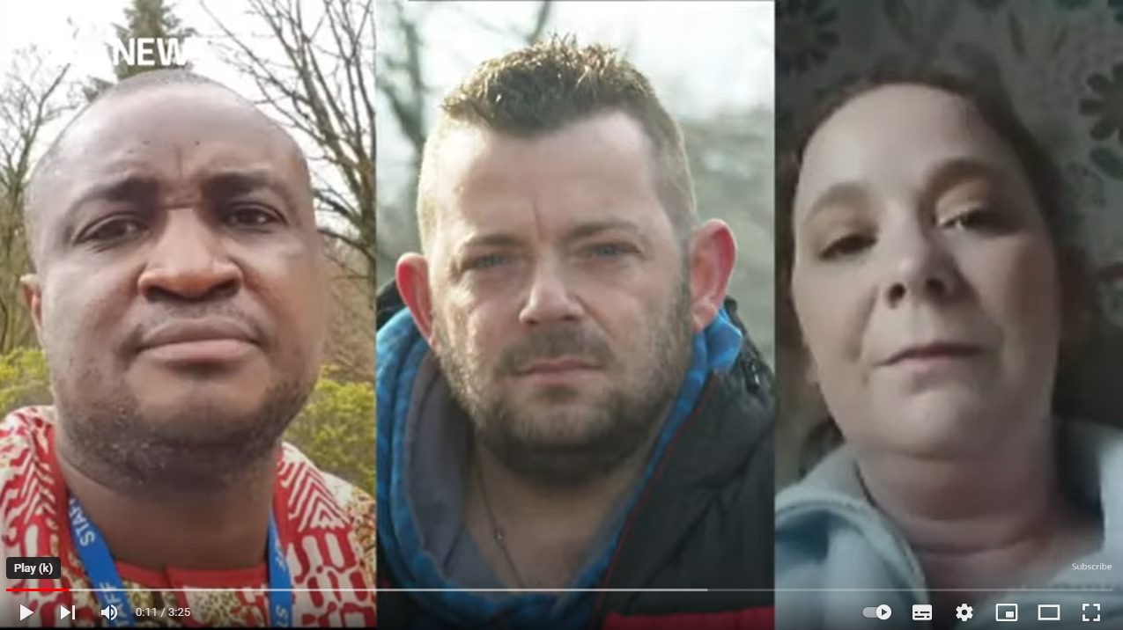
Impact
Notes:
Hate crime victims speak out about impact as figures increase during pandemic | ITV News - YouTube
How do you feel?

Slide 17
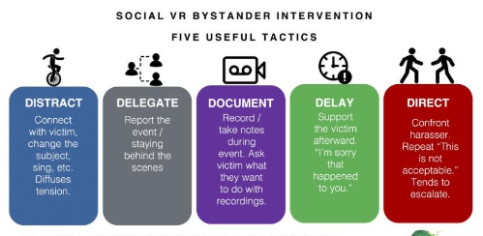
:
Source: Transmap.com
Notes:
Direct action is not always possible…. Look at the model the continuum of intervention –
The most appropriate action will depend on the occasion…knowing about how to make an intervention & when will make you a better ally & an effective & active bystander.
How to be an active bystander How to be an active bystander - Pearn Kandola
by Nic Hammarling, Head of Diversity at Pearn Kandola
When was the last time you heard someone say or do something racist at work? Perhaps it was a derogatory comment made based on a racial stereotype, or something as subtle as watching a colleague be ignored or talked over. Did you think it was acceptable? Did you challenge that inappropriate behaviour? Did you even identify it as racism?
In a study carried out by my psychologists at Pearn Kandola, it was found that over half (52%) of Brits have observed racist behaviour at work. Although we’ve recently seen an increase in reported levels of inappropriate behaviours, sadly, most people who do witness racist behaviour do nothing about it.
All of us who witness inappropriate behaviour are bystanders. But it’s your choice as to whether you’re a passive bystander or an active bystander.
A passive bystander is someone who witnesses a behaviour but does nothing about it. An active bystander is someone who chooses to act when they witness a behaviour, challenging it in an attempt to prevent it from happening again.
So, to those of you who claim not to be racist or claim to be actively anti-racist, I ask: Are you an active bystander?
When do we need to challenge inappropriate behaviour?
The answer to this question is simple: always. Inappropriate behaviour happens often, and whether you’re in a work setting, public setting, or personal setting, it needs to be challenged.
The most obvious examples that might spring to mind are more overt acts of racism. For example, making jokes about someone’s nationality or using racial stereotypes. But racism can also manifest itself in more subtle ways that are less blatantly inappropriate, but still have a corrosive impact. In these situations, the behaviour is likely to go unchallenged.
For example - racial evasiveness – to deny that problems occur which are race related – is also an act of racism. For instance, when discussing the Black Lives Matter protests earlier this year, someone said: “I don’t think people are angry about race, I think they’re angry at not being able to go out because of the pandemic.”
Back to the power of social norms
Every time racist behaviour occurs and goes unchallenged, it is normalised to those around us to make and anti-racist workforce we need to make it normalised to challenge. The more normal or common place or acceptable a behaviour is seen, the more likely it is to happen again, and so the cycle continues. Your response to the actions of those around you strongly impacts whether or not a behaviour is normalised or not, and it’s your responsibility to either accept or challenge that behaviour.
It’s easy enough to suggest that we all must be active bystanders, but at the same time there are a number of reasons why those who witness racist behaviour in the workplace don’t report it. Witnesses may find themselves asking:
Did I really just see that?
Is there an element to their relationship I don’t know about?
Did the victim bring this on themselves?
Do I have the authority to challenge here?
What will happen to me if I intervene?
These seeds of doubt prevent many from standing up to racist behaviour. In order to tackle racism in the workplace, witnesses need to understand exactly what it is to be an active bystander.
How to be an active bystander
Being an active bystander doesn’t necessarily require you to confront a perpetrator face to face, then and there, as in some scenarios that may not be the most logical next step. In fact, there are four different methods of challenging, known as the Four D’s:
Distraction
Indirectly intervening with the situation, distraction involves interrupting the conversation and changing its focus. Particularly useful in public places or where you are unsure of how a perpetrator may act, this method involves talking to the person on the receiving end of the behaviour to stop the behaviour.
Delegation
Delegation involves reporting racist or inappropriate behaviour to seniors or those who can make a difference, like HR. This can be useful in a workplace setting, as long as you aren’t a senior member of staff.
Delay
This involves delaying intervention until after the situation has ended. It might involve speaking to both parties, and is particularly useful in front of bigger groups where you’d like to avoid causing a scene, or if you’re a more junior member of staff. The important thing to remember when delaying is that you can’t delay forever, and it’s still important to bring the issue to light.
Direct
The most obvious and perhaps most satisfying method of intervention is to be direct and challenge the behaviour then and there using a clear statement.

Slide 18
Why is it important?
Community
Trust
Crime Reduction
Trust in Police
Better places to work and live
Safer Neighbourhoods
Happier home/work environment

Slide 19






Over the last year
O
U
R
P
E
O
P
L
E
Last year we prosecuted more than 10,000 cases of hate crime across England and Wales.
In 86% of cases the defendants were found guilty of one or more crimes
In 79% of those cases the court increased the sentence because they agreed that the crime was a hate crime
Racial Hate Crime is the most commonly reported Hate Crime.

Slide 20

Where can you find more information?
O
U
R
P
E
O
P
L
E
To find out more about how we prosecute hate crime visit - www.cps.gov.uk/hate-crime
For national news and updates
You can follow us on Twitter @cpsuk
You can follow us on Instagram @crownprosecutors
For local news and updates:
You can follow us on Twitter: @CPSEastEngland
You can sign up to our Area Newsletter

Slide 21
THANK YOU
ANY QUESTIONS?

