Slide 1
Integrating Health and Care in N&W ICS
Leadership Development Programme
Clinical Strategy and Aligning the Clinical Advisory Machinery
Mike Farrar CBE, FRCGP, FRCP

Slide 2
Building High Performing Teams

Slide 3
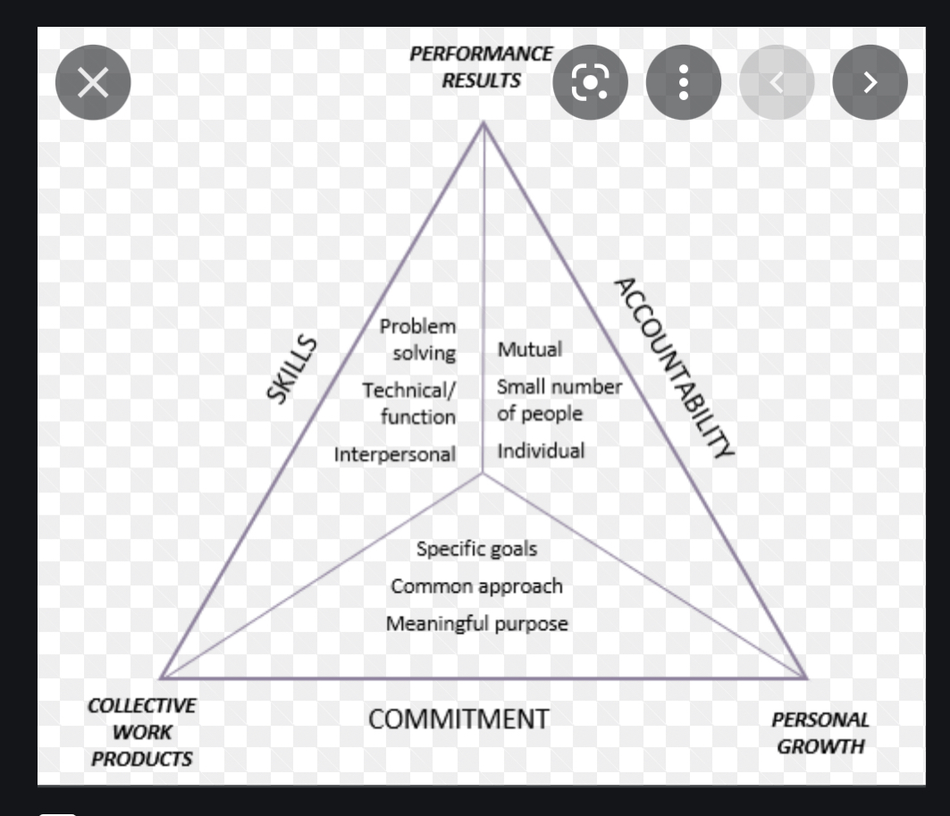
THERE ARE MANY MANY MODELS
KATZENBACH CENTRE
THESE COVER -
DEFINITIONS OF HIGH PERFORMANCE
ATTRIBUTES OF HPT
CONTEXT OF HIGH PERFORMANCE
PHASES OF TEAM GROWTH
MENTALITY AND MINDSETS
BALANCE OF PERFORMANCE AND WELL BEING

Slide 4
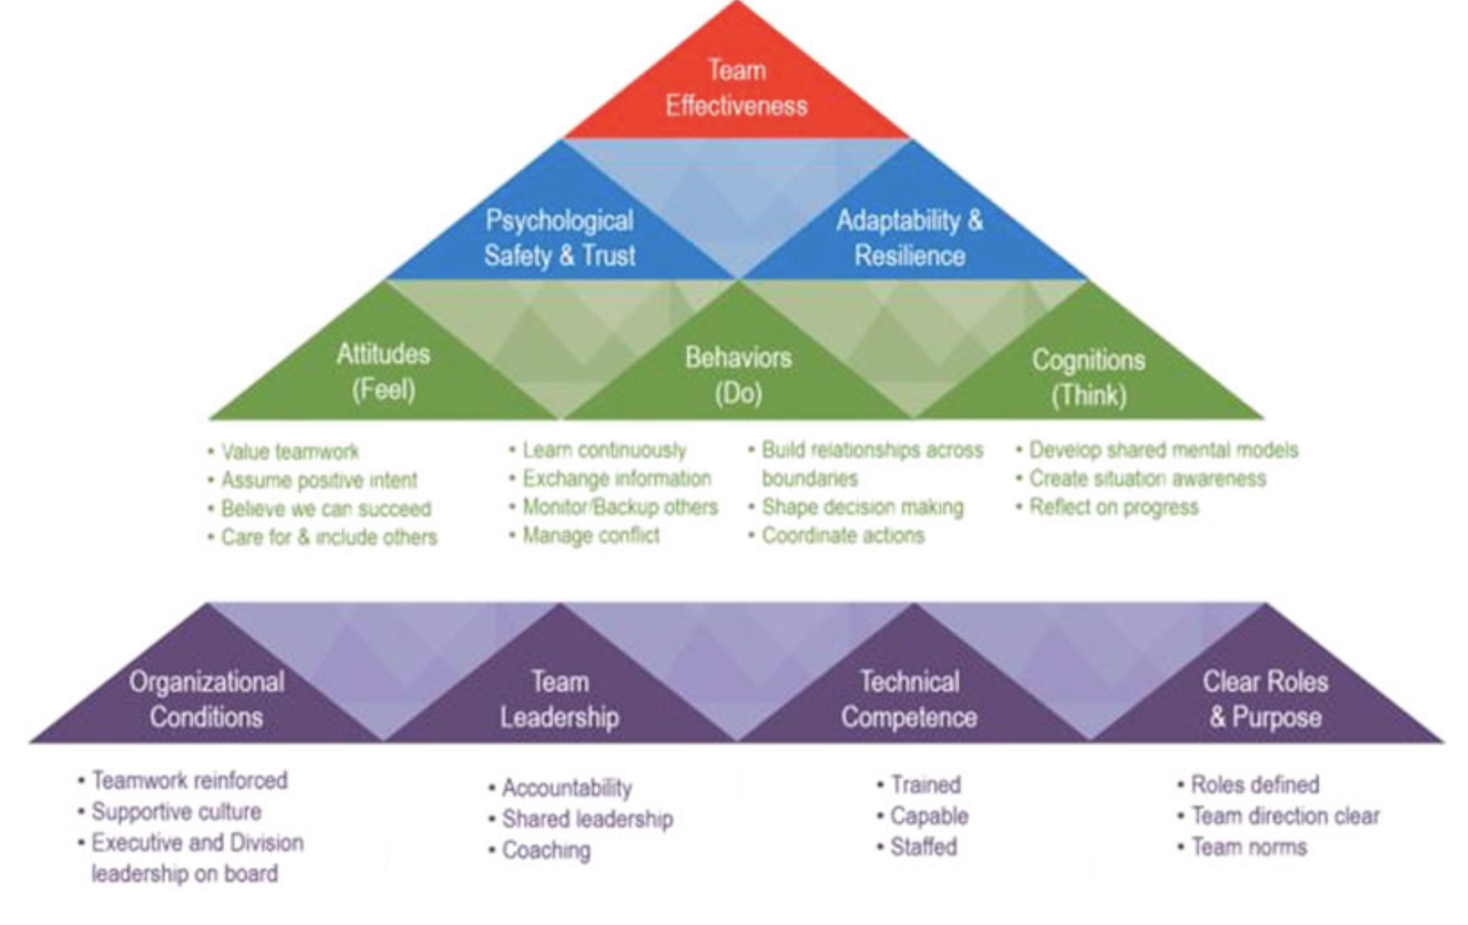
WHAT DOES THE TEAM FEEL, DO, AND THINK?

Slide 5
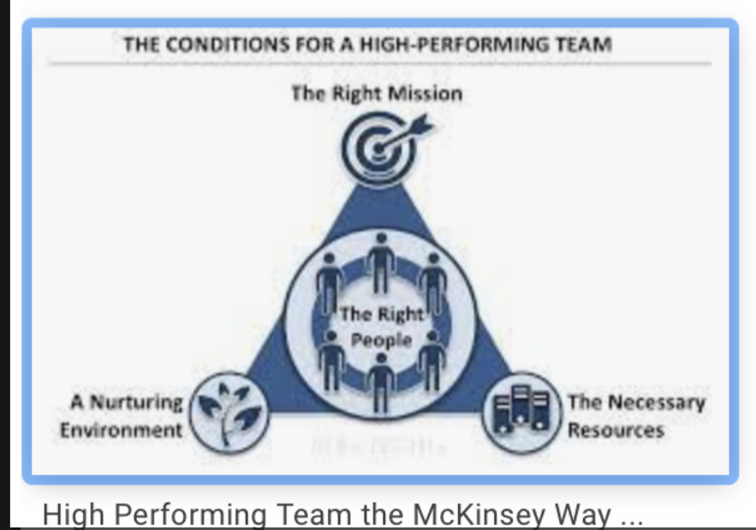
What are the conditions within which N&W CCPLs are operating ?

Slide 6
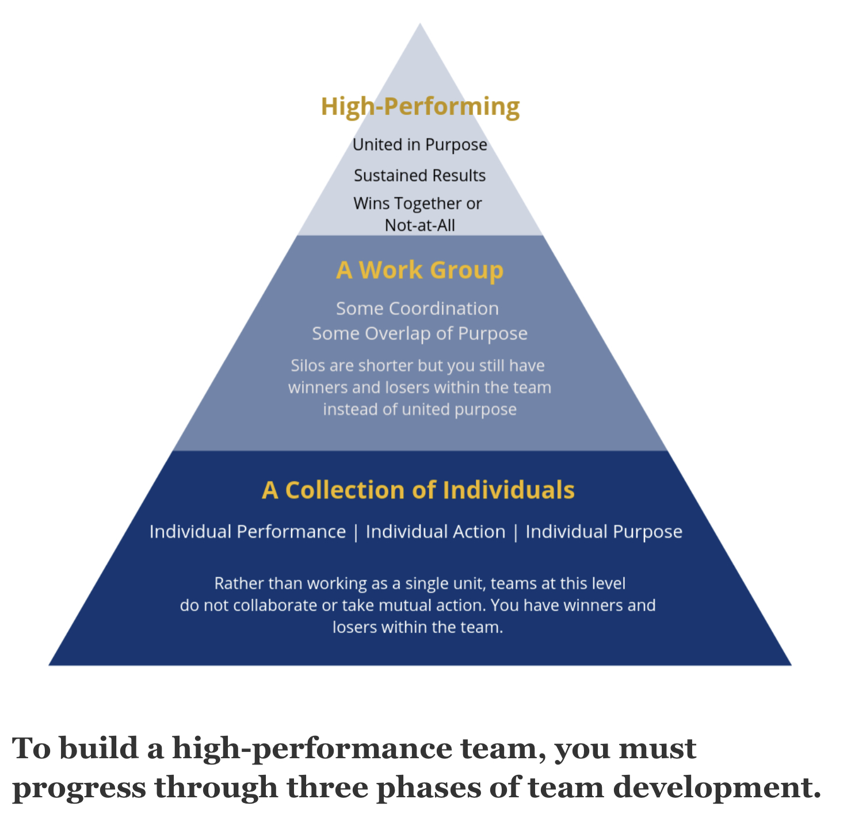
What phase of development is the CCPLs in N&W in?

Slide 7
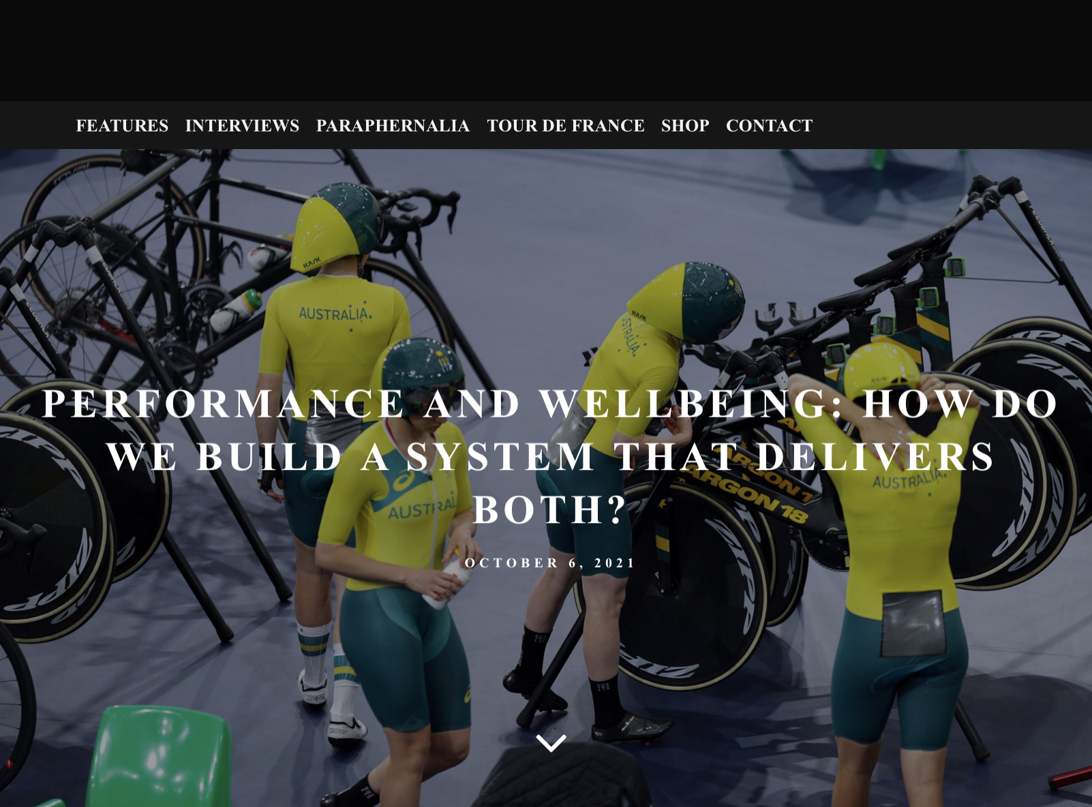

Slide 8
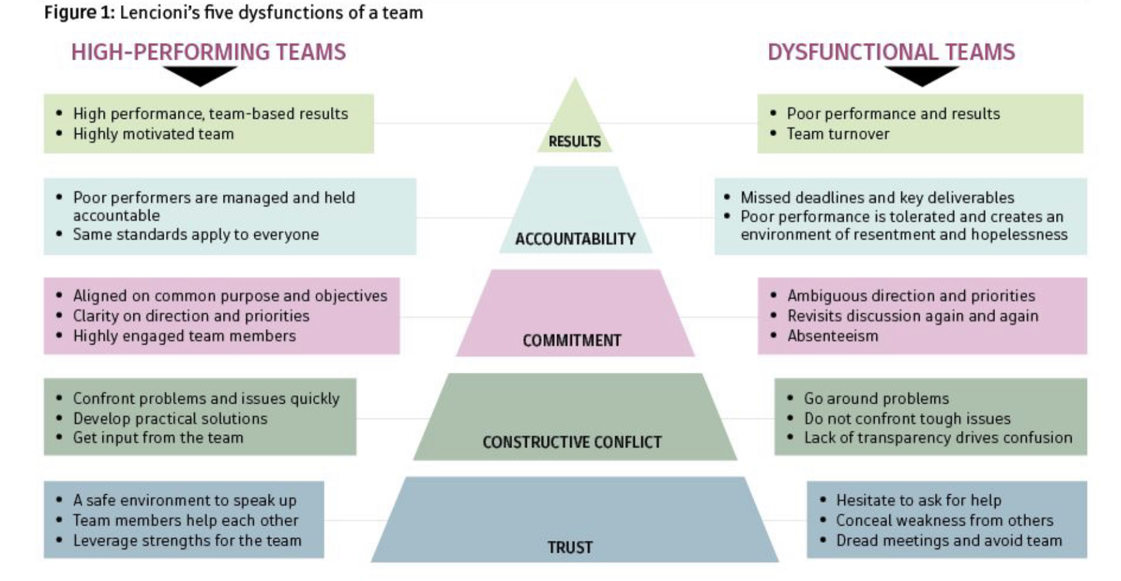

Slide 9


Criteria For Effective Whole Systems Working
Compelling shared purpose
System for sharing risks and benefits
Shared sense of competition versus collaboration
Process of arbitration
Clinically defensible
Strong interpersonal relationships
Proprietary and confidential. Do not distribute.
Notes:
Mike Farrar

Slide 10
GROUP THINK OVER CONFIDENCE EXCLUSIVE | HIGH PERFORMING ENQUIRING CURIOUS VALUE ADDING
PASSIVITY LAISSEZ-FAIRE | MISTRUST AND CHAOS OVER REPORTING
T
R
U
S
T
CHALLENGE

Slide 11

What might we set as the standards against which we assess ourselves ?
Are we a team? Should you be a team?
Common purpose (are we aligned? On mission? On priorities? On style?)
Psychological safety - do we have it?
Talented individuals - Great team? Greater than the sum of our parts?
Well being and nourished
Shared mindset - positive and committed
Learning culture - permission to fail
Getting results - does anything else matter?
Your thoughts?

Slide 12
What might we set as the standards against which we assess ourselves when we actually lead
Leading a team
Have we established a common purpose and an open culture ?
Do we dictate or set direction, or facilitate ?
Have we got the balance right of task and maintenance. How ambitious are we, is this realistic?
Do we have a balanced diverse team ? Or one in our image?
Do we get the best out of the talent in the team ?
Do we have favourites and create cliques ?
Would we want to be led by you ? (Goffee and Jones)
Your thoughts?

