Slide 1
Integrating Health and Care in Norfolk and Waveney ICS
The importance of developing an effective ICS with a clinically and care professionally driven culture - why you are critical to its success
Mike Farrar CBE, FRCGP, FRCP

Slide 2
CCPL is vital if N&W is to be successful in managing to improve outcomes within restricted resources

Slide 3
Eight Typical Strategies For Addressing Current Challenges
ICS REFORMS MIRROR BOX 3
1
Prevention and developing a citizen centred ‘asset based’ approach
2
Investment in primary care
3
Whole systems
approach
4
Managing unwarranted clinical variation
ICS REFORMS REQUIRE BOX 8
5
Using lean management techniques
6
Adopting new digital technologies - PHM, citizen health, telehealth services
7
Adopting new clinical procedures and pharmacological interventions
8
Creating new partnerships and governance approaches (seeking scale)
ICS REFORM MUST DEPLOY BOXES 1-7
Notes:
Mike Farrar

Slide 4


Slide 5
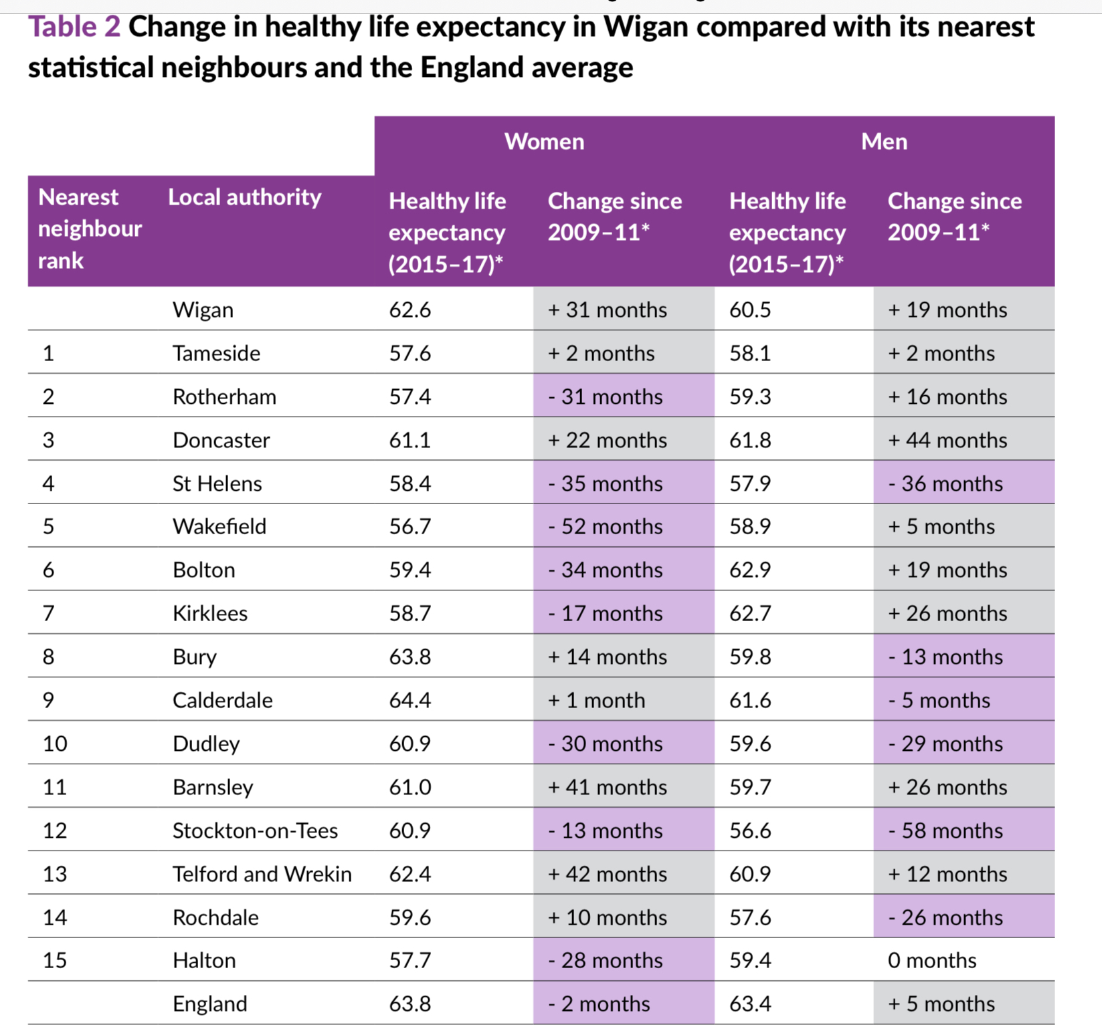

Slide 6
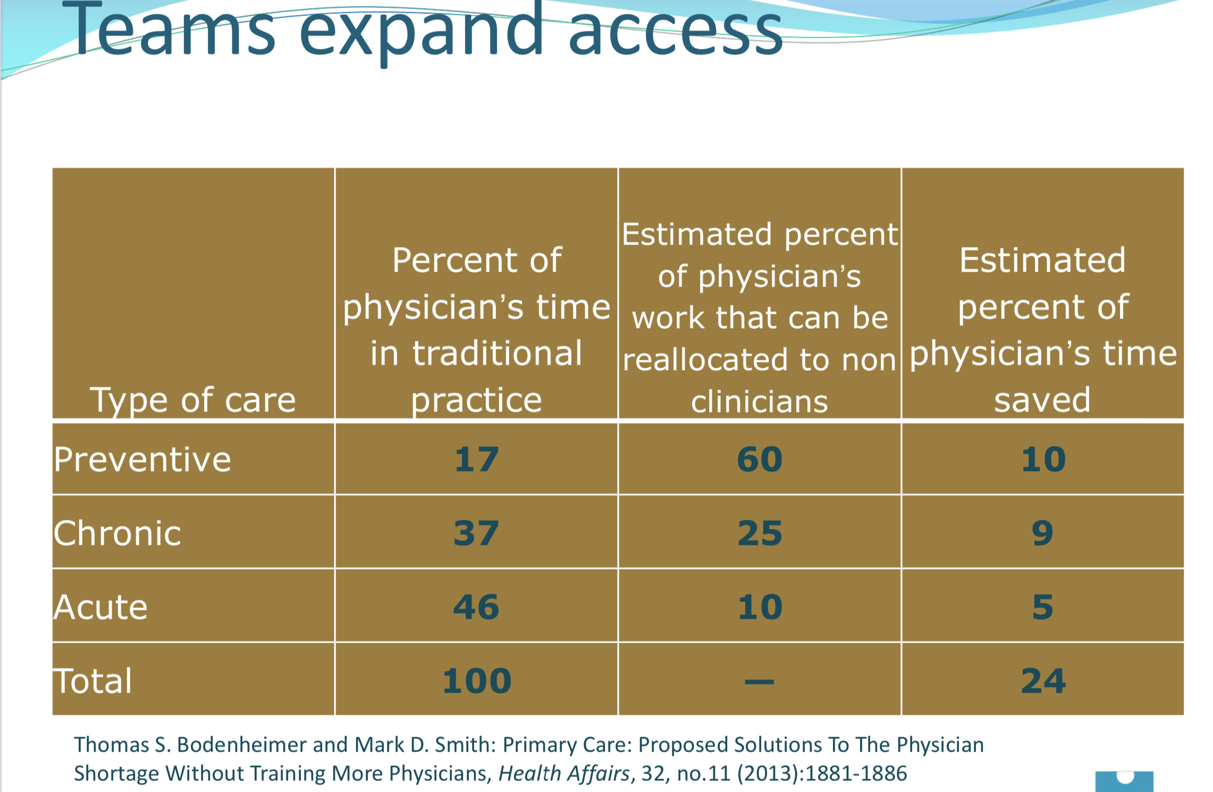

Slide 7
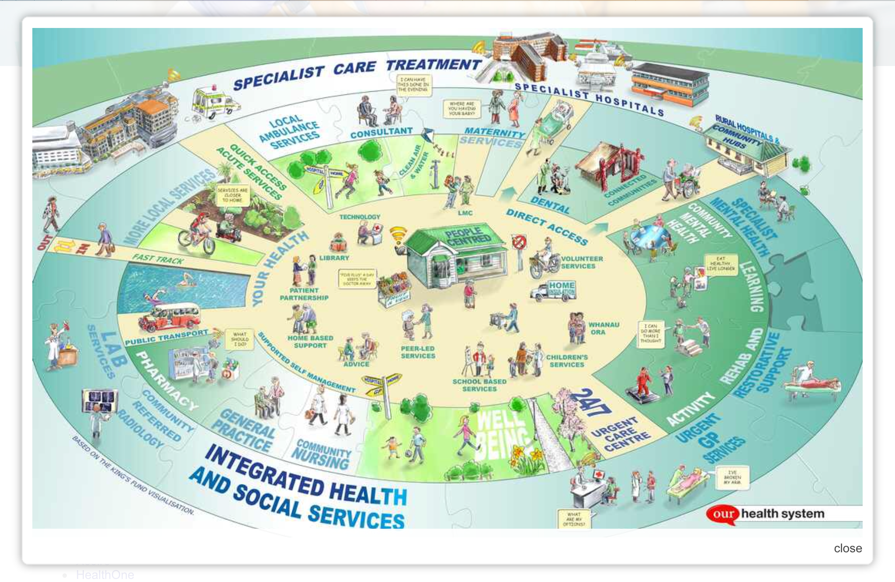
Reorientation of Care from Hospital to patient centred, community based care in Canterbury, New Zealand
N&W CCPL Programme
http://www.cdhbcareers.co.nz/All-About-Us/How-We-Do-What-We-Do/

Slide 8
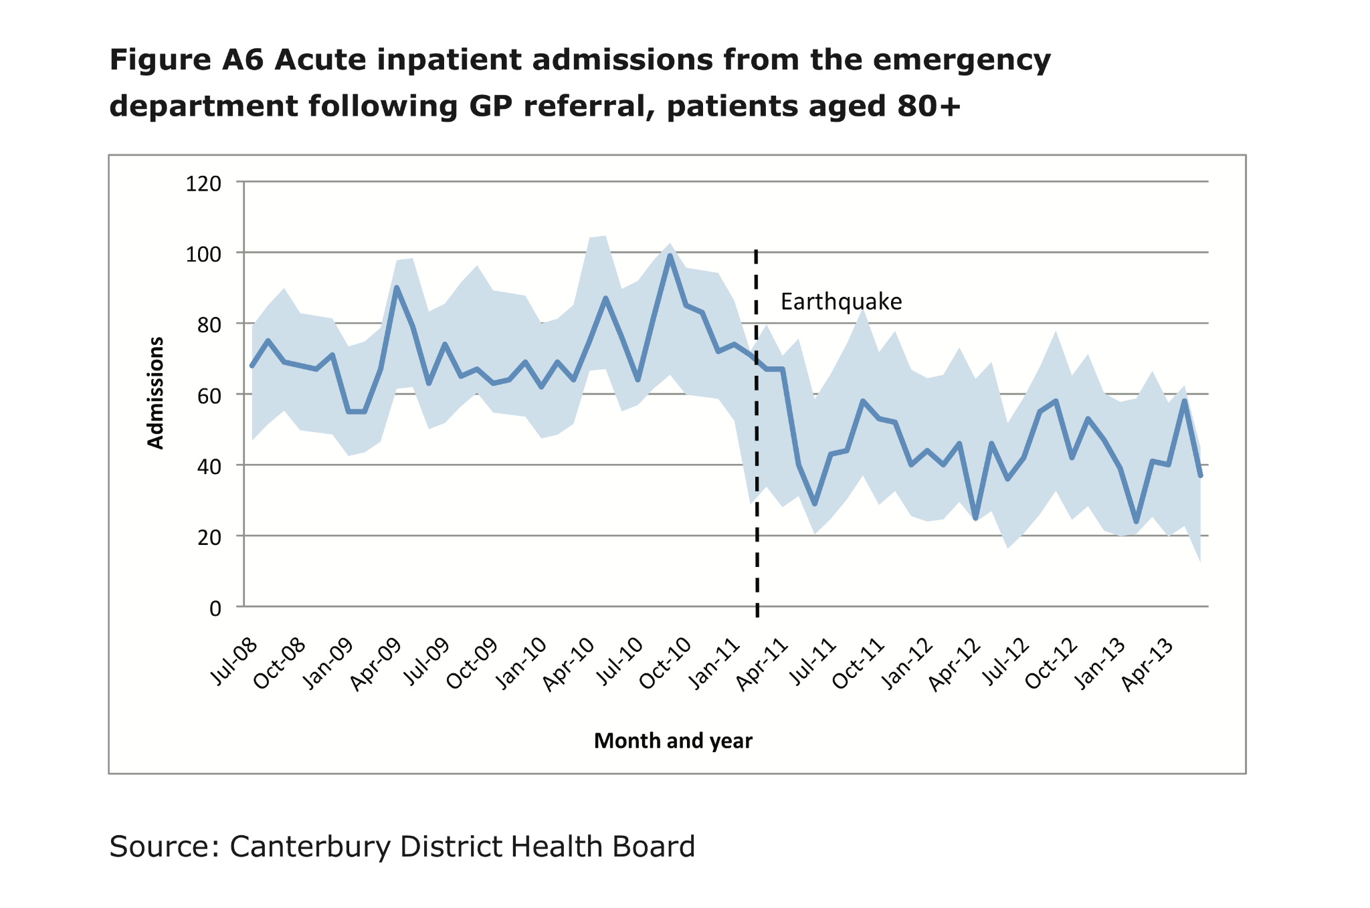
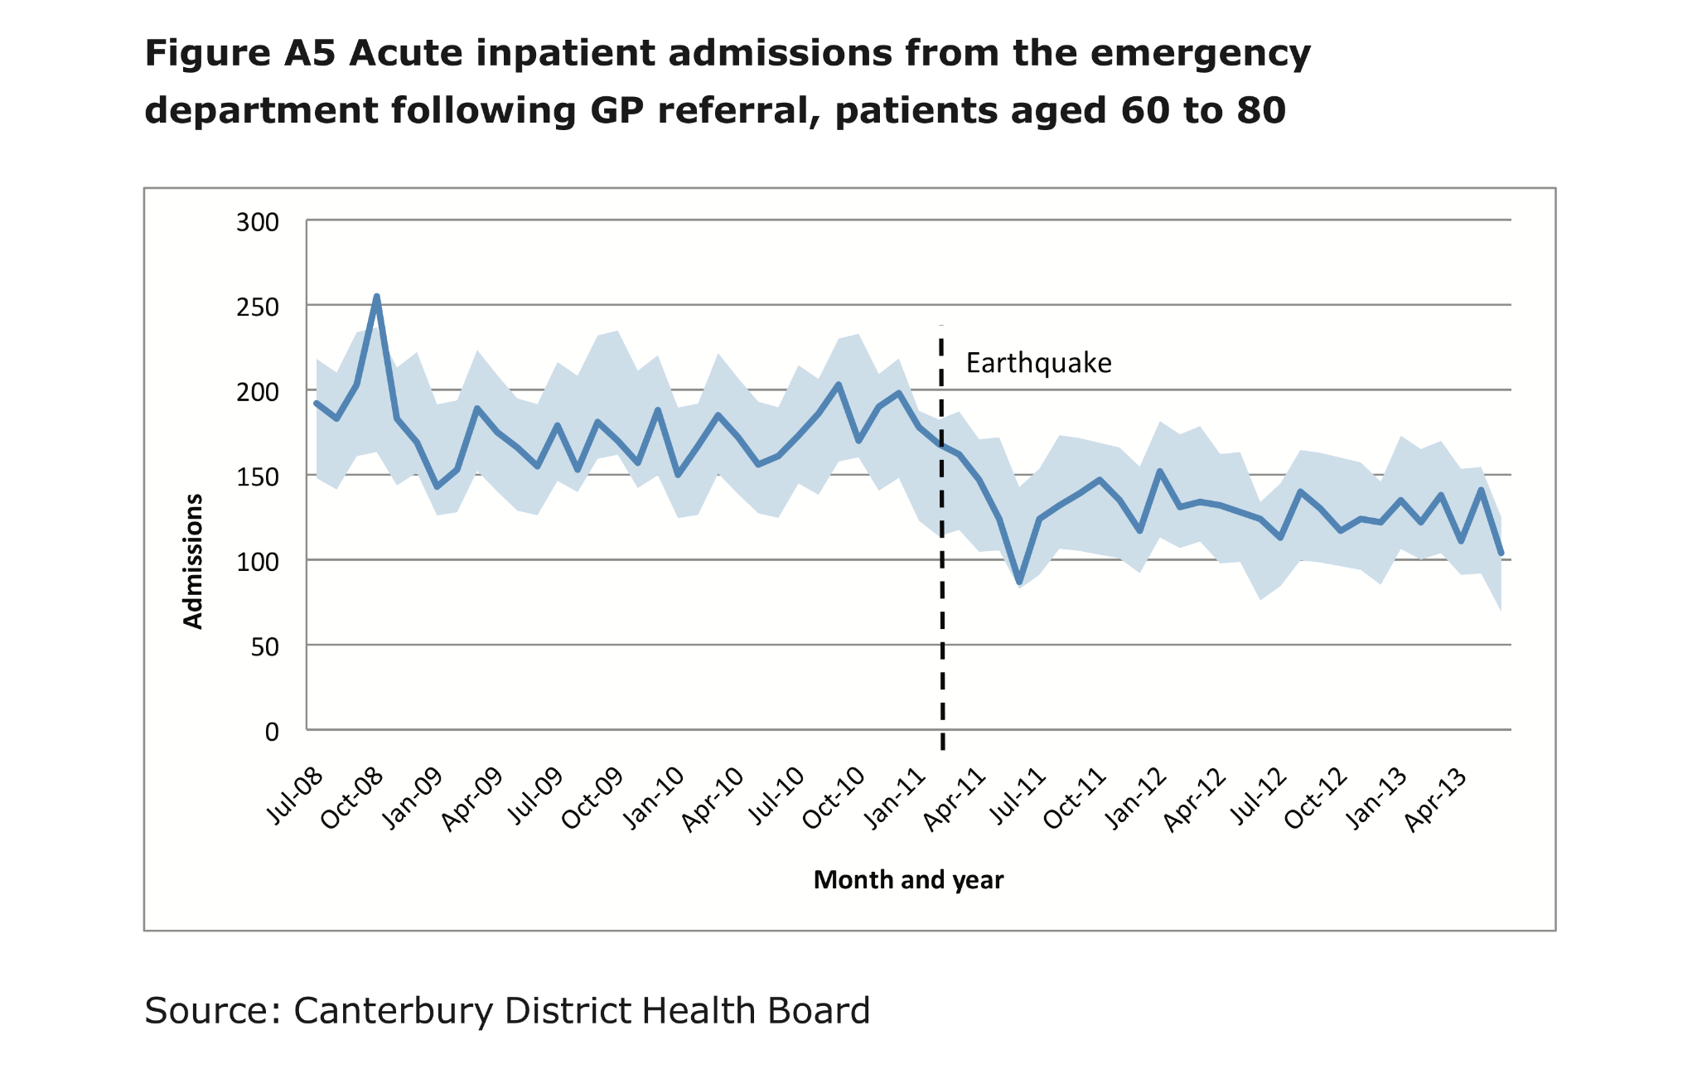
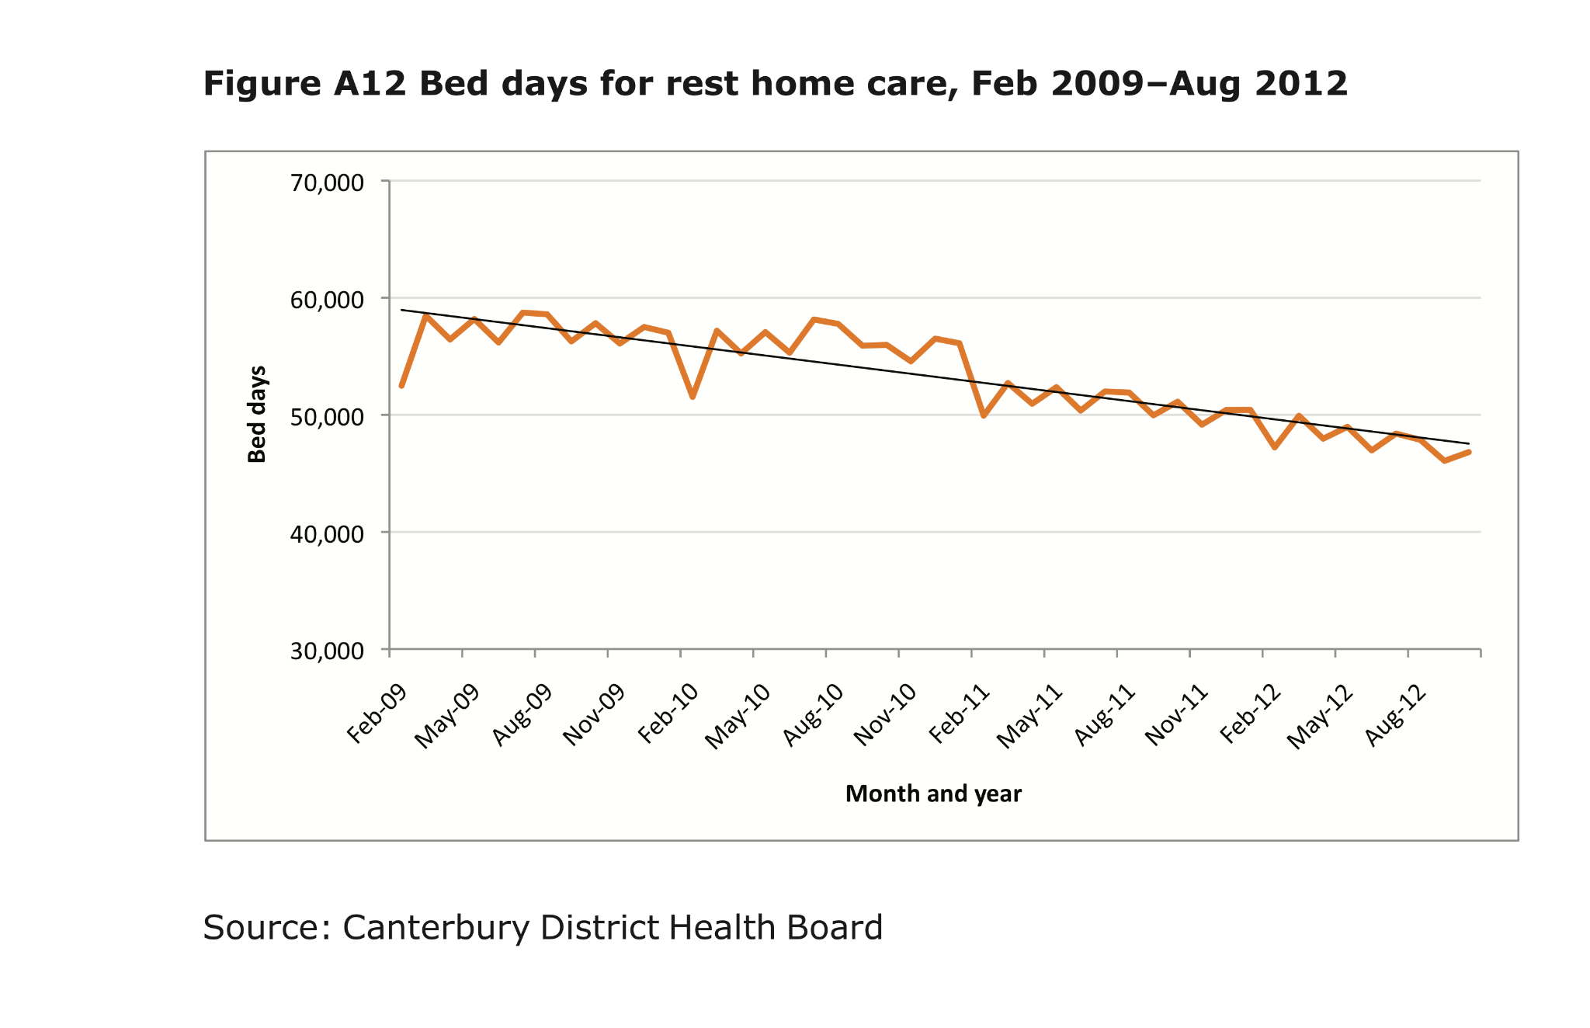
Canterbury approach - impact on hospital admission and rest home care
N&W CCPL PROGRAMME

Slide 9

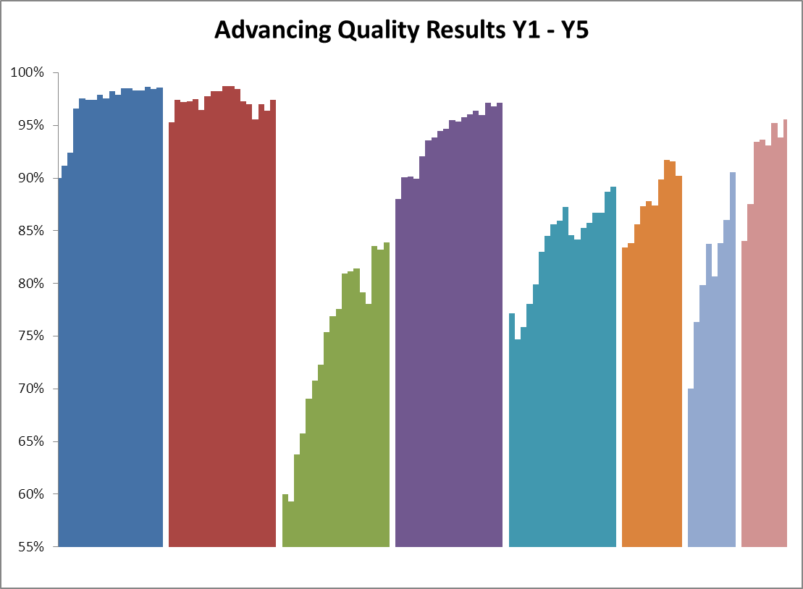
Results Y1 – Y5
The chart shows the quarter on quarter improvements across 32 hospitals in meeting best practice evidence based care through excellence in clinical engagement
Steady improvement, sustained
AMI CABG HEART FAILURE HIP&KNEE PNEUMONIA STROKE DEMENTIA PSYCHOSIS
North West Composite Quality Score over time
Notes:
Composite Quality Score over time

Slide 10
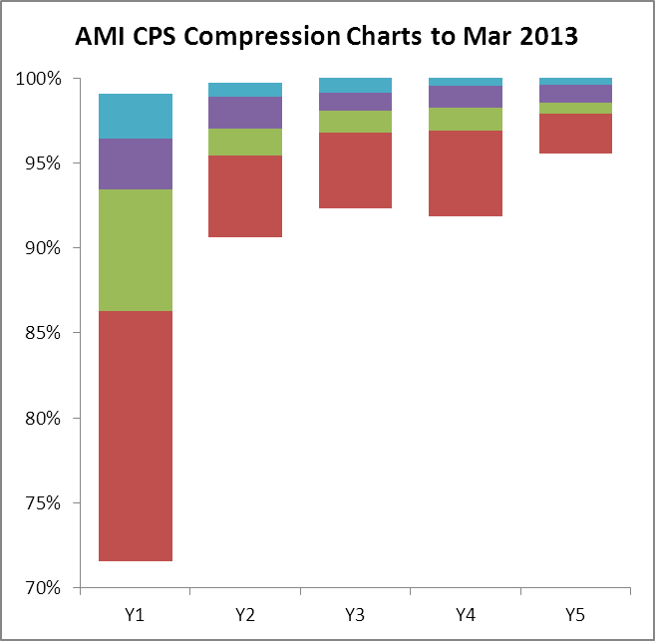
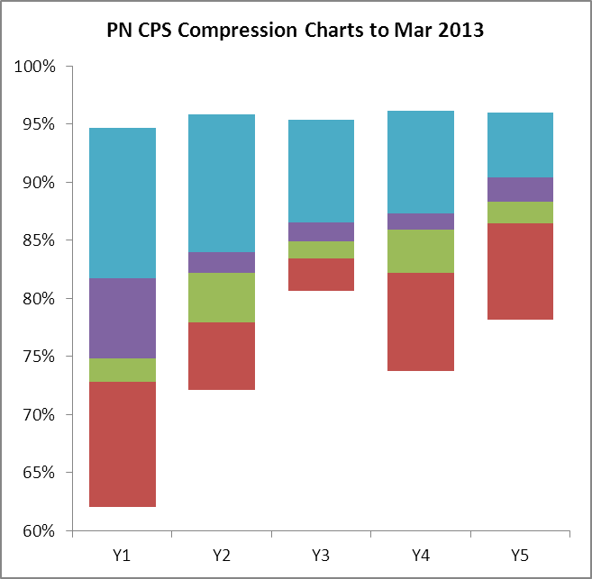
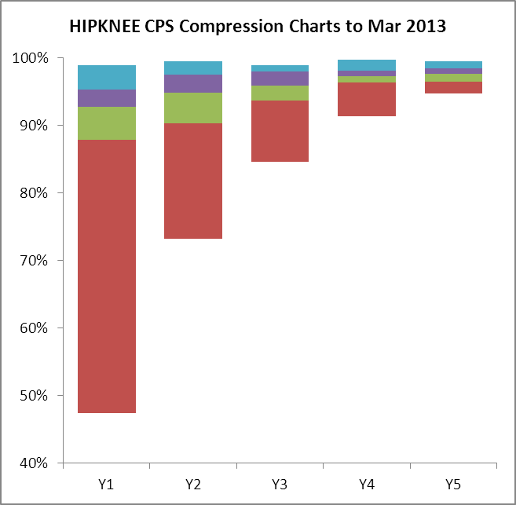
Reducing variation
Y1 – Y5 (2008-2013)
AMI CQS compression Y1 –Y5
HK CQS compression Y1 –Y5
PNE CQS compression Y1 –Y5
The Chart shows the reduction in clinical variation in 32 hospitals in North West England whilst showing overall improvements. NEJM published the evaluation that showed around 1000 lives saved from improved pneumonia care and significant savings of £8 for every £1 invested in the programme.

Slide 11
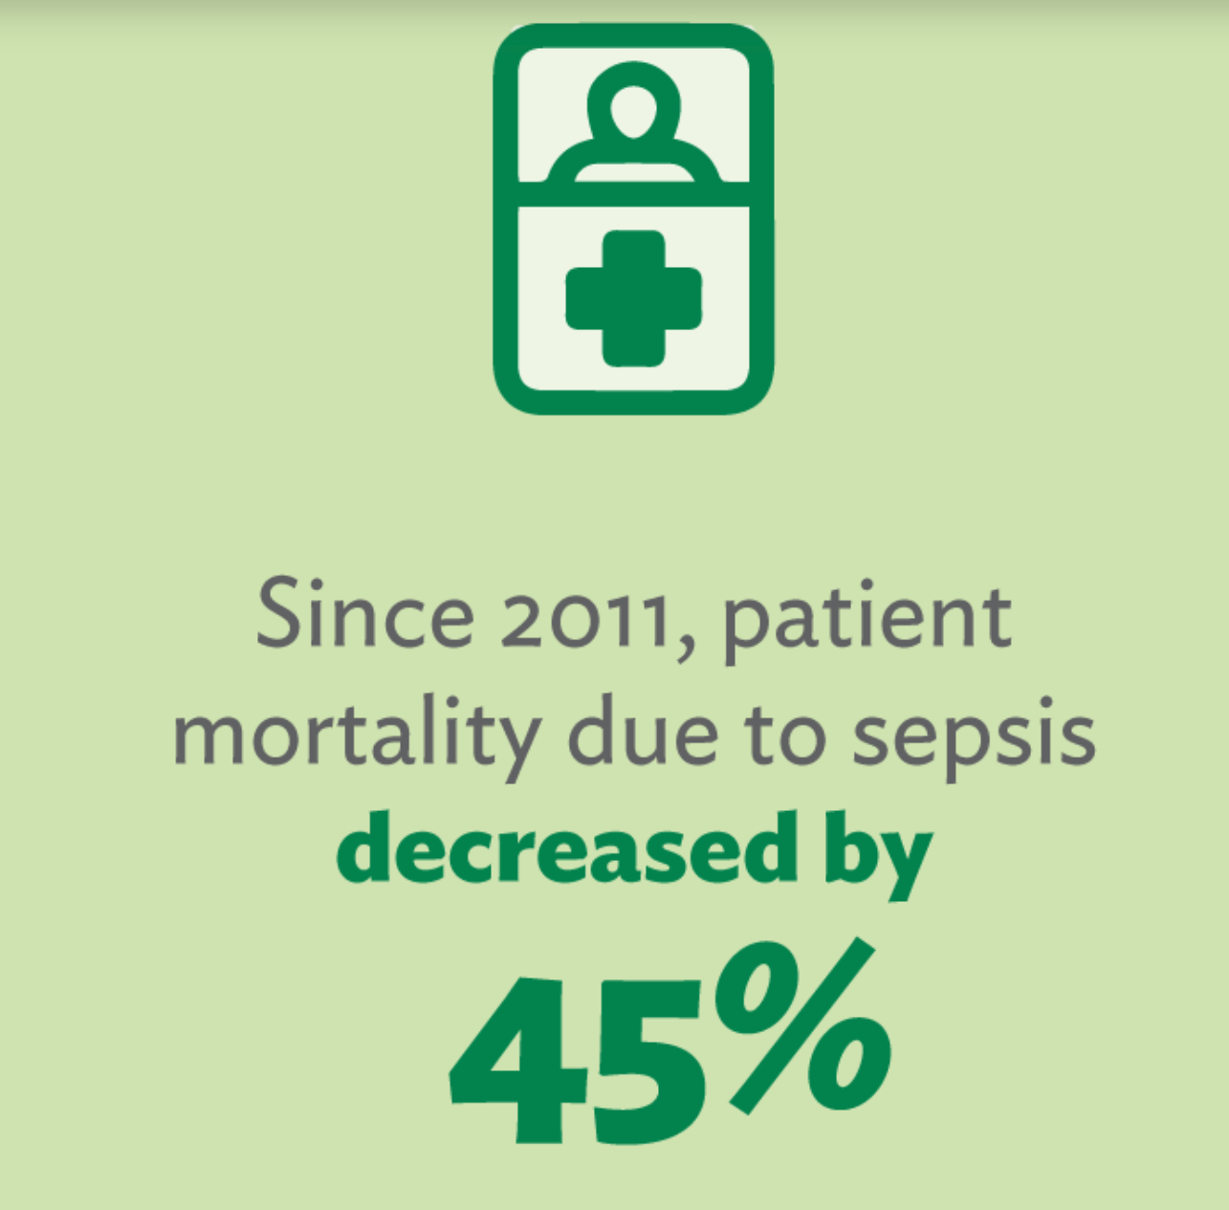
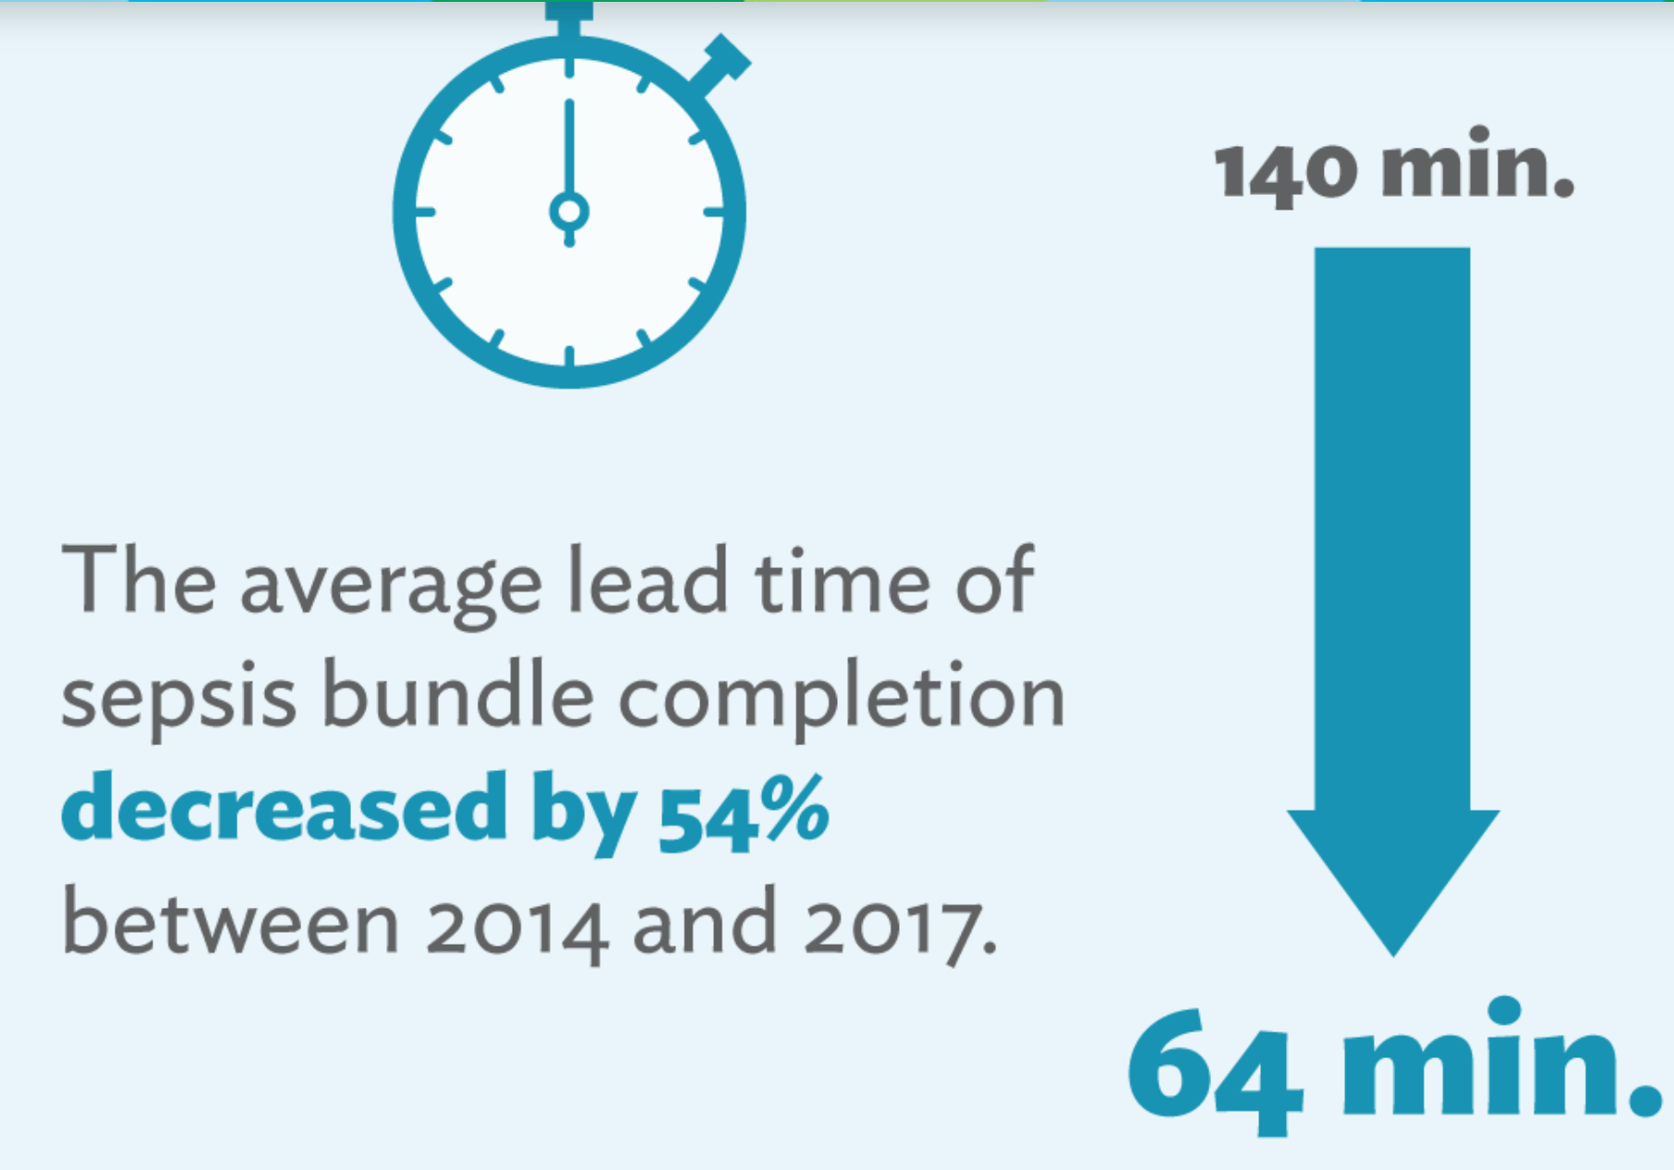
Lean Management techniques can produce benefits in service and financial outcomes
N&W CCPL PROGRAMME
The benefits of using Leah techniques in sepsis management at Virginia Mason hospital, Seattle
Now copied across the world

Slide 12
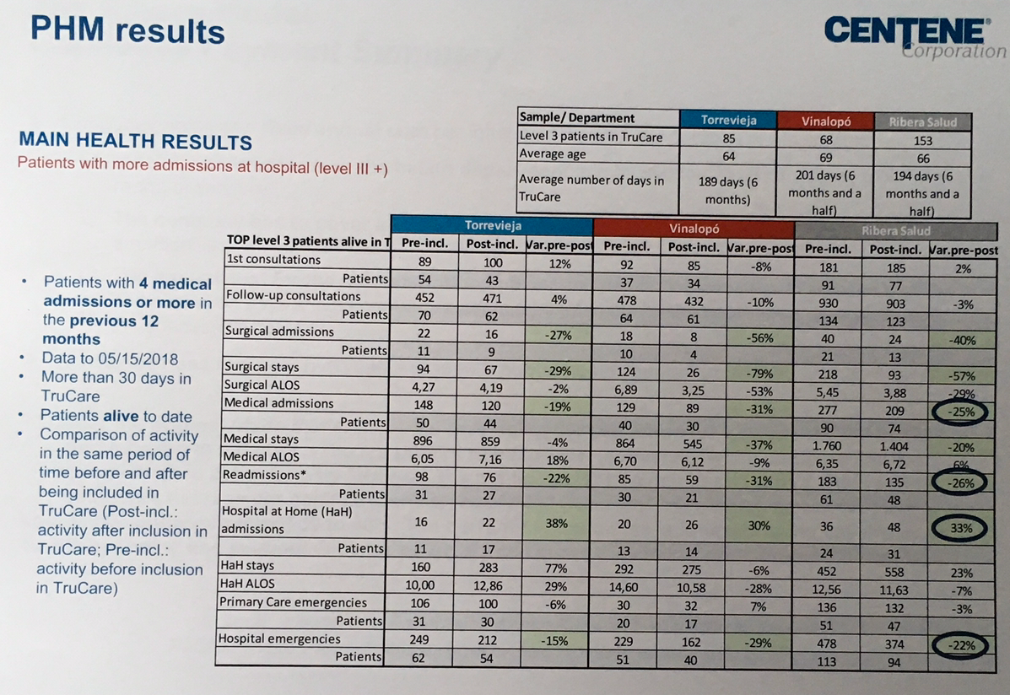
Evidence of using A.I. guided population risk scoring and case management from Spain
N&W CCPL PROGRAMMEc
Reductions in hospital admissions by over 20%

Slide 13
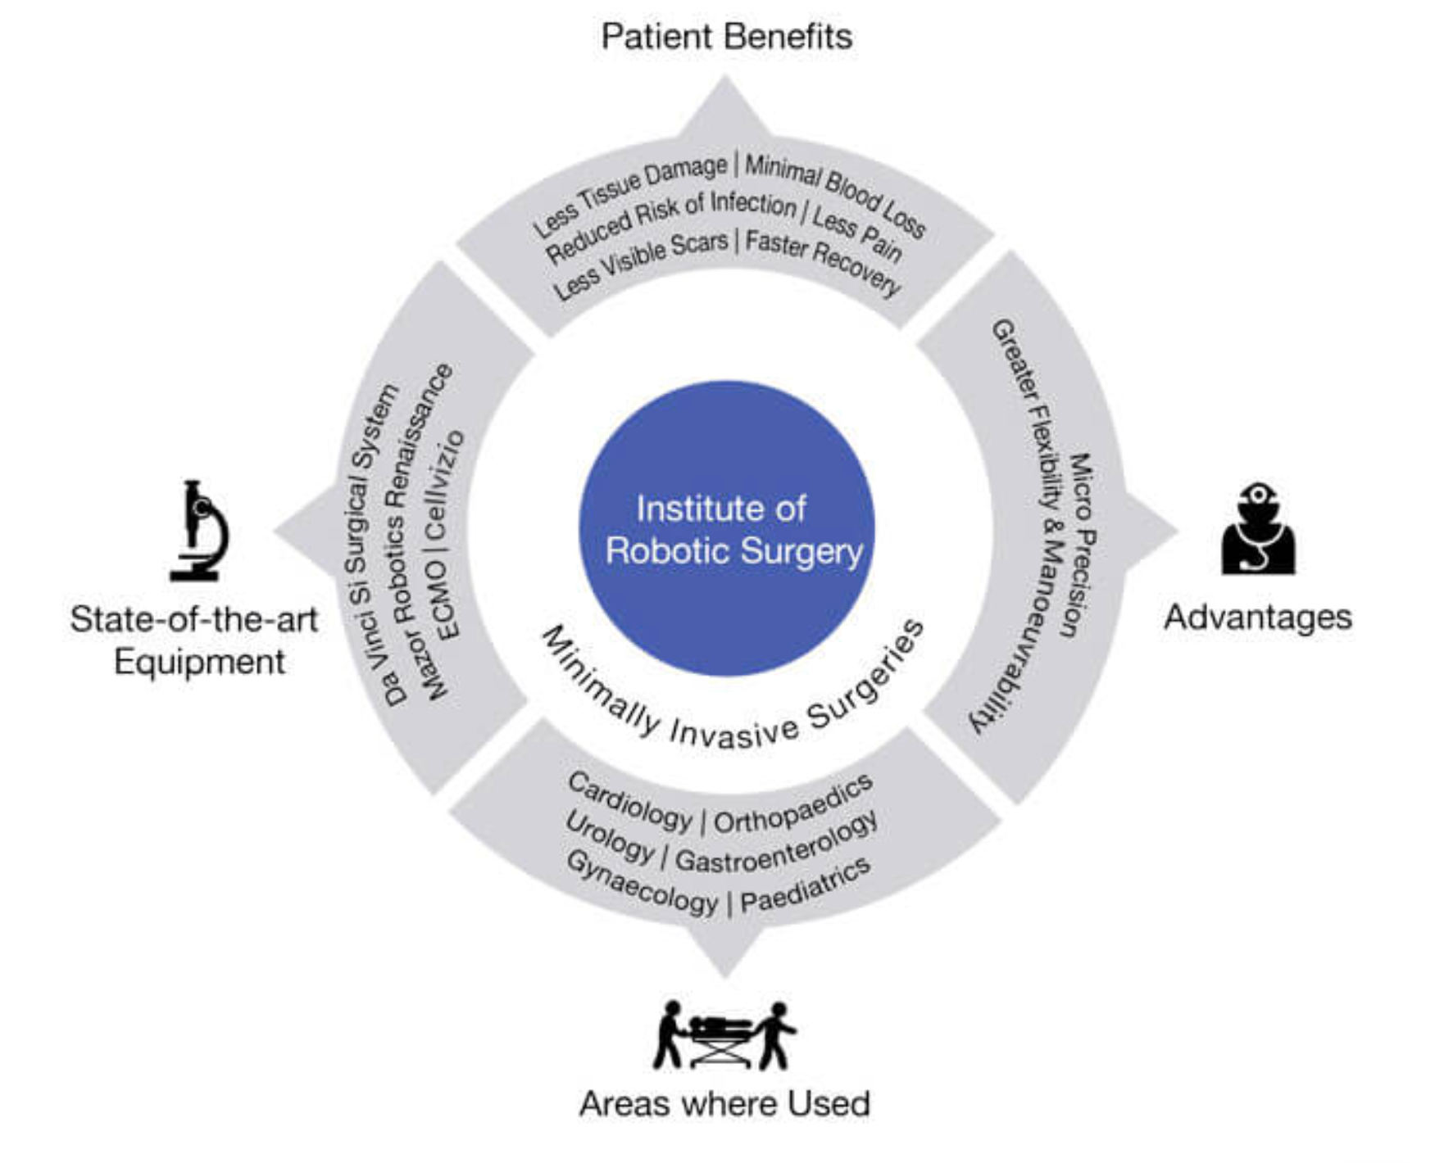
In patient clinical procedures will change - Robotic surgery
N&W CCPL PROGRAMME
Routine use of robotic surgery may guarantee better outcomes and, in time, reduce costs
This is the current robotic surgery offer from Apollo medical systems of India

Slide 14
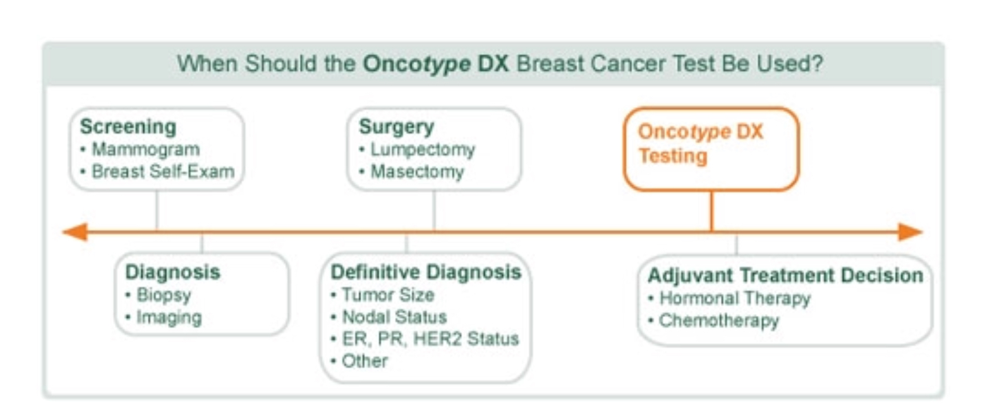
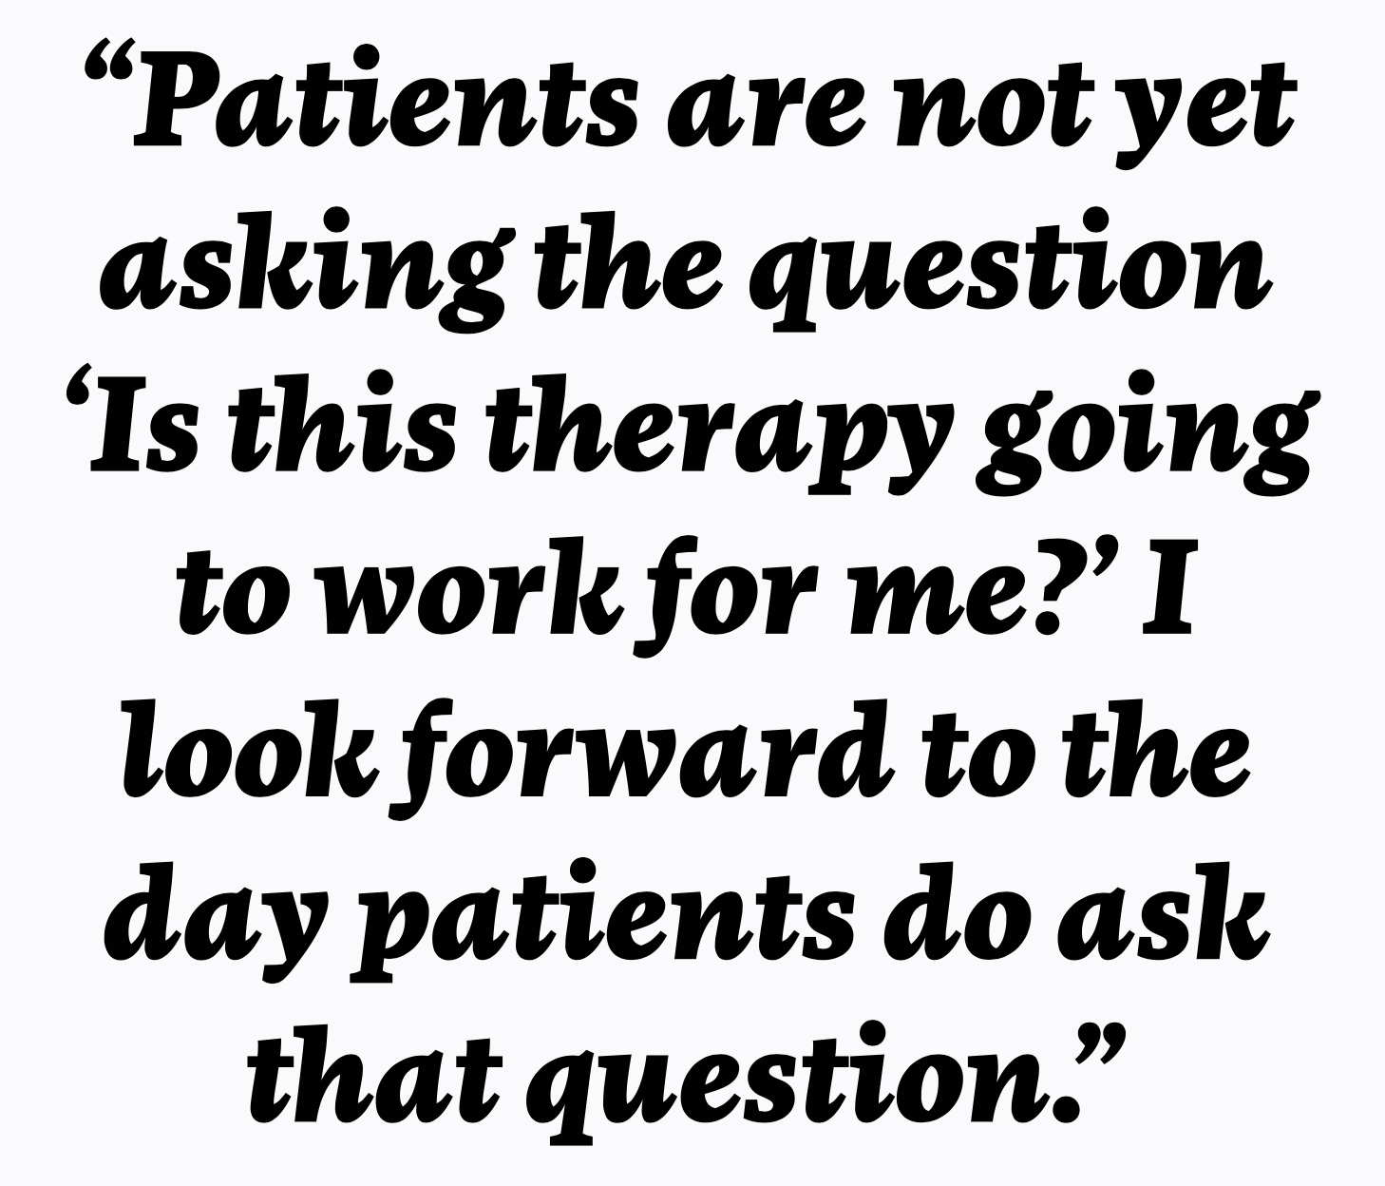

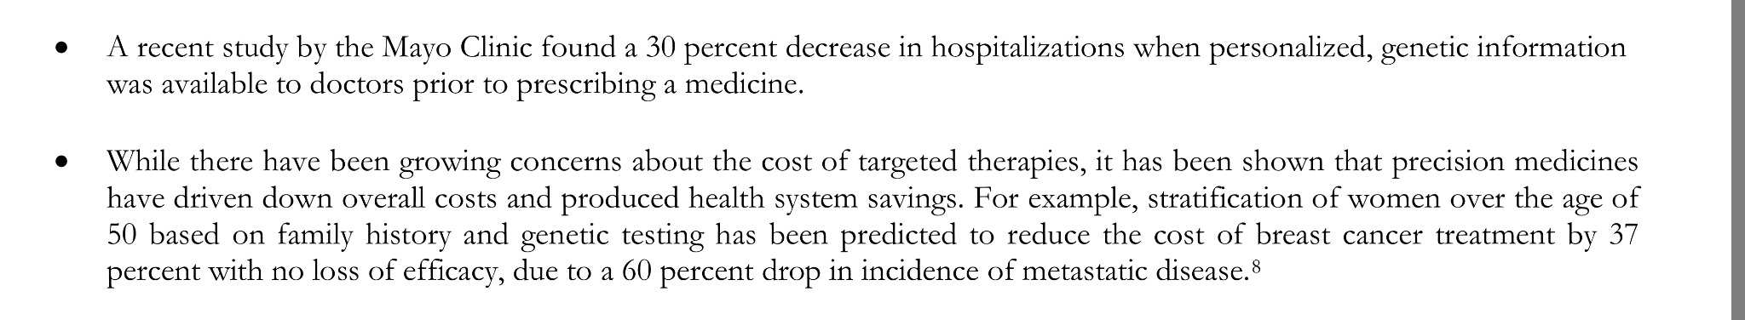
Personalised medicine and genomic science will enable targeting of resources and better use of our services
N&W CCPL PROGRAMME

Slide 15
Challenges of realising these opportunities - what will it take to get ahead of rising demand
N&W CCPL PROGRAMME
Investment (money and people)
Overcoming organisational resistance to change
Educating the workforce (uptake of innovative technology)
Educating the patient (their own health, use of technology, data analysis and behaviour change)
Getting patient consent and support for big data analysis and predictive analytics
Changing the doctor patient relationship
Aligned financial and service regulations and incentives
National and Local actions working in tandem

Slide 16
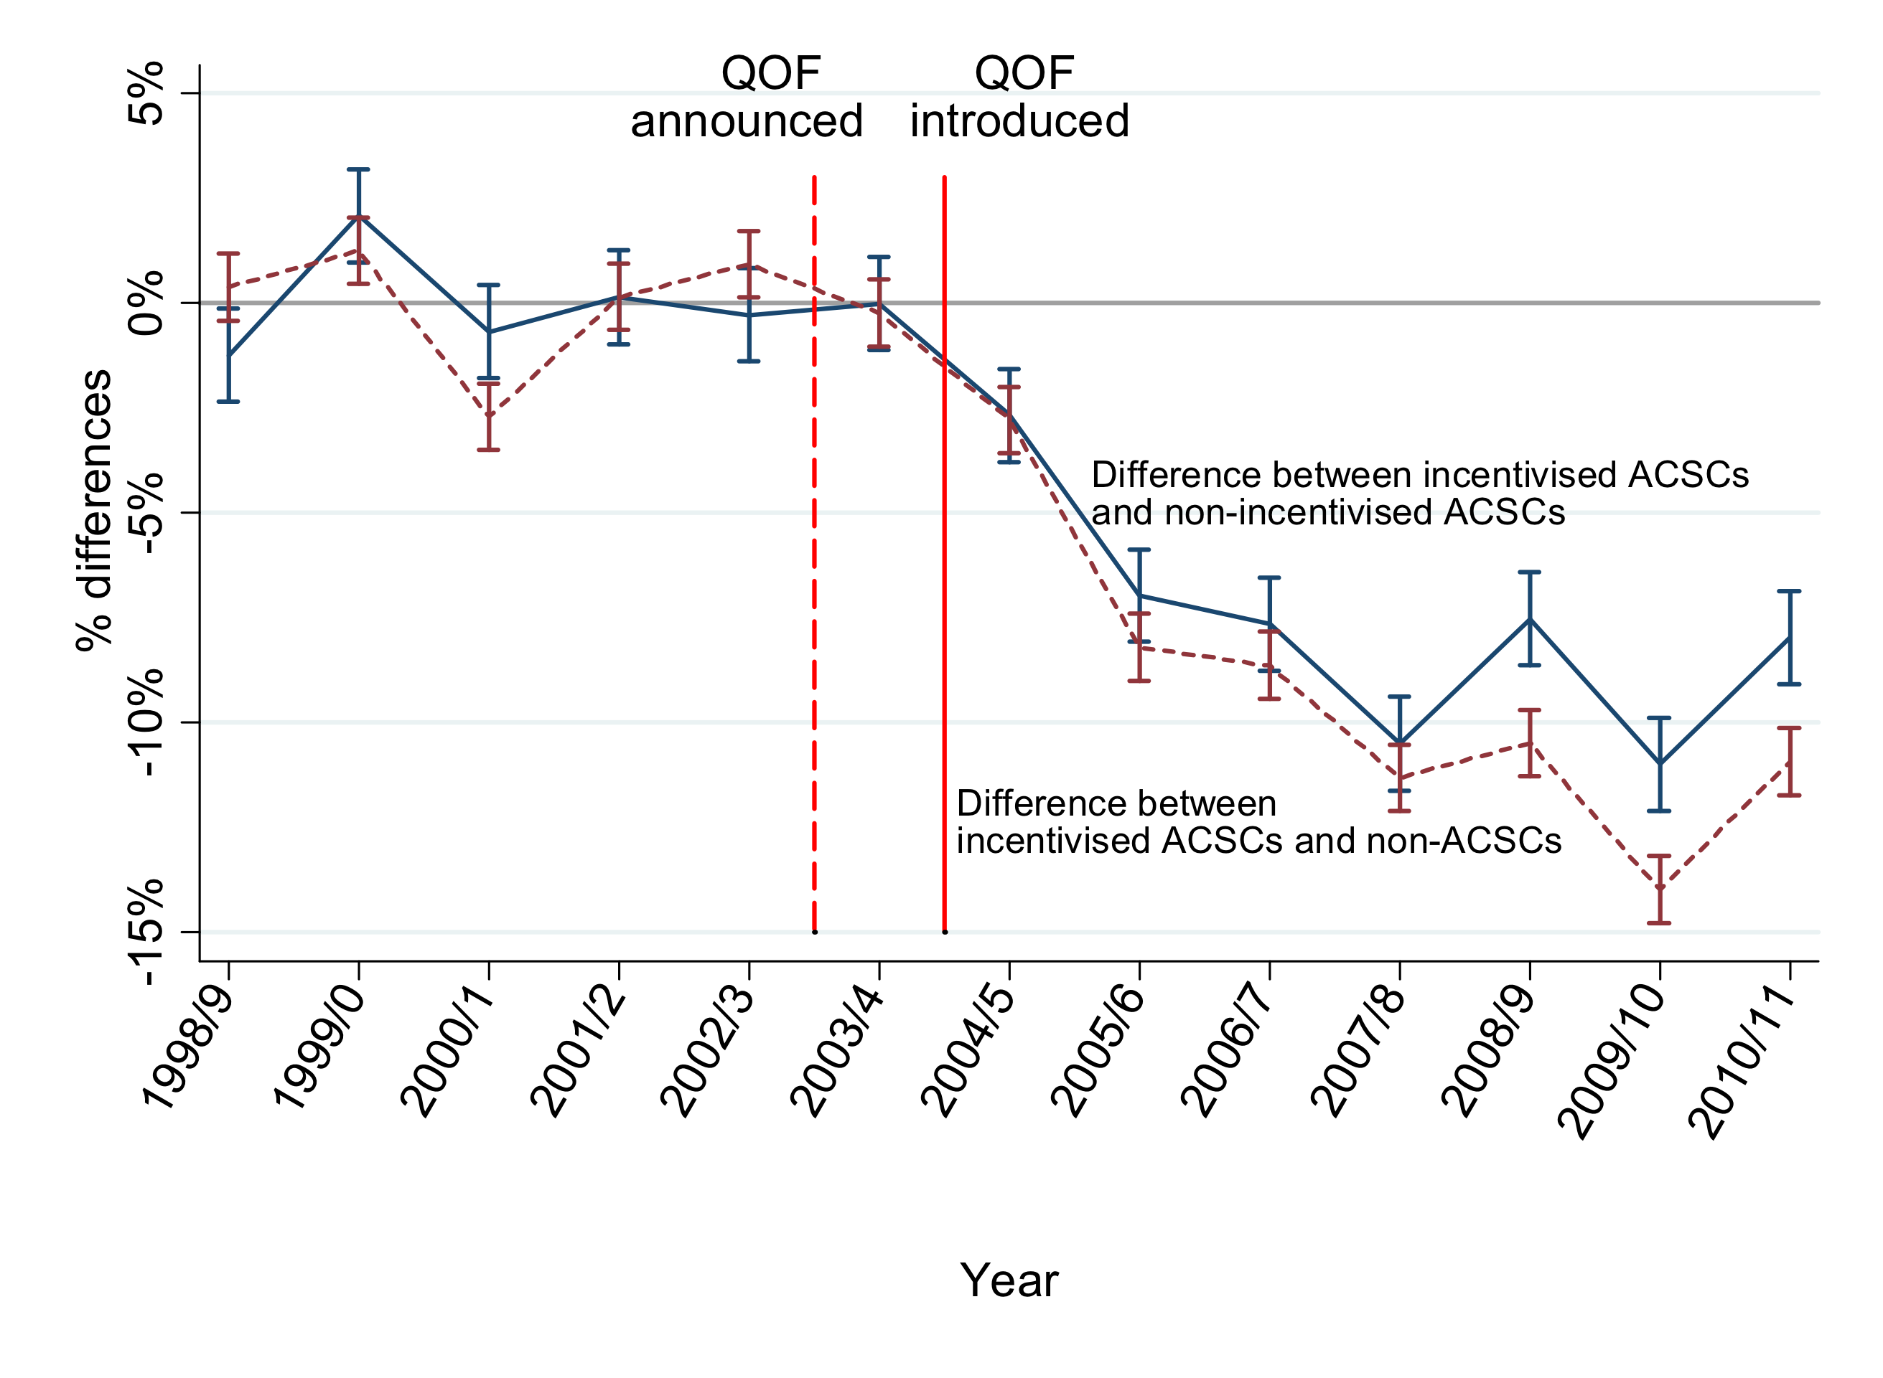
Effect of the QOF on admissions

Slide 17
How are ICBs doing? What are the success criteria and where do they stand currently ?

Slide 18
Integrated Care - Key Functions and programmes
What is the role of EACH TIER in delivering these functions (based on subsidiarity and the ‘value adding’ principle)
maintain or improve physical, social and mental well being
Proactive and preventative care
Community based reablement, Rehabilitative, Palliative and residential care
Integrated urgent care and COVID management
Consistent elective care and NON COVID/COVID recovery
Access to effective specialised care
Citizen/Workforce
Community
Neighbourhood / PCN
Place/Vertical Leadership Groups and Alliances
Horizontal/Provider Collaboratives
Regional
BASED ON AN ANALYSIS OF EVERY NHS ICS STRATEGY (MFCL 2021)
ICBS Have a major architectural Role initially whilst PLACE BASED PARTNERSHIPS and Trusts PLAY A PIVOTAL ROLE IN DELIVERING THESE PROGRAMMES

Slide 19

ICS Development Challenges
8 Critical Success Factors - Leadership and Behaviours
Intrinsically driven - commitment not simply compliance
Compelling leadership narrative and vision that connects the IC reforms to operational priorities (prevention, finance, elective recovery etc) and workforce issues (well being and workload)
Systematic and disciplined approach - narrative, mechanism, mindset, development plan (road map) and simple effective oversight enshrined in an OPERATING MODEL
Fit for purpose - recognising geography, history and culture
Clinical and care professional empowerment, engagement and culture
Shared data and intelligence systems available to all parties
Safe space to raise issues and genuinely co-design the new arrangements
All members are and feel an integral and equal part of the ICS but recognise different contributions and assets
Needs resource and capacity to deliver programmes

Slide 20

ICS Development Challenges
Typical issues that emerging ‘ICBs’ are wrestling with
Jigsaw pieces without a picture on the box - defining the whole operating model - where do the ICS, ICB, PCNs PCs and neighbourhoods fit together
Relationship between Places and Collaboratives (vertical and horizontal)
A blend of allocative efficiency and technical efficiency required and is key to the relationship with LAs
ICB and ICP relationships and roles + legal delegation and financial flow
Sovereignty and shared decision making for statutory organisations - eg role of Committees in Common
Form and function - governance triumphs over mission
Issues of CCG redeployment and culture at ICS - CCG 2.0 v Provider owned and integral
ICS becoming a system management organisation rather than a vehicle for system transformation - impacts on role of PC
Wider geographic complexities
The Risk of Misalignment of Mission, Purpose and Outcomes

