Slide 1
Integrating Health and Care in Norfolk and Waveney ICS
The importance of developing an effective ICS with a clinically and care professionally driven culture - why you are critical to its success
Mike Farrar CBE, FRCGP, FRCP

Slide 2
WITHIN THE OVERALL OBJECTIVES OF THE CCPL PROGRAMME,
THE FOCUS OF THIS ELEMENT IS TO -
ensure that the N&W ICS has an impactful, influential and capable cohort of clinical leaders developing a clinically and care professionally driven culture, Thereby -
ensuring that we create an operating model that inspires clinical and professional staff to engage in the leadership positions aimed at enabling the redesign of patient care and population health management
ensuring that the wider leadership of the N&W ICS understand, value and embrace the role of clinical and professional leadership in the delivery of the ICSs mission and goals, seeing its value conducted through effective clinical leaders
to create routes by which primary and secondary care clinicians and professionals can access support as they take up and fulfil key roles in the new ICS governance structure at neighbourhood, place and ICS level

Slide 3

Clinically and professionally empowered culture
What do we mean?
Clinicians and professionals are listened to, are influential and impactful
Clinical and professional evidence and viewpoint is central to the ICS strategy and decision making
Management process is servant to clinical direction (not the other way round)
Exists in the DNA of the ICS - fundamental mindset for all it does
Consistently supports targeted action to deliver patient outcomes

Slide 4

Why Change is Needed
Recognition that demand outstrips supply (money and workforce)
Exacerbated by COVID-19
Need to develop population health management underpinned by better data and intelligence
Clinicians working ‘despite the system’ rather than ‘as a result of the system’
Major workforce shortages must drive innovation and change to clinical management of patients and engagement of the public
End of commissioning and contracting as we have known it
Services orientated at N&W system/ICS, LA/place and neighbourhood and PCN level
Providers working together with finite population based budgets
Provider collaborations including PCNs
Financial and quality incentives being realigned
What Structural Changes are now emerging

Slide 5
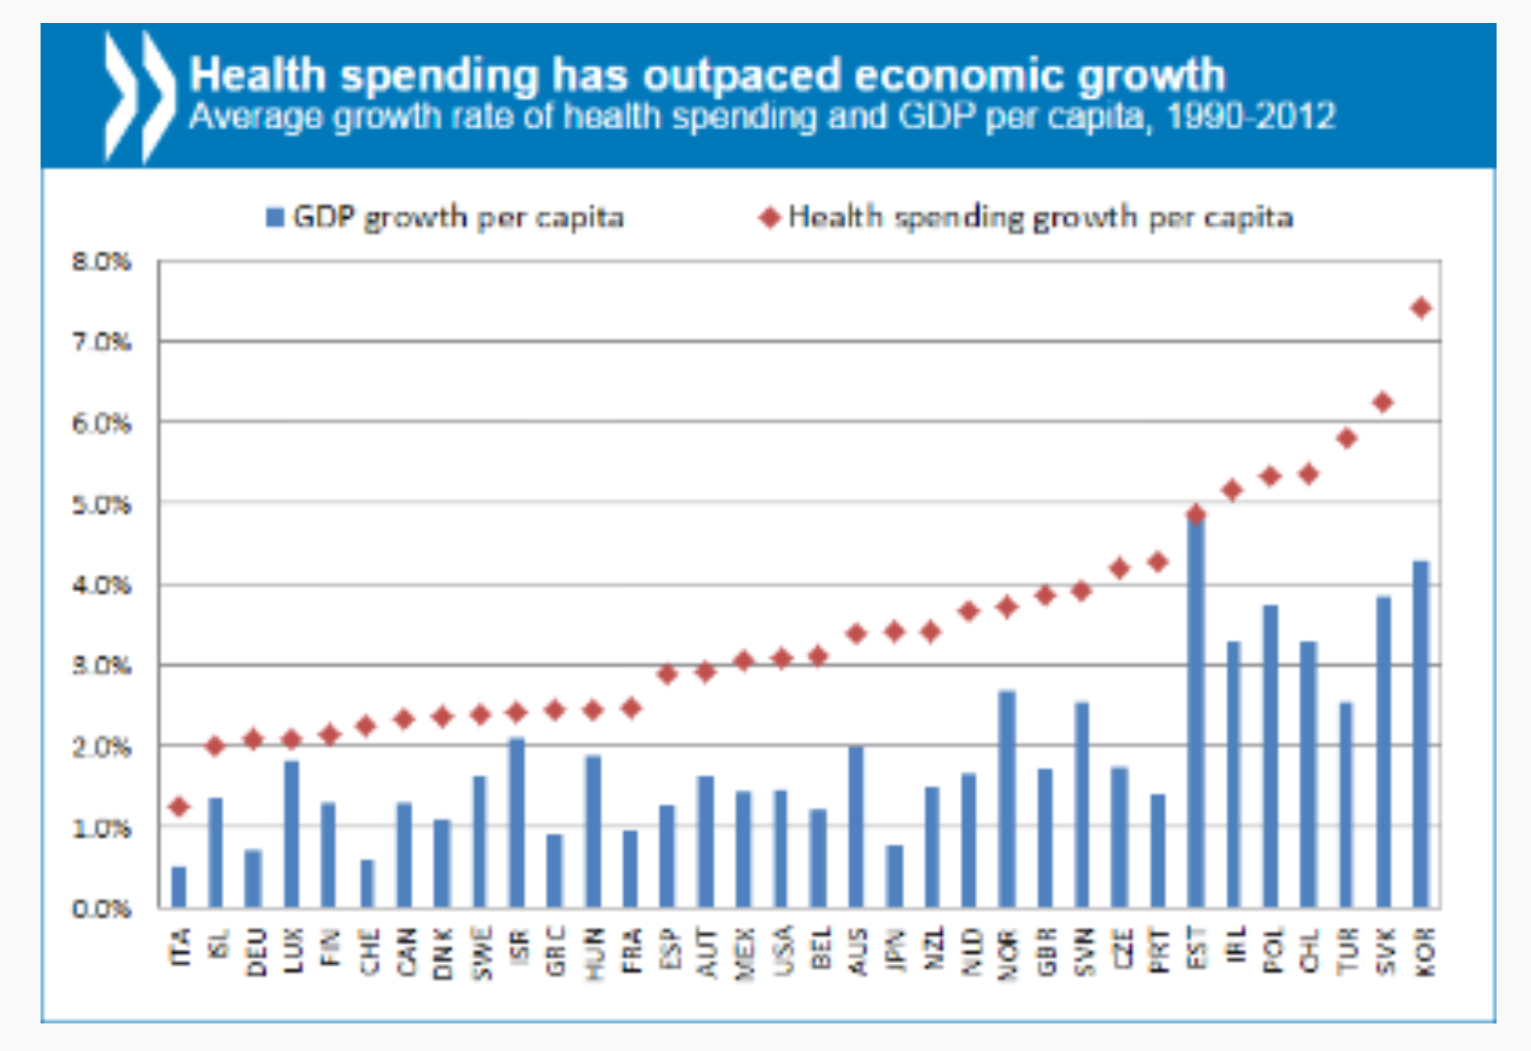
Most countries can not afford to spend exponential amounts on healthcare - health care demand is exceeding the ability of economies to meet the costs
SUSSEX ICS Development session - SEPTEMBER 2021

Slide 6
NHS Budget Projection
4.3% cost pressure
3.4% LTP
Bend the curve
4.5%
1.5%
8.6%
Closing the gap requires that the NHS gets 25-30p added value for every pound it spends ..
2000
2010
2022

Slide 7
Eight Effective Strategies For Addressing Current Challenges
1
Prevention and developing a citizen centred ‘asset based’ approach
2
Investment in primary care
3
Whole systems
approach
4
Managing unwarranted clinical variation
5
Using lean management techniques
6
Adopting new digital technologies - PHM, citizen health, telehealth services
7
Adopting new clinical procedures and pharmacological interventions
8
Creating new partnerships and governance approaches (seeking scale)
Notes:
Mike Farrar

Slide 8
Integrated Care - Key Functions and programmes
WhatEVER LEVEL ACTIVITY IS NEEDED TO DELIVER THESE PROGRAMMES CCPL ENGAGEMENT AND EMPOWERMENT IS MISSION CRITICAL
maintain or improve physical, social and mental well being
Proactive and preventative care
Community based reablement, Rehabilitative, Palliative and residential care
Integrated urgent care and COVID management
Consistent elective care and NON COVID/COVID recovery
Access to effective specialised care
Citizen
Community
Neighbourhood / PCN
Place / Vertical Collaboration
N&W/ Horizontal Provider Collaboration
Regional

Slide 9

Key Messages and Lessons Learnt from Elsewhere - Successful Integration and Population Health Relies on Clinical Engagement and Empowerment
Role of General Practice and Primary Care
Population health management
Use of GP data -Primary care at scale
Seattle - primary care home
Midlands Health Network-NZ
Clinical Engagement
This only makes sense if clinicians use the structural changes to redesign care
Canterbury - pathway redesigns
Alzira - community delivered cardiology
Boston Partners Network
Terms of Engagement
Downside protection - upside benefit
Funded time
Equal partners
Rochdale - Manifesto
Manchester - GP Forum and Representstion
Working with Residents & LAs
Citizen deals
Shared Care
Prevention and social prescribing
Wigan deal
Catalonia - social care
Texas Double Jump
O/D
Leadership perspective
Representation

Slide 10
Challenges
Why this is not straightforward
Workforce shortage and tiredness
Perverse financial and clinical incentives
Polemic problem of prevention v cure (allocative v technical efficiency)
Posts v culture
Clinical attitude
Terms of engagement

Slide 11

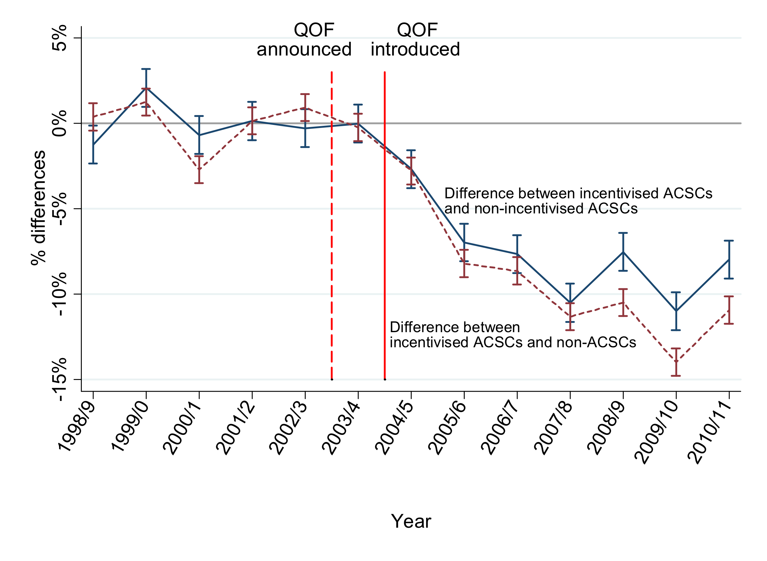
Effect of the Primary Care Quality and Outcomes and Hospitalisation and admissions
This chart shows the impact of introducing quality incentives for primary care clinicians to manage chronic conditions, thereby reducing hospital admissions. But GPs didn’t receive major benefit of this, but they can now under ICP option
NHS UK data
ACSC - Ambulatory Sensitive Conditions
QOF - Quality and Outcome Framework

Slide 12
The Norfolk and Waveney CCP story so far
Workshop for 103 clinical and care professionals held November 2021 led by Mark Lim and workforce team
Draft Framework developed using outputs of these meetings by interim DoN, submitted to NHSEI June 2022
MD and DoN for ICB in post for 1 July 2022, MD appointed SRO for CCP leadership
Framework revised by MD in light of national feedback, best practise from other systems, and meeting with buddy ICS: Mid and South Essex July 2022
Draft framework and manifesto shared and adapted through extensive engagement: 3 open CCPL Q+A sessions led by MD (~45 attendees from primary care, acute, community and MH trusts, social care, NCC, public health and VCSE sector), meetings with CCTG membership, PCN CDs, presentation to our provider collaborative July and August 2022
Workshop to formally launch CCPL programme and refine plans 8 September with programme director to lead implementation joining 27 September
Series of masterclasses on specific areas launches 27 September 2022

Slide 13
November 21 Workshop outputs
Clinical and Care Professionals Engagement
The initial workshop was held on 9th November 2021 and was attended by 103 participants from across the health, care and voluntary sector.
Active engagement of grassroots clinicians felt to be important.
Some participants felt the language could be alienating e.g., clinician is used in some areas, practitioners in others.
Fully inclusive – ensuring diversity seen as important.
Some participants felt there was a risk it could be dominated by ‘health’.
Important to link with education and HEIs.
Welcome the opportunity to work together & collaborate.
NHS Futures Space.
Blended roles

Slide 14
Our CCP Manifesto
The Norfolk & Waveney CCP framework vision is to put CCP leadership at the heart of our discussions at every level of our system so that it becomes integral to our culture and how we work together.
1 The ICB tangibly commits to a clinical and care professional empowerment culture (as defined by the two national expectations and 5 core principles).
2 The ICB will identify resources to support this CCP framework and undertake a baseline survey and then periodic surveys over time to measure the initial and subsequent achievement of these principles.
3 The ICB will review its decision-making structures to ensure that there is clear accountability of where, how and by whom decisions are made. We will also build CCP leadership / representation into every decision making body including at neighbourhood and place.
4 The ICB will establish a formal CCP Assembly (CCPA). This will be recruited through open competition and reflect the diversity of our CCP community (including by profession, band and organization). The assembly will review and advise on all ICB decisions affecting care, becoming a diverse sounding board for the ICB to sense check its ideas and decisions with. This will provide a coherent and effective CCP voice in shaping ICS strategy and resourcing. This will include experts by experience and research/academic representation and support the MD & ND. This will replace the previous CCTG
5 The ICB will also establish a much smaller Clinical and Care Professional Council. It will lead the coproduction of the CCP framework and strategy, support the ongoing programme of training and OD for CCPs and subsequently, act as guardian of the empowerment culture we wish to create, and underpin the work and responsibilities of the ICB MD and ND.

Slide 15
Our CCP Manifesto
The Norfolk & Waveney CCP framework vision is to put CCP leadership at the heart of our discussions at every level of our system so that it becomes integral to our culture and how we work together.
6 - The ICB will also continue to have specialist clinical advisory roles to lead on specific areas such as cancer and diabetes, but these will be recruited in line with this framework reflecting the national principals.
7 - The ICB will invest in short, medium and long term O/D and education to secure the commitment of all CCPs. This will start with a series of masterclasses from September 22. Further work will be overseen by the ICB CCP Council, to develop a pipeline of appropriately trained future system leaders who understand the system and what we are trying to achieve and how.
8 -- The ICB Quality Management team will develop a rolling series of open educational events, to empower all CCPs to use a common QI approach. The ICB evaluation hub will support CCPs to develop appropriate evaluations before trying new things, and the QM and PMO team will provide practical support with those evaluations - to supercharge innovation to improve our services.
9 -The ICB and the CCP Council will work with primary care and practice leadership professionals to keep extending the reach of our CCP community (including AHPs, Pharmacists, Dental and Ophthalmic practitioners, social workers, carers, behaviour specialists and sensory experts), and to regularly review this framework to ensure it remains inclusive and fit for purpose.
10 - The ICB commit to using a clinical prioritisation process for resource allocation that fully involves CCPs, patients and the population, and allows the ICS to maximise health outcomes and reduce health inequalities within our available resources.

Slide 16
Our commitments
Two take home points:
We want to support our people.
We want to build, broaden and strengthen our current CCP leadership community through this series of events, to bring them together, to ensure a common understanding of our system and aims.
We plan to build a permissive culture of Quality Improvement, sharing learning, collaboration and innovation for CCPs to work together in. We want to support them to use a common language, common data, and a common QI methodology, to support them to innovate and continuously measure and improve the services we provide, by providing training and practical support in QI
We also want to build a rolling leadership development programme so we have a pipeline of trained leaders for the future.
We want to put clinical and care professional leadership at the heart of our ICS
by building CCPL roles into every formal decision making body and at every level of the ICS including Place
We want to capture the voices of our wider CCP workforce by building a CCP assembly

Slide 17
Continuous Improvement
6-12m progress review of vision and framework. Do CCPs have a voice in N&W ICS? Are CCPs supported to innovate, learn and share
Pipeline of trained future leaders supported by workforce team, meaningful CCP roles in decision making structures
CCPC leads and develops CCPL training, engagement and delivery of framework
Diverse CCP ideas captured and supported, standard QM approach available, defined clinical prioritization of innovations for QF and PMO support
Diverse Clinical and Care Assembly – scrutinising and influencing ICB decision-making

