Slide 1
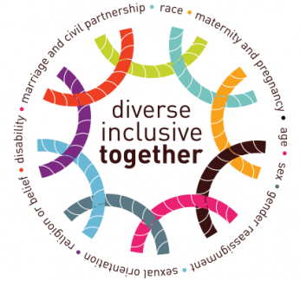
Equality, Diversity and Inclusion
Virtual Mandatory Training
Notes:
These terms, Equality, Diversity and Inclusion could mean different things to different people. I am curious to know, before we start, what these terms mean to you? Using the chat function, type in a brief definition or meaning for each word.

Slide 2

What is Equality?
Equality is about ensuring that every individual has an equal opportunity to make the most of their life and talents irrespective of their protected characteristics
Notes:
Equality is about creating a fairer society where everyone can participate and has the same opportunity to fulfil their potential
Based in law. Equality is about ensuring that every individual has an equal opportunity to make the most of their life and talents irrespective of age, sex, race, disability, religion/belief, sexual orientation, gender reassignment, maternity/pregnancy and marriage/civil partnerships. It is also the belief that no one should have poorer life chances because of the way they were born, where they come from, what they believe, or whether they have a disability. Equality recognises that historically certain groups of people with protected characteristics, such as age, disability, gender reassignment, sex, sexual orientation, race or due to the fact they have chosen to have children, have experienced discrimination.

Slide 3

What is Diversity?
Everyone is different. Everyone has individual qualities and differences. Each individual should be valued for their skills experience and talent and be treated with dignity and respect.
Notes:
Everyone is different. Everyone has individual qualities and differences. Each individual should be valued for their skills experience and talent and be treated with dignity and respect. It is acknowledging the benefit of having a range of perspectives in decision-making, widening participation and making a workforce representative of the organisation’s service users.

Slide 4
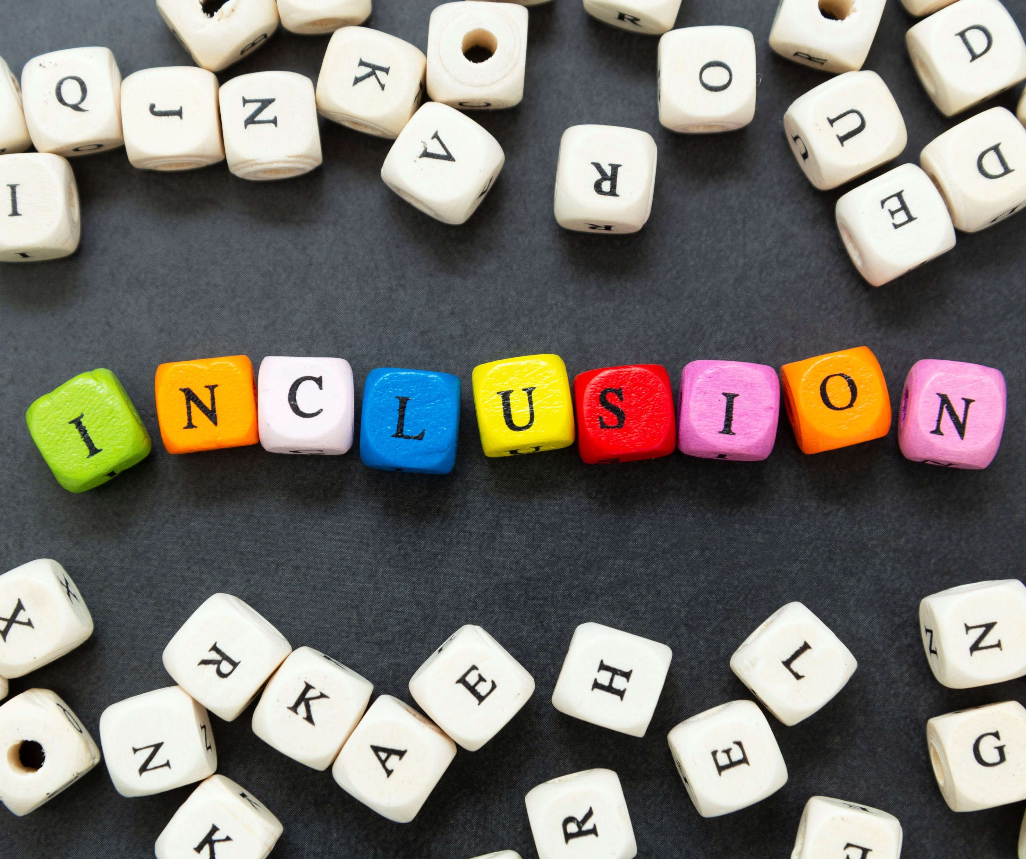
What is Inclusion?
Inclusion is where different is seen as a benefit to utilise; and where perspectives and differences are shared, leading to better decisions.
An inclusive workplace enables a diverse range of people to work together effectively.
Notes:
Inclusion is where different is seen as a benefit to utilise; and where perspectives and differences are shared, leading to better decisions. An inclusive working environment is one in which everyone feels valued, that their contribution matters, and they are able to perform to their full potential, no matter their background, identity or circumstances. An inclusive workplace enables a diverse range of people to work together effectively.

Slide 5
What Characteristics are Protected?
Sexual Orientation
Age
Race
Religion or Belief
Marriage and Civil Partnership
Pregnancy and Maternity/Paternity
Sex
Disability
Gender Reassignment
Notes:
What are Protected Characteristics? – List them in the chat
Link: Which of these characteristics do you feel you are included in – how it affects us all
Diversity is made up of all these and more – intersectionality, not just one thing
Age
Means a person belonging to a particular age group.
Disability
A person is deemed to have a disability if they have a physical or mental impairment, and the impairment has a substantial and long-term adverse effect on the person’s ability to carry out normal day-to-day activities.
Someone who may have had an impairment or condition such as cancer is also covered by this legal definition of disability.
Gender Reassignment
The Equality Act defined gender reassignment as:
Where a person has proposed, started or completed a process to change his or her sex.
Marriage and Civil Partnership
People who are married or in a civil partnership have this protected characteristic
Pregnancy and Maternity
Maternity refers to the period after the birth. Maternity discrimination is linked to maternity leave in employment.
In the non-work context, protection against maternity discrimination is for 26 weeks after giving birth, and includes treating a woman unfavourably because she is breastfeeding.
Race
People who have or share characteristics of colour, nationality or ethnic or national origin can be described as belonging to a particular racial group.
“Race” is usually associated with biology and linked with physical characteristics such as skin color or hair texture. “Ethnicity” is linked with cultural expression and identification.
Religion or Belief
People who have a religion or religious or philosophical belief, or a lack of religion or belief, share this protected characteristic.
Sex
Being a man or a woman. However, it should be noted that, although not acknowledged in the Equality Act, some people may recognise themselves as non-binary or intersex.
Intersex people are individuals whose anatomy or physiology are different from the typical definitions of male and female
Those with non-binary genders do not see themselves as exclusively male or female
Sexual Orientation
A person’s sexual orientation may be towards:
People of the same sex as him or her (in other words the person is a gay man or a lesbian)
People of both sexes (the person is bisexual)
People of the opposite sex from him or her (the person is heterosexual)

Slide 6
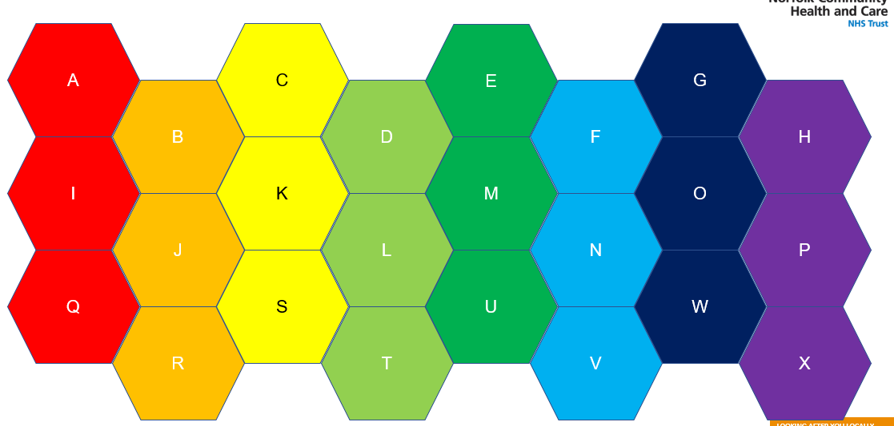

EDI Activity
Start Timer
i
Notes:
On the powerpoint that we will load for you, you will see a grid of letters. Behind each letter is a question.
Start by selecting a ‘red’ question to discuss as a group. Remember: all members of the group can request a ‘pass’ on any question without needing to explain why.
There is a timer on each question page which will slowly turn red as time passes. Press ‘start timer’ when you begin discussing and aim to move onto another topic once it finishes. Make a note of the letters of the questions you completed. The aim is to answer a question in each colour category however as the main purpose is the fruitful conversations that are stimulated, feel free to take your time and answer those that are most meaningful to your group.
On each question page there is an information button ‘i’. This button can be clicked without affecting the time and will provide further discussion points.
You are also welcome to use the internet, to look up definitions or research further into the conversation to provide alternative views. We recommend our Trust Equality, Diversity and Inclusion page as a good place to start.
Please do not share your screen as part of this session as you will lose this presentation and will need a facilitator to reload it. If you have a link you wish to share then use the chat function to share it instead.
When you have exhausted this topic or your timer runs out and you are ready to move on, click the ‘MENU’ button to return to the grid and choose another question.

Slide 7

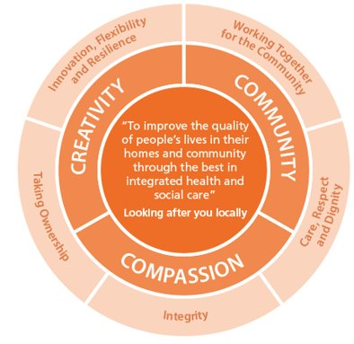
Remember:
Be curious
Be open minded
Be inclusive
Think broadly
Feel free to share personal experiences, equally feel free not to
Free ‘pass’ for all on any question no explanation required
LOOKING AFTER YOU LOCALLY
Notes:
Explain we will pop in and out do feel free to invite us into the conversation as you require
Don’t let us stop your train of thought/ disrupt conversation, supports us to create best training possible.
Like us wandering around a classroom
Also welcome to call us in to invite into the conversation

Slide 8

What is your key takeaway from this session?
Notes:
The aim of this session is to stimulate thinking and begin or contribute to the journey of discovery of seeing the world through the lens of others.
There are links on the training resource page on the loop to videos which can help deepen your discovery. Other things you can do is to read biographies of people with different life experiences to yours, listen to others, continue to be curious and look to create an inclusive environment wherever you can, rather than expecting others to assimulate.
What was your key takeaway from the session?

