Slide 1
Pregnant Individuals Vaccine Uptake in Norfolk
28/09/2021

Slide 2

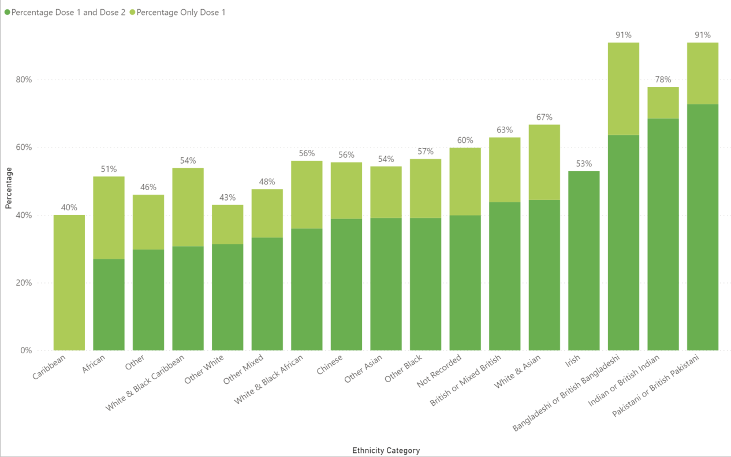
Uptake by Ethnicity:

Slide 3
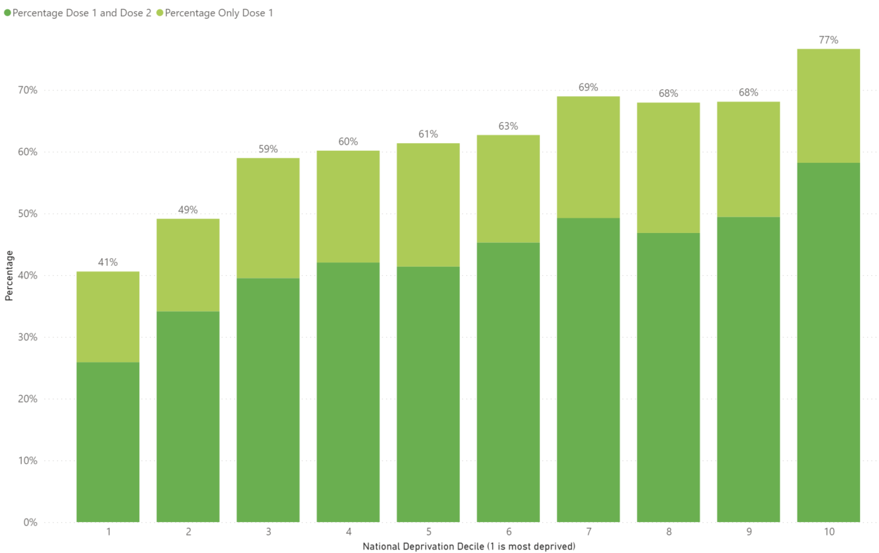
Uptake by Deprivation Decile:

Slide 4
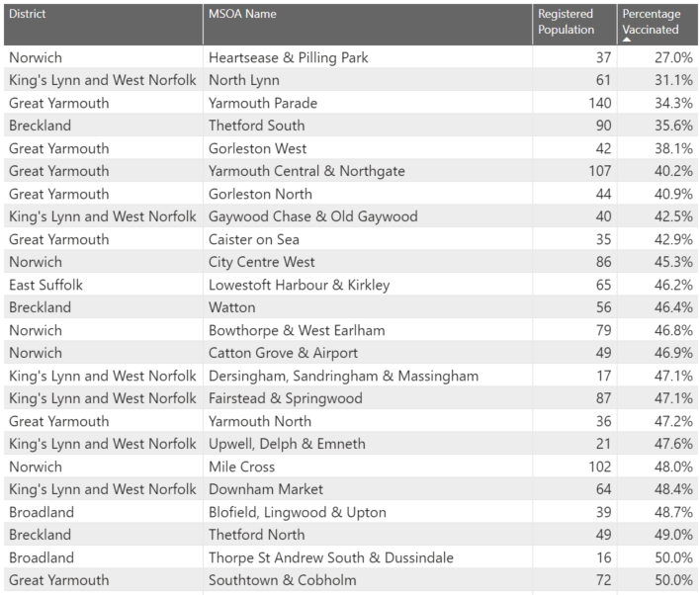
Uptake by MSOA:

