Slide 1
A MVP resource allocation method for localities across Norfolk and Waveney
29/03/2021
Contact: tim.winters@norfolk.gov.uk

Slide 2



In order to understand a locality and enable comparison it is helpful to use a standard building block. Some considerations when selecting a building block include
Something small enough to represent a community within a locality?
Something that is stable so boundaries do not change very often?
Something for which data is readily available and is less likely to be disclosive?
Something for which reliable estimates of eligible population are available so that need can be quantified?
Something that is coterminous with other geographies (districts, PCNs, market towns) which makes aggregation easier and less confusing and allows for easier conversations with partners across the system?

Slide 3
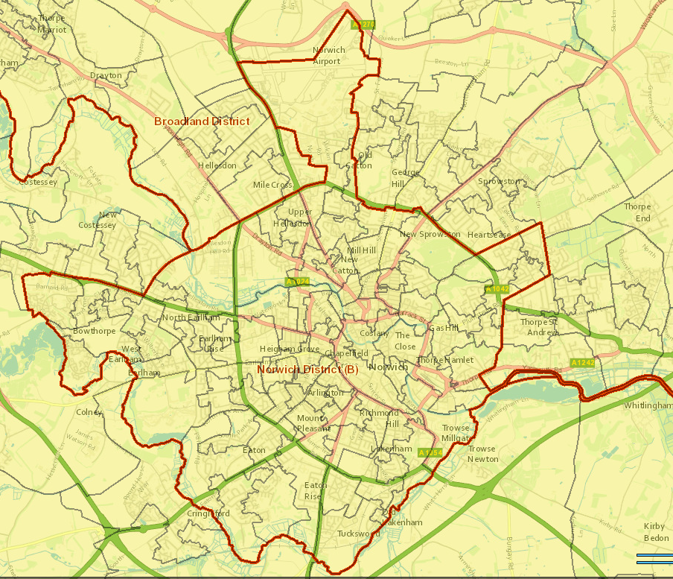
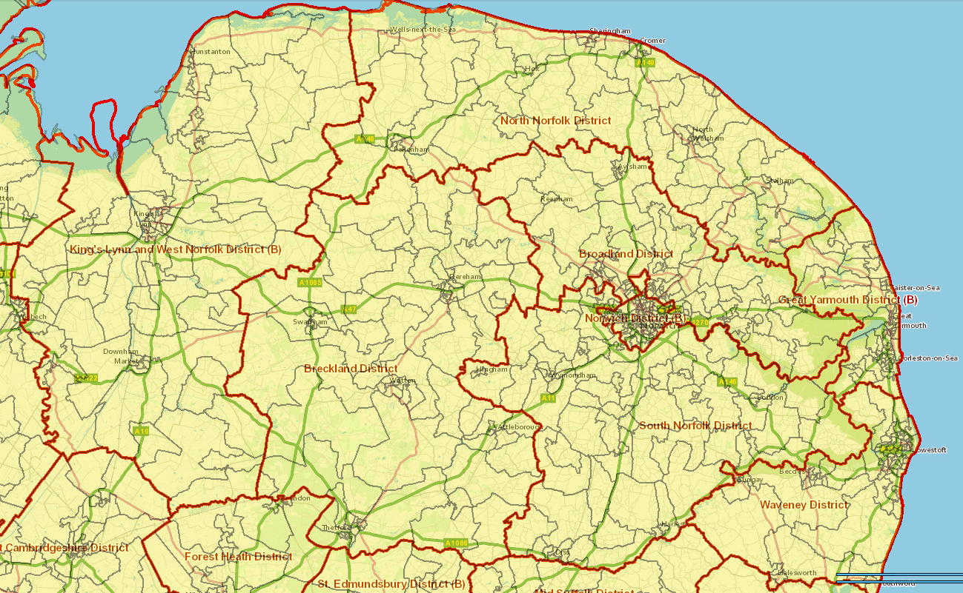
Locality building blocks that reflect a community within a locality are readily available in the form of LSOAs – 538 of them in Norfolk, 611 in Norfolk and Waveney
There is a lot of detailed information at this level already (e.g. Service level data, IMD, hospital data, mortality, LGA data, DWP benefits etc.)
Pseudonymised record level information can be safely shared
Population estimates are available annually. GP practice registered populations are also available by LSOA.
LSOAs are coterminous with district geography, county geography, health geography which makes aggregation (and allocation) easier and less confusing.
The geography is more consistent over time than other administrative geographies.
Allows targeting within a locality
District | LSOAs
Breckland | 78
Broadland | 84
Great Yarmouth | 61
King’s Lynn and West Norfolk | 89
North Norfolk | 62
Norwich | 83
South Norfolk | 81
Waveney | 73
Norfolk and Waveney | 611

Slide 4
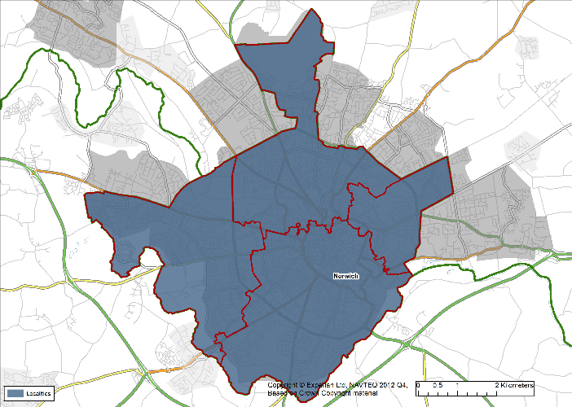
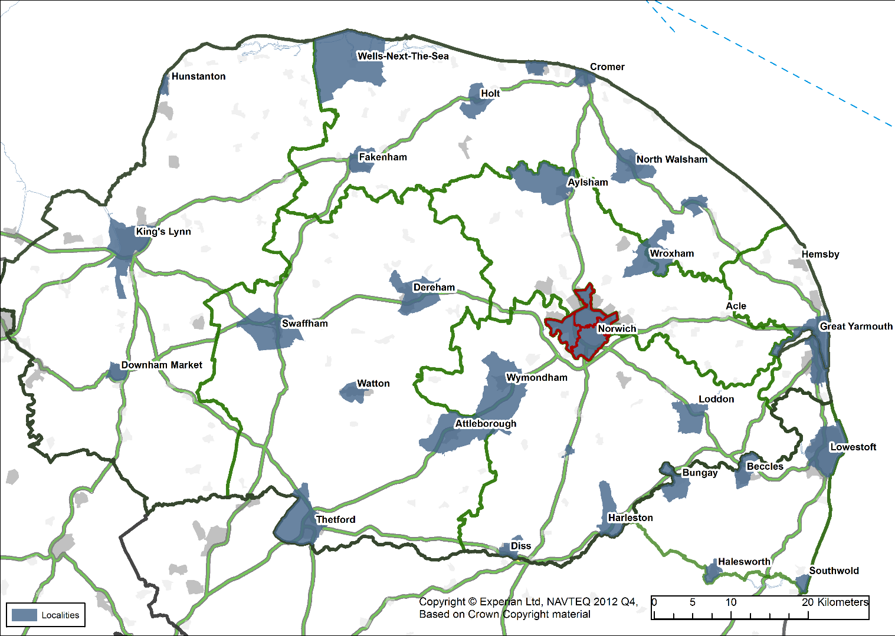
This community building block approach can be applied across Norfolk and Waveney to build localities – for example market town localities
Norwich 1
Locality | Population 2019 | Female Population 15 to 44 2019
Attleborough | 12,448 | 2,087
Aylsham | 7,116 | 1,047
Cromer | 7,738 | 1,002
Dereham | 19,464 | 3,223
Diss | 8,604 | 1,387
Downham Market | 11,005 | 1,635
Fakenham | 7,937 | 1,127
Gorleston | 25,726 | 4,453
Great Yarmouth | 29,158 | 5,404
Holt | 4,189 | 559
Hunstanton | 3,999 | 403
King's Lynn | 41,746 | 8,035
Loddon | 3,005 | 471
Long Stratton | 2,122 | 393
North Walsham | 12,901 | 1,909
Norwich 1 | 36,157 | 8,202
Norwich 2 | 17,504 | 3,443
Norwich 3 | 37,768 | 10,784
Norwich 4 | 49,144 | 11,356
Redenhall with Harleston | 5,226 | 815
Sheringham | 7,365 | 816
Stalham | 3,154 | 498
Swaffham | 8,278 | 1,247
Thetford | 26,837 | 5,169
Watton | 8,248 | 1,233
Wells-next-the-Sea | 2,694 | 348
Wroxham and Hoveton | 4,074 | 447
Wymondham | 17,325 | 2,999
Other Norfolk | 486,828 | 68,855
Beccles | 10,375 | 1,633
Bungay | 5,112 | 781
Halesworth | 4,984 | 612
Lowestoft | 62,798 | 10,096
Southwold | 960 | 69
Other Waveney | 34,204 | 4,800
Norfolk | 907,760 | 149,347
Norfolk and Waveney | 1,026,193 | 167,338
Norwich 2
These can be amended
Outlier areas can be assigned to their nearest locality
Do they look about right?
Norwich 3
Norwich 4
The localities listed make up about 49% of the total Norfolk and Waveney population

Slide 5

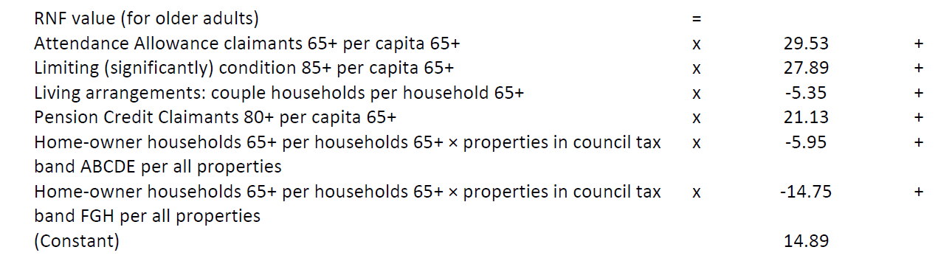
How we can take information about our communities and put together a resource allocation method that is impartial, fair, relatively simple and transparent
High proportion of key workers
Lower % in deprivation
In summary, weighting of an eligible population by indicators of need
Using this method, more resources are directed to areas estimated to have higher needs, or where inequalities can be reduced by providing services – for example those with more children and young people at risk, those with higher levels of deprivation.
More complicated versions are used by
  NHS fair shares resource allocation for NHS funding
  Allocation of Public Health grant
  Adult Social Care Relative Needs Formula - not a weighted capitation estimate but an estimate of the per capita expenditure and per capita need across LSOAs for adults 18 to 64 and also 65+
Weighted capitation can also be used to develop an index for each community to understand need in relation to service use within a locality
This can then be combined with other information to understand how to engage with that community e.g. customer insight, geodemographic data
Higher proportion of older people
Higher density of HMOs
more need for tests
potentially less at risk
potentially more need for support
potentially more hard to reach groups

Slide 6
Indicators can be selected to understand the target populations within communities– more can be added if they are available or some removed if they are not relevant
Resource allocation Indicator | Rationale | Note | Source
Female population 15 to 44 | Initial population of interest | This population gets weighted to understand need in community | ONS mid year LSOA population estimates
IMD 2019 score | Target the more deprived areas | Higher value = more need | MHCLG
General fertility rate (2015-2019) | Higher rate of births potentially indicates more need for services | Higher value = more need | Norfolk Insight (NOMIS)
Low Birth Weight per 1,000 live births (2015-2019) | Higher rate of low birth weight births potentially indicates more need for support maternity services | Birth weight < 2500g, Higher rate = more need | Civil registration dataset (Births)
Infant Mortality per 1,000 live births (2015-2019) | Higher rate of infant mortality might indicate more need for post birth services | Higher value = more need | Civil registration dataset (PCMD)
Percentage deliveries white other (2015-2019) | Higher proportion of births from non british white communities might require more resources | Higher value = more need | HES
Percentage deliveries BAME (2015-2019) | Higher proportion of births from BAME communities might require more resources | Higher value = more need | HES
Population density | Lower density implies more difficult to access support? | Currently lower density = more need | ONS census estimates
Percentage deliveries JPUH | Contextual to show where residents from Norfolk and Waveney communities are likely to give birth. This enables any required targeting from trust to community |  | HES
Percentage deliveries NNUH | As above |  | HES
Percentage deliveries QEH | As above |  | HES
Average deliveries per year (2015-2019) | Understand how many deliveries per year take place in a community | Used as denominator for other indicators | HES
Average deliveries per year to Norfolk and Waveney mothers in Norfolk and Waveney trusts (2015-2019) | Understand how many deliveries per year from a community take place in Norfolk and Waveney trusts | Used as a target population for weighting of resources by trust rather than community | HES

Slide 7
This table represents the selected indicators by locality – in all cases the higher the number the higher relative need.
Locality | Unweighted female population 15 to 14 (2019) | IMD 2019 | General Fertility Rate (2015/19)* | Low Birthweight Rate (2015/19) | Infant Mortality Rate (2015/19) | % Deliveries White Other | % Deliveries BAME | Inverse Population density | Weighted female population 15 to 14 (2019) | % Deliveries JPUH | % Deliveries NNUH | % Deliveries QEH | Average deliveries per year (2015/19) | Unweighted deliveries per year (2015/19) in Norfolk and Waveney trusts | Weighted deliveries per year (2015/19) in Norfolk and Waveney trusts
Attleborough | 2,087 | 13.3 | 65.7 | 56.9 | < 5 | 11.7% | 3.1% | 0.25 | 2,109 | 0% | 99% | 0% | 127 | 126 | 123
Aylsham | 1,047 | 12.6 | 58.2 | 78.4 | < 5 | 4.1% | 1.4% | 0.41 | 976 | 0% | 100% | 0% | 45 | 45 | 42
Cromer | 1,002 | 26.3 | 60.1 | 40.3 | < 5 | 8.0% | 3.3% | 0.06 | 949 | 0% | 99% | 0% | 61 | 60 | 56
Dereham | 3,223 | 19.8 | 59.8 | 76.0 | 6.1 | 7.1% | 2.5% | 0.11 | 3,238 | 0% | 99% | 1% | 194 | 193 | 193
Diss | 1,387 | 18.0 | 69.0 | 82.1 | < 5 | 16.6% | 5.9% | 0.06 | 1,657 | 0% | 88% | 0% | 96 | 85 | 98
Downham Market | 1,635 | 19.6 | 66.3 | 57.2 | < 5 | 13.8% | 3.2% | 0.05 | 1,652 | 0% | 2% | 93% | 96 | 91 | 90
Fakenham | 1,127 | 18.8 | 62.9 | 77.1 | < 5 | 9.7% | 3.3% | 0.11 | 1,220 | 0% | 62% | 38% | 75 | 74 | 79
Gorleston | 4,453 | 34.3 | 65.9 | 77.5 | 5.4 | 2.1% | 2.6% | 0.02 | 4,253 | 99% | 1% | 0% | 294 | 293 | 257
Great Yarmouth | 5,404 | 54.1 | 77.4 | 91.9 | 2.8 | 12.0% | 7.5% | 0.05 | 6,834 | 98% | 1% | 0% | 417 | 415 | 504
Holt | 559 | 16.8 | 46.3 | 39.7 | < 5 | 4.1% | 3.3% | 0.29 | 496 | 1% | 97% | 2% | 25 | 25 | 24
Hunstanton | 403 | 30.9 | 52.1 | 83.3 | < 5 | 7.7% | 4.8% | 0.05 | 426 | 0% | 0% | 100% | 21 | 21 | 24
King's Lynn | 8,035 | 30.7 | 69.0 | 83.2 | 6.0 | 24.3% | 5.0% | 0.07 | 9,597 | 0% | 0% | 99% | 554 | 549 | 643
Loddon | 471 | 14.1 | 55.8 | 55.1 | < 5 | 7.4% | 0.8% | 0.46 | 422 | 8% | 91% | 0% | 26 | 26 | 23
Long Stratton | 393 | 9.4 | 52.9 | 56.6 | < 5 | 6.4% | 6.4% | 0.07 | 360 | 0% | 99% | 0% | 22 | 22 | 21
North Walsham | 1,909 | 19.8 | 54.4 | 76.5 | < 5 | 3.5% | 2.1% | 0.13 | 1,722 | 2% | 98% | 0% | 104 | 104 | 95
Norwich 1 | 8,202 | 33.5 | 64.3 | 63.8 | 3.3 | 18.6% | 9.3% | 0.03 | 9,370 | 0% | 99% | 0% | 529 | 527 | 601
Norwich 2 | 3,443 | 33.1 | 62.7 | 73.7 | < 5 | 12.9% | 8.0% | 0.02 | 3,828 | 0% | 99% | 0% | 215 | 215 | 239
Norwich 3 | 10,784 | 27.7 | 34.8 | 70.2 | < 5 | 13.0% | 12.7% | 0.03 | 10,727 | 0% | 99% | 0% | 369 | 368 | 419
Norwich 4 | 11,356 | 21.1 | 43.5 | 74.0 | 2.4 | 15.2% | 13.8% | 0.03 | 11,413 | 1% | 99% | 0% | 474 | 472 | 517
Redenhall with Harleston | 815 | 14.2 | 68.1 | 67.4 | < 5 | 5.2% | 1.9% | 0.26 | 769 | 2% | 93% | 0% | 56 | 53 | 46
Sheringham | 816 | 15.0 | 45.0 | 41.9 | < 5 | 3.1% | 5.6% | 0.05 | 642 | 1% | 98% | 1% | 40 | 39 | 34
Stalham | 498 | 24.6 | 56.4 | 100.0 | < 5 | 8.1% | 1.6% | 0.18 | 554 | 6% | 94% | 0% | 25 | 25 | 29
Swaffham | 1,247 | 27.5 | 72.3 | 64.7 | < 5 | 9.7% | 4.3% | 0.36 | 1,464 | 0% | 18% | 81% | 76 | 75 | 85
Thetford | 5,169 | 23.9 | 65.4 | 67.7 | < 5 | 29.4% | 7.9% | 0.11 | 6,069 | 0% | 5% | 0% | 320 | 15 | 18
Watton | 1,233 | 18.7 | 75.0 | 56.7 | < 5 | 26.4% | 1.3% | 0.09 | 1,337 | 0% | 95% | 1% | 80 | 78 | 79
Wells-next-the-Sea | 348 | 21.0 | 52.4 | 43.0 | < 5 | 6.2% | 1.2% | 1.72 | 341 | 0% | 41% | 59% | 16 | 16 | 16
Wroxham and Hoveton | 447 | 20.3 | 63.2 | 51.9 | < 5 | 3.4% | 0.8% | 0.61 | 433 | 2% | 97% | 0% | 24 | 24 | 22
Wymondham | 2,999 | 11.2 | 59.3 | 50.5 | < 5 | 4.1% | 4.1% | 0.26 | 2,602 | 0% | 99% | 0% | 155 | 154 | 129
Other Norfolk | 68,855 | 16.5 | 58.6 | 59.6 | 3.2 | 4.9% | 3.0% | 1.01 | 65,908 | 9% | 67% | 21% | 3,835 | 3,710 | 3,533
Beccles | 1,633 | 22.6 | 53.6 | 54.7 | < 5 | 2.3% | 0.8% | 0.08 | 1,325 | 71% | 28% | 0% | 86 | 86 | 70
Bungay | 781 | 21.0 | 58.4 | 90.9 | < 5 | 5.8% | 1.6% | 0.21 | 759 | 41% | 56% | 0% | 46 | 45 | 43
Halesworth | 612 | 18.4 | 69.3 | 50.9 | < 5 | 5.8% | 2.6% | 0.09 | 605 | 57% | 31% | 0% | 41 | 36 | 34
Lowestoft | 10,096 | 32.9 | 66.1 | 71.8 | 4.5 | 1.8% | 2.1% | 0.03 | 9,219 | 97% | 2% | 0% | 657 | 653 | 569
Southwold | 69 | 18.1 | 51.5 | 0.0 | < 5 | 0.0% | 9.1% | 0.28 | 57 | 71% | 24% | 0% | 4 | 4 | 4
Other Waveney | 4,800 | 16.8 | 51.2 | 59.2 | 4.0 | 2.2% | 1.4% | 0.94 | 4,003 | 83% | 15% | 0% | 249 | 245 | 213
Norfolk | 149,347 | 21.1 | 58.3 | 66.2 | 3.2 | 10.1% | 5.1% | 0.59 | 151,369 | 13% | 63% | 19% | 8,372
Norfolk and Waveney | 167,338 | 21.7 | 58.6 | 66.4 | 3.4 | 9.3% | 4.8% | 0.56 | 167,338 | 21% | 57% | 16% | 9,456
*excluded when deliveries per year in Norfolk and Waveney trusts as the target population

Slide 8
This table represents the selected indicators by district. We can aggregate the weighted populations from our localities to districts to give an overall weighted population for the district.
District | Unweighted female population 15 to 14 (2019) | IMD 2019 | General Fertility Rate (2015/19)* | Low Birthweight Rate (2015/19) | Infant Mortality Rate (2015/19) | % Deliveries White Other | % Deliveries BAME | Inverse Population density | Weighted female population 15 to 14 (2019) | % Deliveries JPUH | % Deliveries NNUH | % Deliveries QEH | Average deliveries per year (2015/19) | Unweighted deliveries per year (2015/19) in Norfolk and Waveney trusts | Weighted deliveries per year (2015/19) in Norfolk and Waveney trusts
Breckland | 21,663 | 19.8 | 63.1 | 65.4 | 3.5 | 13.9% | 3.7% | 0.93 | 23,212 | 0% | 62% | 10% | 1,292 | 934 | 962
Broadland | 20,081 | 11.8 | 56.2 | 60.2 | 2.0 | 4.5% | 3.8% | 0.42 | 17,604 | 1% | 98% | 0% | 1,057 | 1,053 | 925
Great Yarmouth | 15,612 | 33.3 | 66.5 | 78.4 | 3.0 | 5.6% | 4.2% | 0.18 | 16,095 | 97% | 3% | 0% | 1,037 | 1,033 | 1,039
King's Lynn and West Norfolk | 22,508 | 23.9 | 65.8 | 67.7 | 5.2 | 13.2% | 3.1% | 0.94 | 24,754 | 0% | 2% | 94% | 1,434 | 1,368 | 1,471
North Norfolk | 13,176 | 21.0 | 55.7 | 61.6 | 1.9 | 4.9% | 2.0% | 0.92 | 12,879 | 1% | 87% | 10% | 726 | 722 | 716
Norwich | 33,785 | 27.6 | 47.9 | 69.7 | 2.2 | 15.5% | 11.3% | 0.03 | 35,338 | 0% | 99% | 0% | 1,587 | 1,581 | 1,776
South Norfolk | 22,522 | 13.1 | 59.3 | 59.1 | 3.8 | 6.4% | 4.4% | 0.64 | 21,487 | 2% | 96% | 0% | 1,239 | 1,210 | 1,149
Waveney | 17,991 | 26.1 | 60.6 | 67.3 | 4.5 | 2.3% | 1.8% | 0.00 | 15,969 | 88% | 11% | 0% | 1,084 | 1,069 | 932
Norfolk | 149,347 | 21.1 | 58.3 | 66.2 | 3.2 | 10.1% | 5.1% | 0.59 | 151,369 | 13% | 63% | 19% | 8,372 | 7,901 | 8,038
Norfolk and Waveney | 167,338 | 21.7 | 58.6 | 66.4 | 3.4 | 9.3% | 4.8% | 0.56 | 167,338 | 21% | 57% | 16% | 9,456 | 8,971 | 8,971
Based on the average % of deliveries from a locality at each trust we can calculate the weighted population for each trust.
However, some deliveries take place outside of Norfolk. For example, for mothers in Thetford and parts of West Norfolk.
We can take the same approach using only those deliveries for Norfolk and Waveney mothers that take place in Norfolk and Waveney trusts as the target population but then excluding General Fertility rate from the weighting
Trust | Unweighted Population aged 15 to 44 | Weighted Population aged 15 to 44 | Unweighted deliveries per year (2015/19) in Norfolk and Waveney trusts (A) | Weighted deliveries per year (2015/19) in Norfolk and Waveney trusts (B) | Unweighted % A | Weighted % B
JPUH | 31,868 | 30,503 | 2,014 | 1,894 | 22.5% | 21.1%
NNUH | 102,463 | 100,294 | 5,400 | 5,394 | 60.2% | 60.1%
QEH | 24,646 | 27,148 | 1,556 | 1,683 | 17.3% | 18.8%
Other | 8,361 | 9,393
Total | 167,338 | 167,338 | 8,971 | 8,971

Slide 9
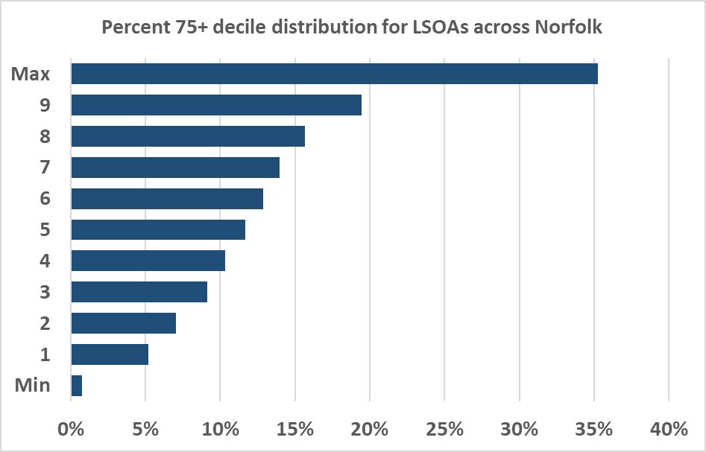
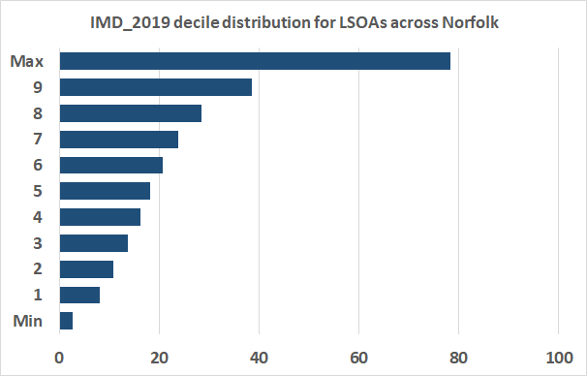
Potential allocation method
For each LSOA
Start with the base population
Calculate decile distribution of the various variables indicative of need
Assign decile for each indicator for each LSOA (1 is least need, 10 is most need)
For each indicator multiply the base population by the decile and then “normalise” to give the weighted population for each indicator
Multiply each population by the indicator weights (at the moment these are all set to 1) and sum to arrive at a total weighted population for the LSOA
Work out the % of the total weighted population for each LSOA
Multiply this % by the original total population of interest to give a weighted population for the LSOA
Sum the LSOA weighted populations for the locality of interest (and additionally for CCG, district etc.)
Deciles for % population aged 75+
Deciles for IMD 2019 score

Slide 10
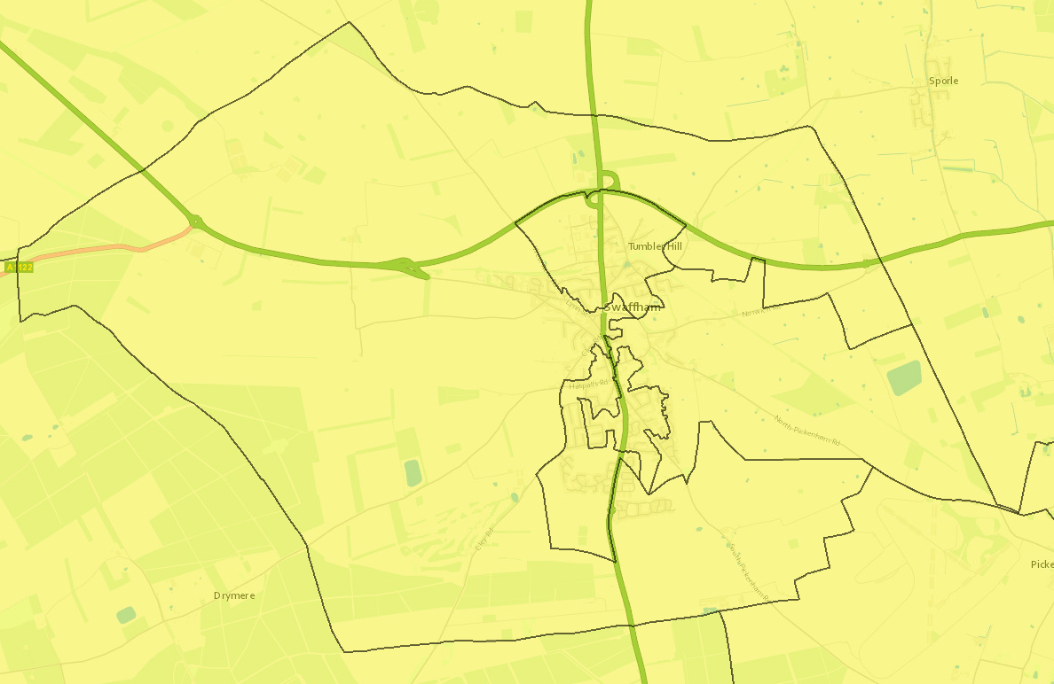
Example using Swaffham locality total for all ages weighted by IMD 2019 score
Swaffham LSOAs | All Ages | % All Ages Total | IMD 2019 Score | Decile IMD 2019 | Decile*All Ages | (Decile * All Ages)/Swaffham Total | IMD 2019 weighted population
E01026455 | 2,682 | 32% | 37 | 9 | 24,138 | 40% | 3,310
E01026456 | 1,174 | 14% | 14 | 4 | 4,696 | 8% | 644
E01026457 | 1,344 | 16% | 15 | 4 | 5,376 | 9% | 737
E01026458 | 1,542 | 19% | 27 | 8 | 12,336 | 20% | 1,692
E01026459 | 1,536 | 19% | 33 | 9 | 13,824 | 23% | 1,896
Swaffham Total | 8,278 |  | 143 |  | 60,370 |  | 8,278
E01026459
E01026455
Deciles for IMD 2019 score
E01026456
Increasing Need
E01026457
E01026458

Slide 11

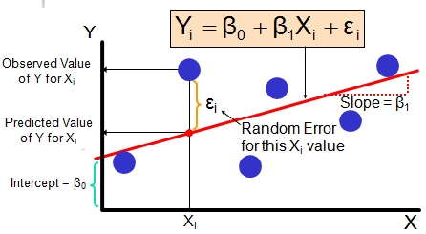


If we choose the option of weighting the indicators then there are different ways of doing this
Equal weighting - useful if there is equal status for all indicators (e.g. when policy assessments are involved). Alternatively, if we have insufficient knowledge of causal relationships, or are unsure about the correct model to apply, or even stem from the lack of consensus on alternative solutions.
Regression models – a regression model can be used to estimate the weights of the need variables potentially associated with an outcome, but we need to understand what outcome we are interested in (costs, frail older people, CIN CP or LAC, FSP not Good Level of Development,?)
Public / expert opinion - participatory approaches, which involve public or expert judgement, are often used for the determination of the weights, with a view to express the relative importance of the indicators from the societal viewpoint.

Slide 12
Example need for resource allocation using the allocation to deciles and unweighted indicators method
Norfolk Localities | Unweighted expected | % based on unweighted population | Weighted Population | % based on weighted population | Resource Need Index
Attleborough
Aylsham
Cromer
Dereham
Diss
Downham Market
Fakenham
Gorleston
Great Yarmouth
Holt
Hunstanton
King's Lynn
Loddon
Long Stratton
North Walsham
Norwich 1 – North Norwich
Norwich 2 – East Norwich
Norwich 3 – West Norwich
Norwich 4 - South Norwich
Redenhall with Harleston
Sheringham
Stalham
Swaffham
Thetford
Watton
Wells-next-the-Sea
Wroxham and Hoveton
Wymondham
Other
Total
North Norwich
East Norwich
West Norwich
Darker colour = higher than average need
South Norwich
This is what the distribution of resource might look like based on the indicators used.

Slide 13
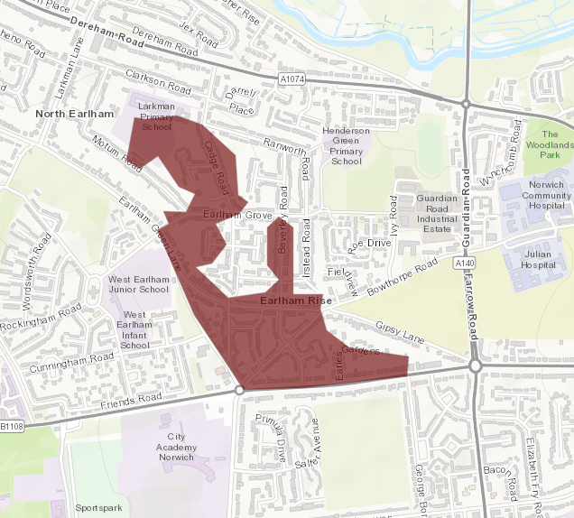
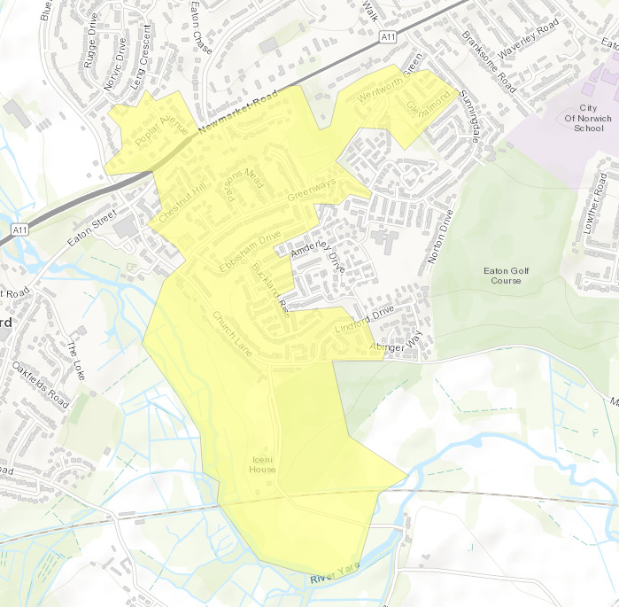
LSOA E01026868
Most deprived 20%
Norwich 3 locality
Population = 1,711
Example communities within Norwich 3 and Norwich 4 localities at either end of Bluebell Road – different scores but there are still indicators to consider in E01026813
LSOA E01026813
Least deprived 20%
Norwich 4 locality
Population = 1,384
Need Index = 125
Need index= 73

