Slide 1
Norfolk and Waveney Population Overview
December 2021

Slide 2
Contents
1. System overview of organisations and geography
  System overview of organisations and geography
  Areas of Norfolk and Waveney in the 20% most deprived nationally
2. Age
  Summary of change over time for broad age range
  Norfolk and Waveney population structure and median age
  NHS Locality population structure
  Maps of broad age range groups
  Rural and urban population
3. Population Change
  Components of population change across Norfolk and Waveney between 2011 and 2020
  Migration
  Population projections and dependency ratio
4. Hospital catchment populations and projections
5. Ethnicity
6. People with disabilities and vulnerable populations
7. Births
8. Life Expectancy
9. Deaths
  Trends and variation
  Leading causes of death
  Premature and preventable mortality
  Leading risk factors for morbidity and mortality

Slide 3
Introduction
This document provides information on how many people live in Norfolk and Waveney broken down by age, sex, ethnicity, disability and other characteristics. There is also detail on life expectancy, inequalities in life expectancy and leading causes of death in the population.
Data provided are for Norfolk and Waveney, which is based on the footprint of the local Integrated Care System (ICS). This is a new partnership between the organisations that aims to meet health and care needs across Norfolk and Waveney, coordinate services and to plan in a way that improves population health and reduces inequalities between different groups.
Norfolk and Waveney is made up of the seven districts in Norfolk (Breckland, Broadland, Great Yarmouth, King’s Lynn and West Norfolk, North Norfolk, Norwich and South Norfolk) and the area that was the former Waveney district in Suffolk.
Where possible we have calculated or sourced the information for Norfolk and Waveney as a whole. For some indicators this is not yet available.
3

Slide 4


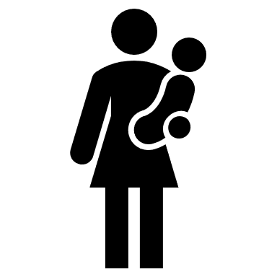




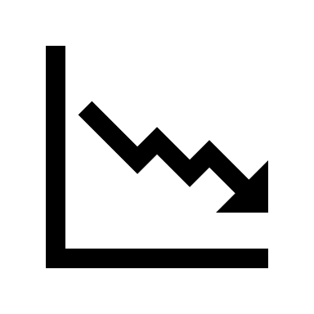




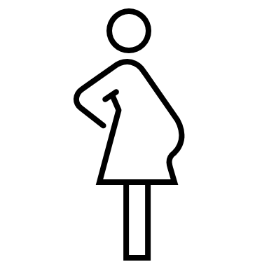

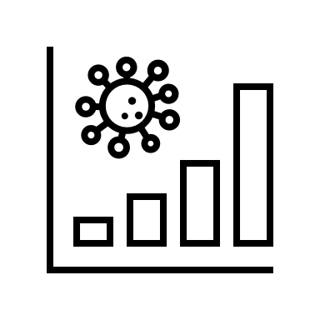


Norfolk and Waveney Population
Population Deprivation
1,033,000 residents
1 in 5 are over 65
1 in 20 are under 5
Norfolk and Waveney population is expected to grow by about 110,000 people between 2020 and 2040, the largest growth is expected in the older age bands.
The most deprived communities are in the urban areas of Great Yarmouth, King’s Lynn,
Lowestoft, Norwich
and Thetford.
Almost 164,000 people live in communities that are in the
20% most deprived in England.
Norfolk and Waveney is less ethnically diverse than England, about 9% are non-white British compared to 21% in England.
But there are also
pockets of deprivation
in rural areas too.
The population is generally older than the England population.
Births Deaths Life and Healthy Life Expectancy
There were about 12,700 deaths in 2020.
All cause mortality rates are lower than England
Life expectancy is almost
80 years for males and
84 years for females,
slightly higher than England average.
The gap in life expectancy between the most deprived and least deprived areas is over 8 years for males
and over 6 years for females.
Deaths from circulatory diseases, cancer and respiratory diseases contribute most to this life expectancy gap.
Healthy life expectancy is about
62.7 years for males
and
62.4 years for females
lower than England and has decreased over the last few years.
Births are declining
In 2019 there were about 9,100 births.
The rate of births to mothers aged 15-44 is lower compared to England.
Leading causes of death for males and females;
Dementia and Alzheimer’s
Heart Disease
This means that people spend in ill health is getting longer and is
17.4 years for males and 21.7 years for females.
COVID-19
Stroke and
Lung Cancer

Slide 5
1. System overview of organisations and geography
Norfolk and Waveney is the footprint of the local Integrated Care System (ICS). This is a new partnership between the organisations that aims to meet health and care needs across Norfolk and Waveney, coordinate services and to plan in a way that improves population health and reduces inequalities between different groups.
The ICS footprint is made up of the seven districts in Norfolk (Breckland, Broadland, Great Yarmouth, King’s Lynn and West Norfolk, North Norfolk, Norwich and South Norfolk) and the area that was the former Waveney district in Suffolk.
5

Slide 6
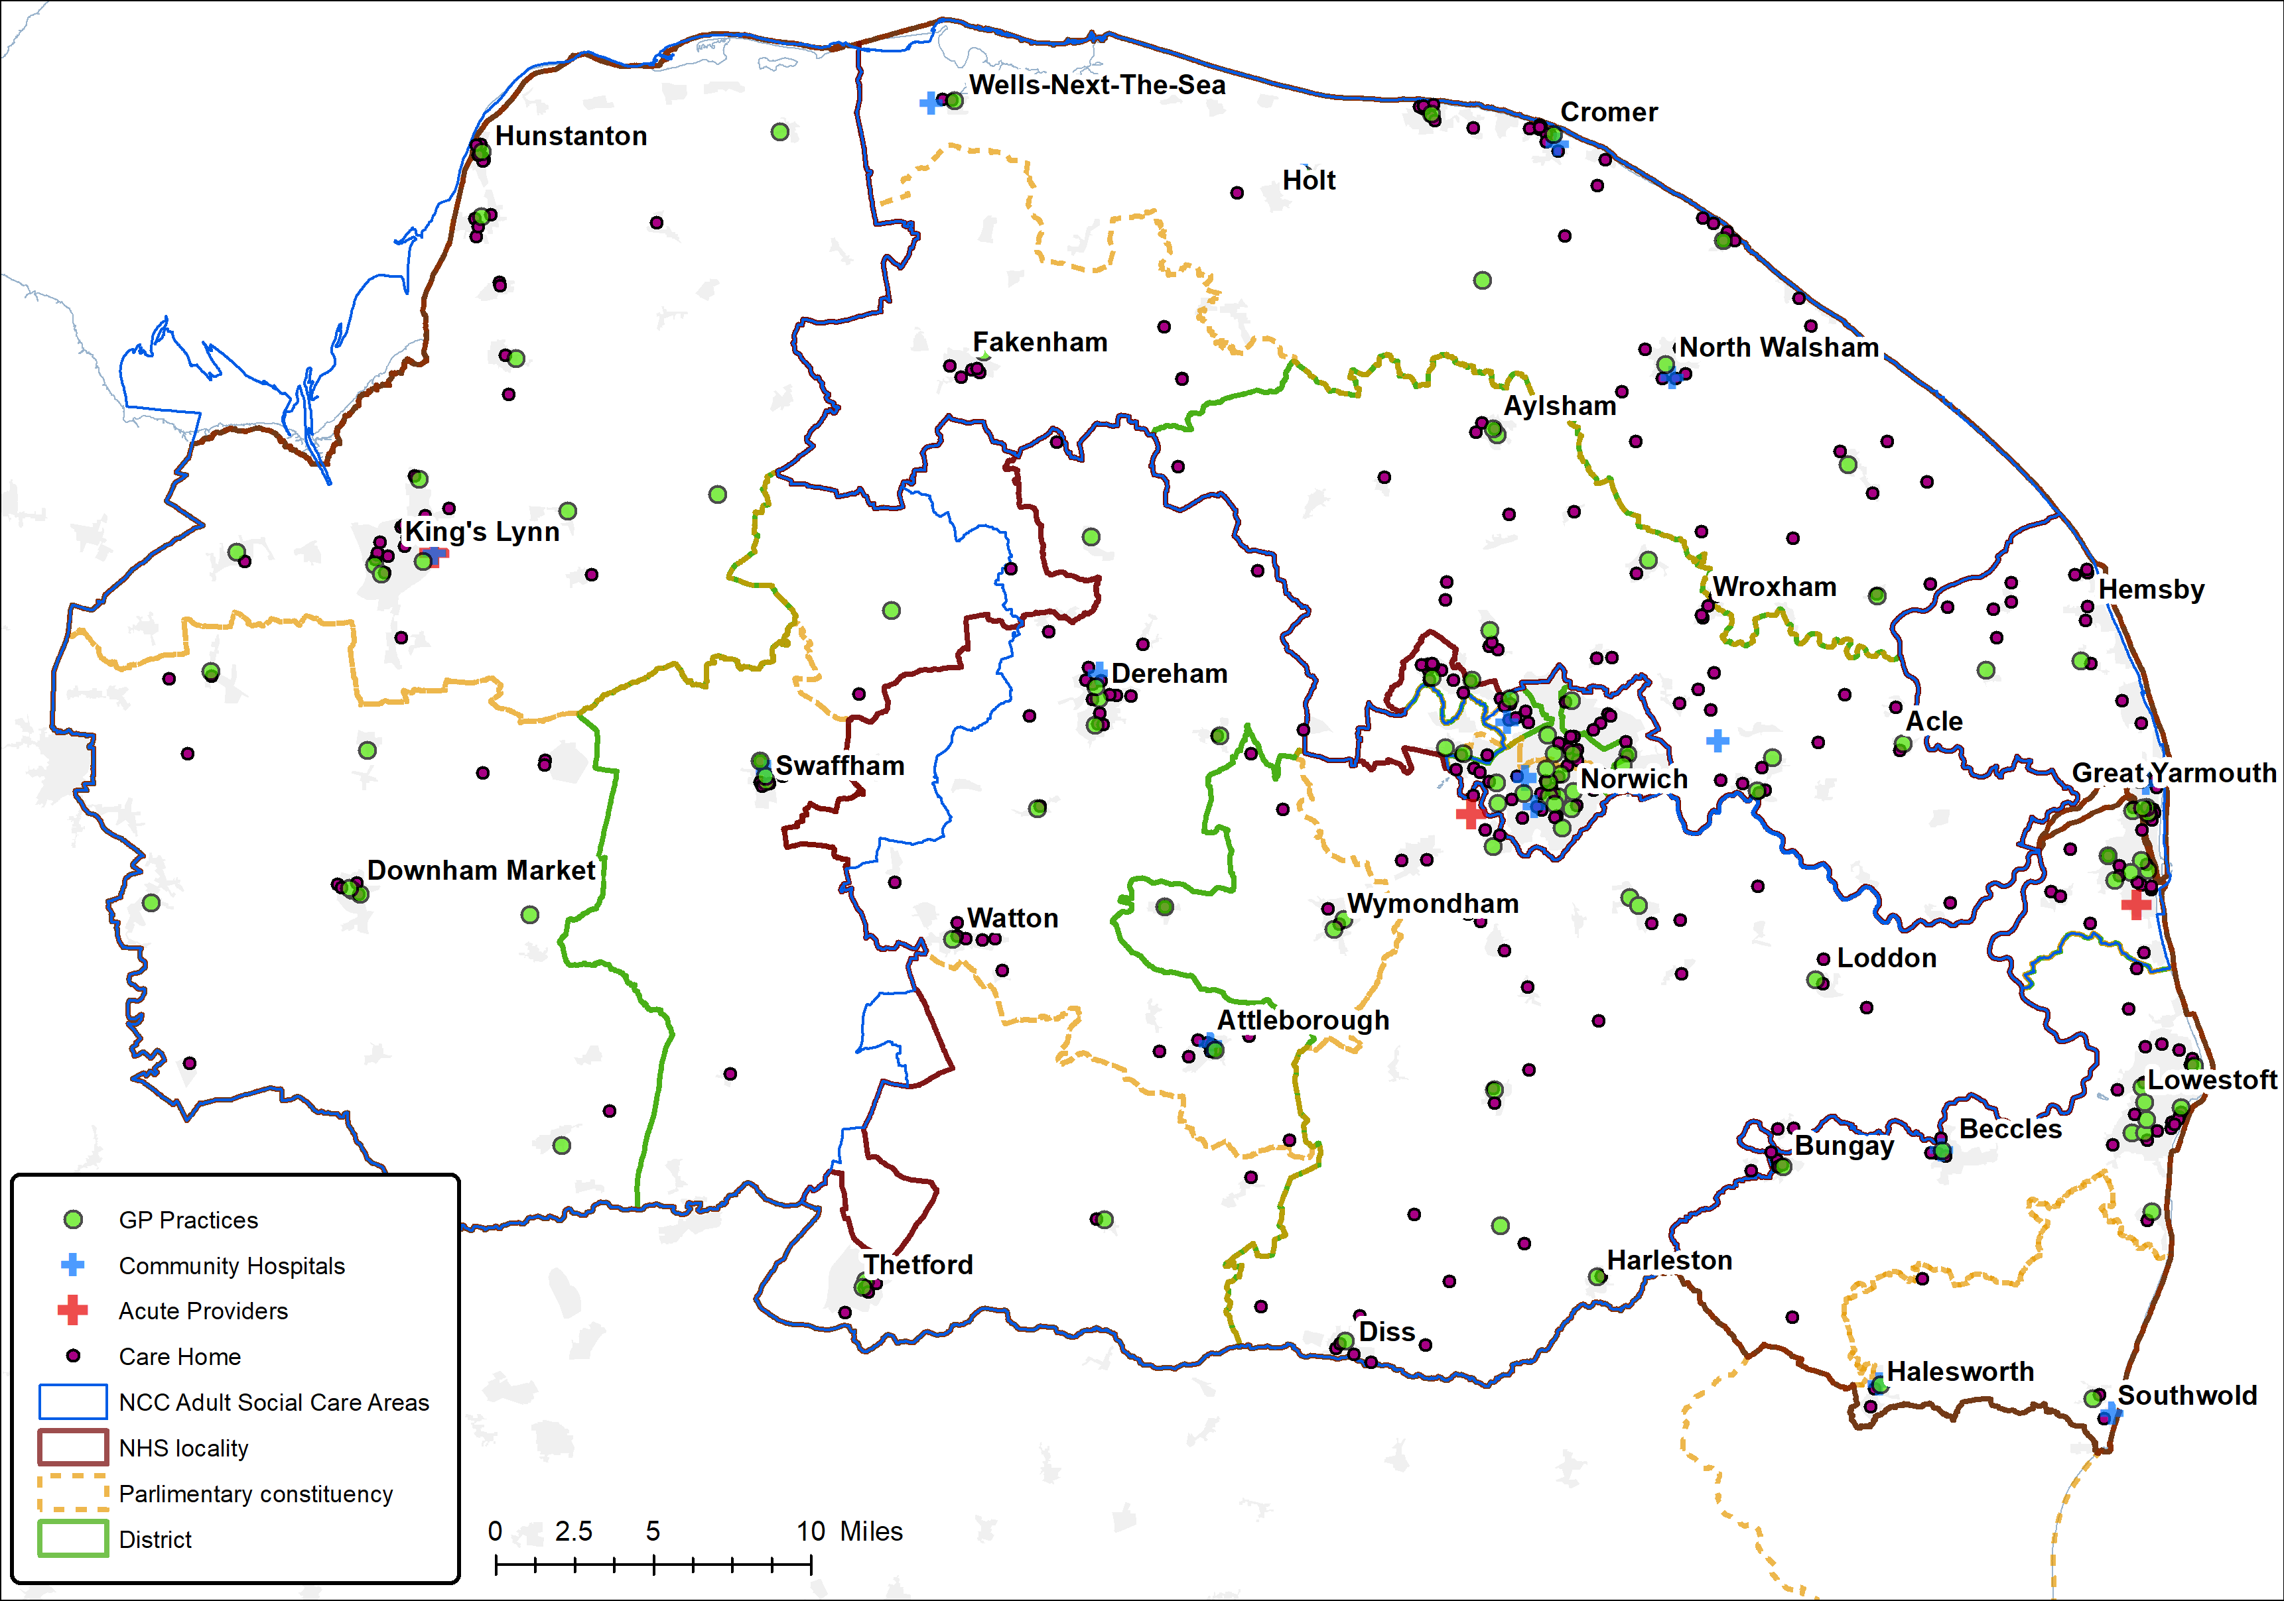


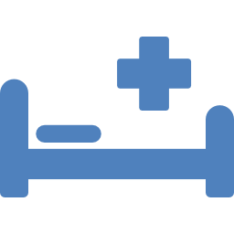







Norfolk county, 7 Norfolk districts and Waveney, 11 parliamentary constituencies
Norfolk and Waveney Integrated Care System (ICS) April 2021
Norfolk and Waveney (ICS)
About 1,033,000 people
5
NHS Commissioning Localities
5
Adult Social Care Localities + Waveney
2 community providers
1 mental health trust
1 ambulance trust
3 acute hospitals, about 1,800 G&A beds
+ community hospitals
17 PCNs + 4 Norwich Neighbourhoods
105 GP practices
400+ care homes, 11,000+ beds
Copyright © Experian Ltd, NAVTEQ 2016,Based on Crown Copyright material
Icons made by Freepik from www.flaticon.com

Slide 7
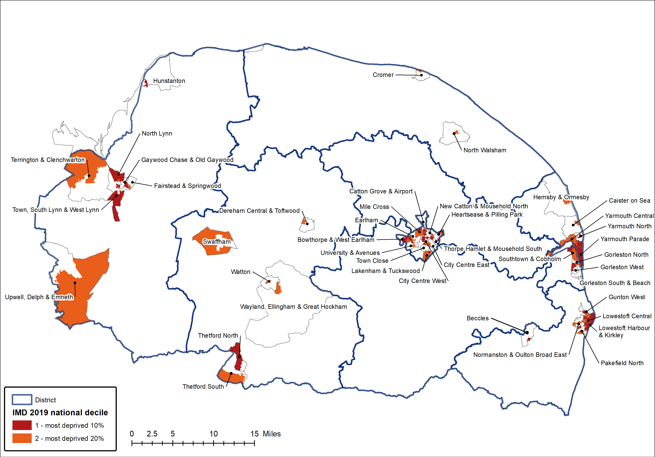
There are 42 communities across Norfolk and Waveney where some or all the population live in the 20% most deprived areas in England. However, none of these communities are in Broadland or South Norfolk
District | Most deprived decile 1 Core 20 | Most deprived decile 2 Core 20 | Other deciles | Core 20 Population
Breckland | 2,500 | 12,300 | 126,500 | 14,700
Broadland | 0 | 0 | 131,900 | 0
Great Yarmouth | 26,900 | 12,800 | 59,500 | 39,700
KLWN | 12,100 | 11,200 | 127,900 | 23,300
North Norfolk | 0 | 2,800 | 102,400 | 2,800
Norwich | 27,400 | 28,100 | 86,700 | 55,500
South Norfolk | 0 | 0 | 143,100 | 0
Waveney | 16,000 | 11,800 | 90,700 | 27,900
Norfolk and Waveney | 84,900 | 78,900 | 868,800 | 163,800
England | 5,603,900 | 5,697,200 | 45,249,000 | 11,301,100
District | Most deprived decile 1 Core 20 | Most deprived decile 2 Core 20 | Other deciles | Core 20 Population
Breckland | 1.7% | 8.7% | 89.6% | 10.4%
Broadland | 0.0% | 0.0% | 100.0% | 0.0%
Great Yarmouth | 27.1% | 12.9% | 60.0% | 40.0%
KLWN | 8.0% | 7.4% | 84.6% | 15.4%
North Norfolk | 0.0% | 2.6% | 97.4% | 2.6%
Norwich | 19.3% | 19.7% | 61.0% | 39.0%
South Norfolk | 0.0% | 0.0% | 100.0% | 0.0%
Waveney | 13.5% | 10.0% | 76.5% | 23.5%
Norfolk and Waveney | 8.2% | 7.6% | 84.1% | 15.9%
England | 9.9% | 10.1% | 80.0% | 20.0%
40% of the populations of Great Yarmouth and Norwich live in the most deprived 20% of areas in England compared to 16% for Norfolk and Waveney as a whole.
7

Slide 8
2. Age
This chapter shows the breakdown of the Norfolk and Waveney population by broad age groups and population pyramids.
8

Slide 9




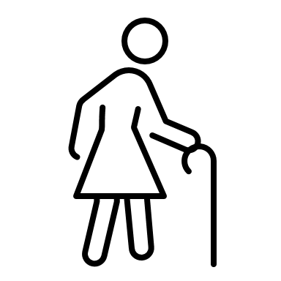
Summary of change over time for broad age range
A breakdown of Norfolk and Waveney's population by broad age group can be found in the table below.
Between the Office for National Statistics (ONS) 2011 and 2020 mid-year population estimates there has been a 5.9% increase in the population overall. This was not uniform across all age groups, however.
The largest percentage change was an increase in number of children and the number of older people.
 | Mid 2011 | Mid 2020 | % change 2011 to 2020 | Mid 2040 projection | Change from mid 2020 – mid 2040
0-4 (Babies and infants) | 52,900 | 49,700 | -5.9% | 53,200 | +7.1%
5-11 (children) | 100,300 | 114,000 | +13.7% | 108,700 | -4.7%
12-15 (young people) | 57,300 | 52,400 | -8.6% | 56,900 | +8.5%
16-64 (working age adults) | 549,700 | 558,600 | +1.6% | 577,700 | +3.4%
65+ (older people) | 214,600 | 257,900 | +20.1% | 352,800 | +36.8%
TOTAL | 974,800 | 1,032,700 | +5.9% | 1,149,200 | +11.3%
% change 2011 to 2020
-5.9%
Babies & infants
+13.7%
Children
-8.6%
Young people
+1.6%
Working age adults
+20.1%
Older people
9

Slide 10
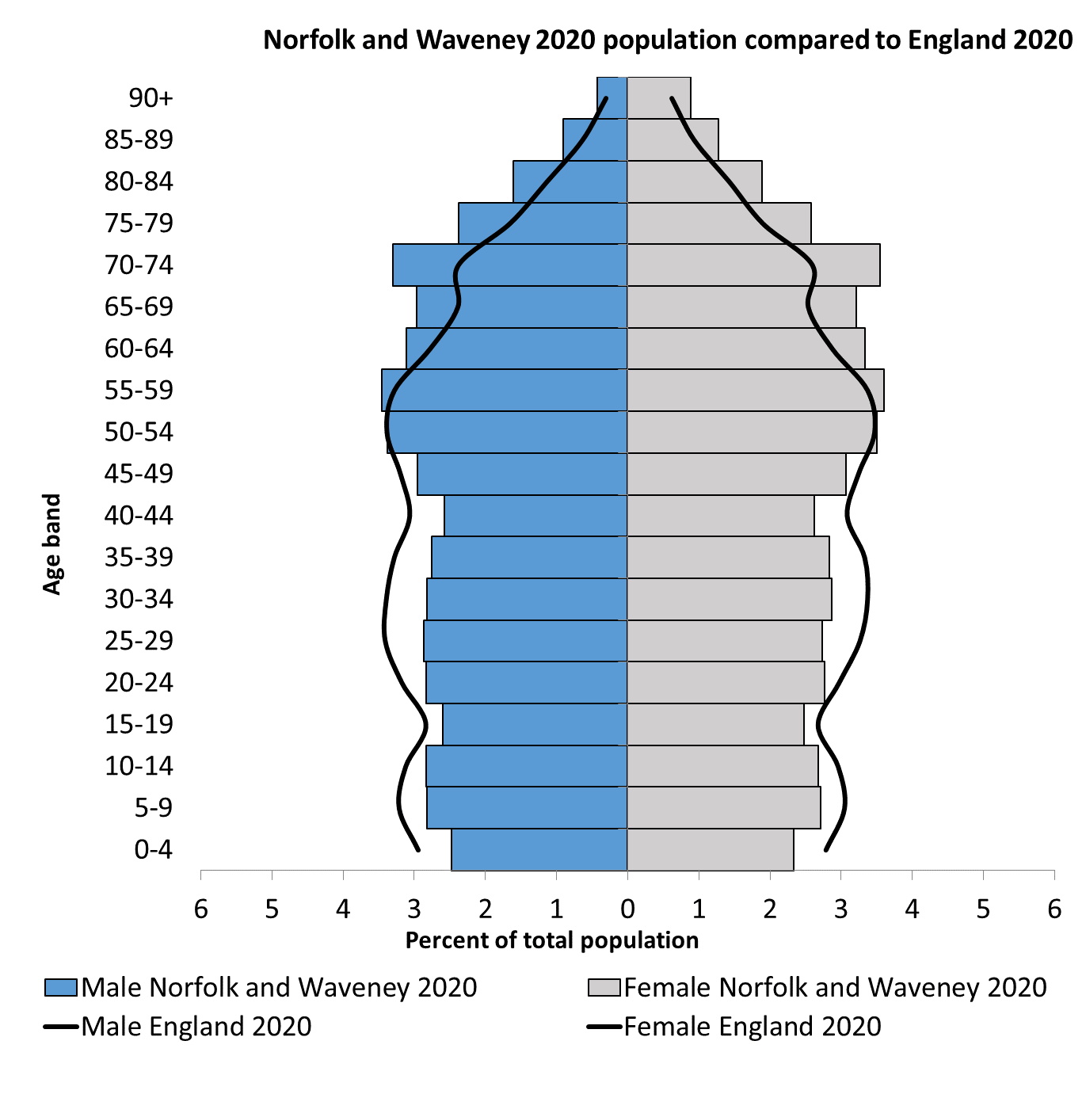
Population structure – Norfolk and Waveney
The chart shows Norfolk and Waveney's population by five year age bands. The black line shows the England average.
Norfolk and Waveney has an older population compared to England. About 1 in 4 of the population is aged 65 and over and about 1 in 30 is aged 85 and over.
Norwich is the youngest population and North Norfolk the oldest. This has remained the case over the last 10 years
Area | Median Age Mid-2020 | Median Age Mid-2011
Norfolk | 46.0 | 44.1
Breckland | 47.0 | 44.1
Broadland | 48.2 | 46.0
Great Yarmouth | 46.2 | 43.6
King's Lynn and West Norfolk | 48.2 | 45.2
North Norfolk | 54.7 | 51.3
Norwich | 33.3 | 34.2
South Norfolk | 46.3 | 45.1
Suffolk | 45.6 | 42.9
East Suffolk (Waveney) | 49.6 | 46.3 (45.7)
England | 40.2 | 39.4
10

Slide 11
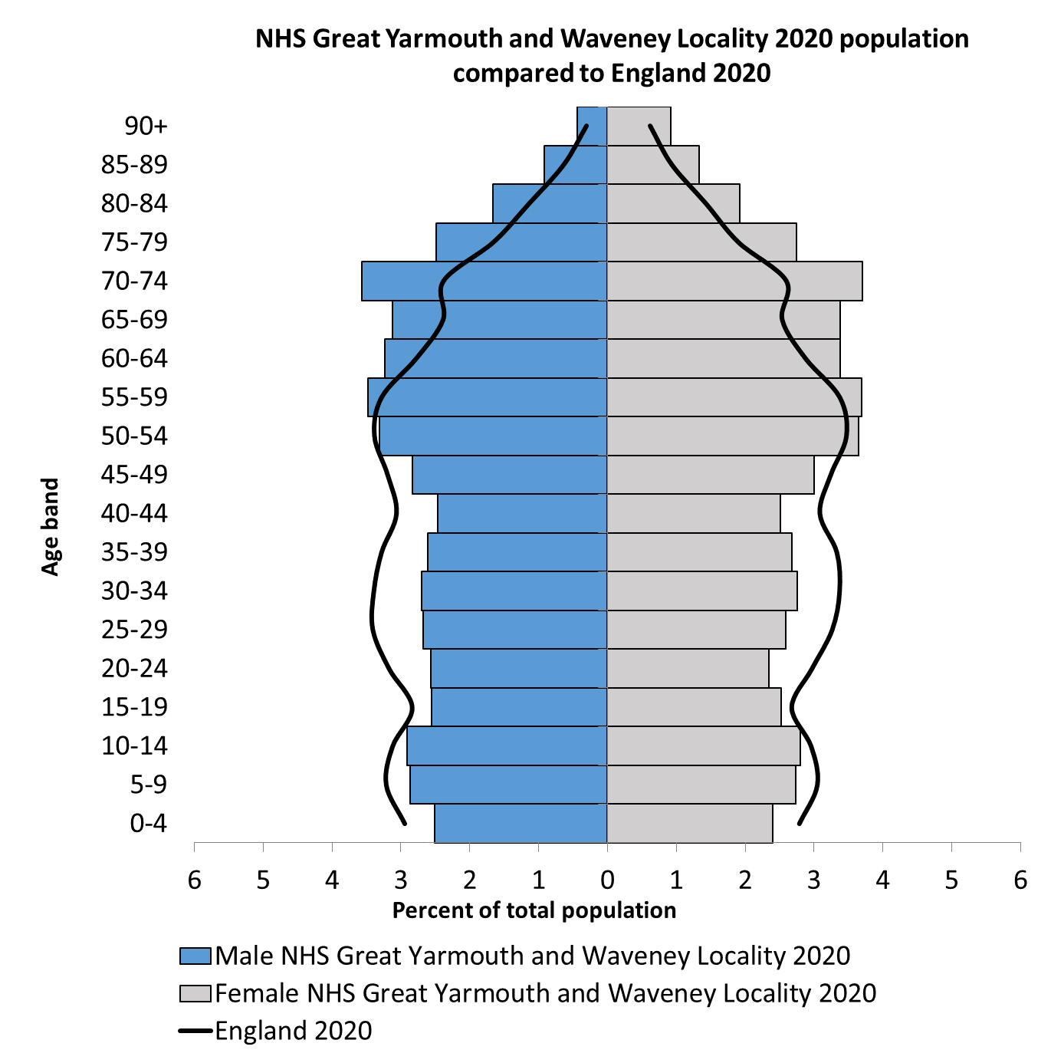
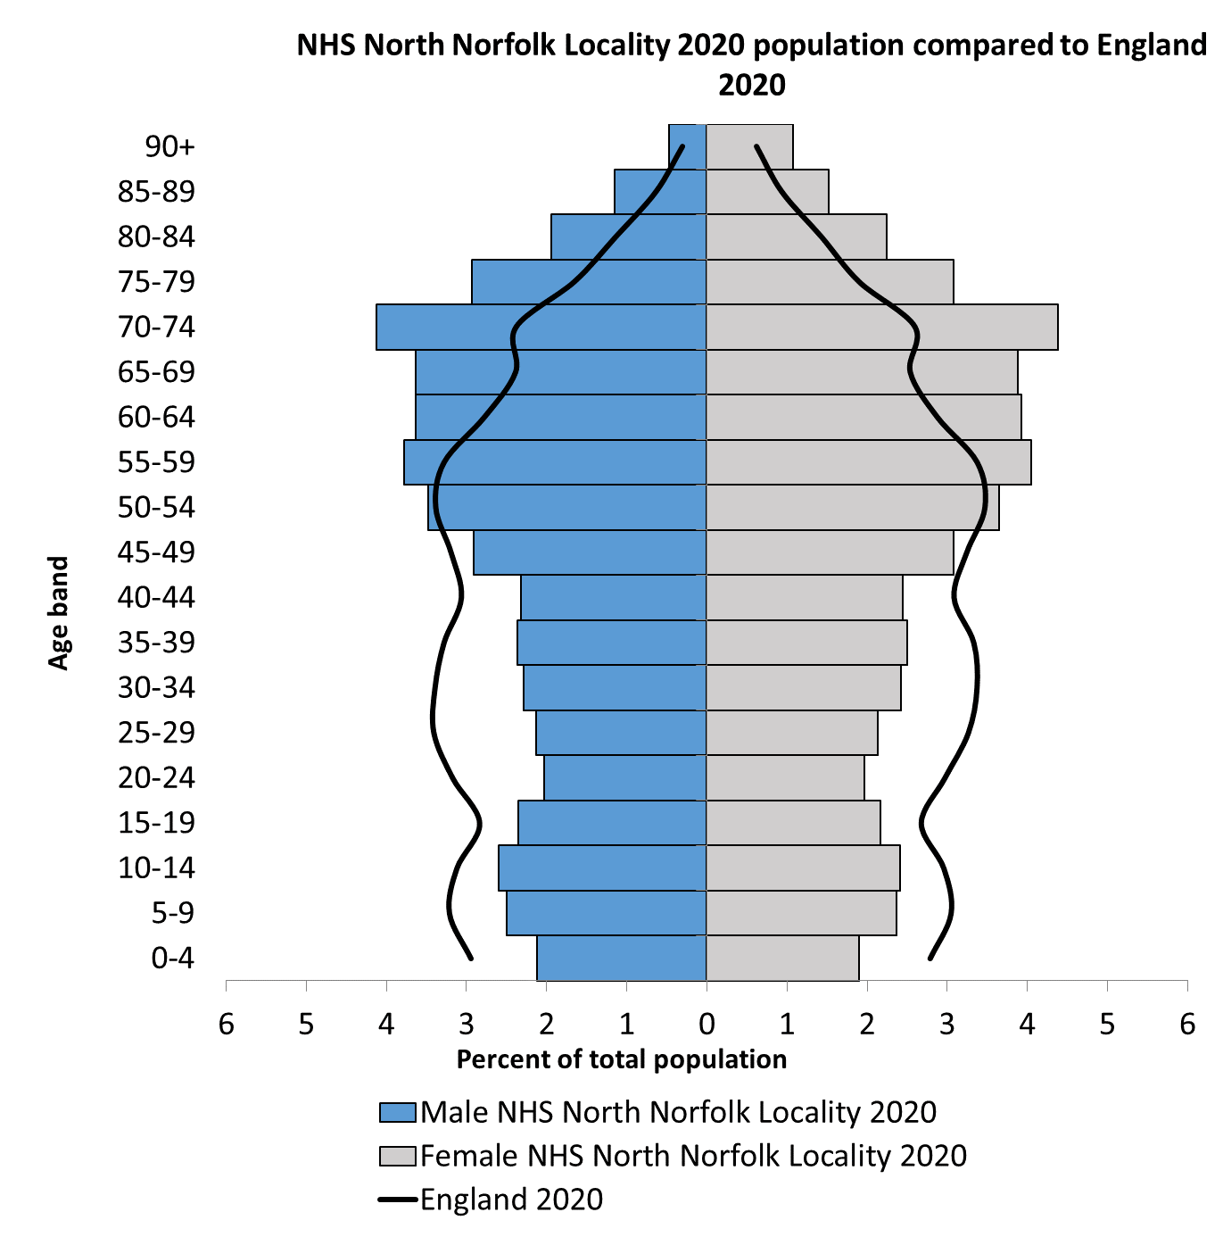
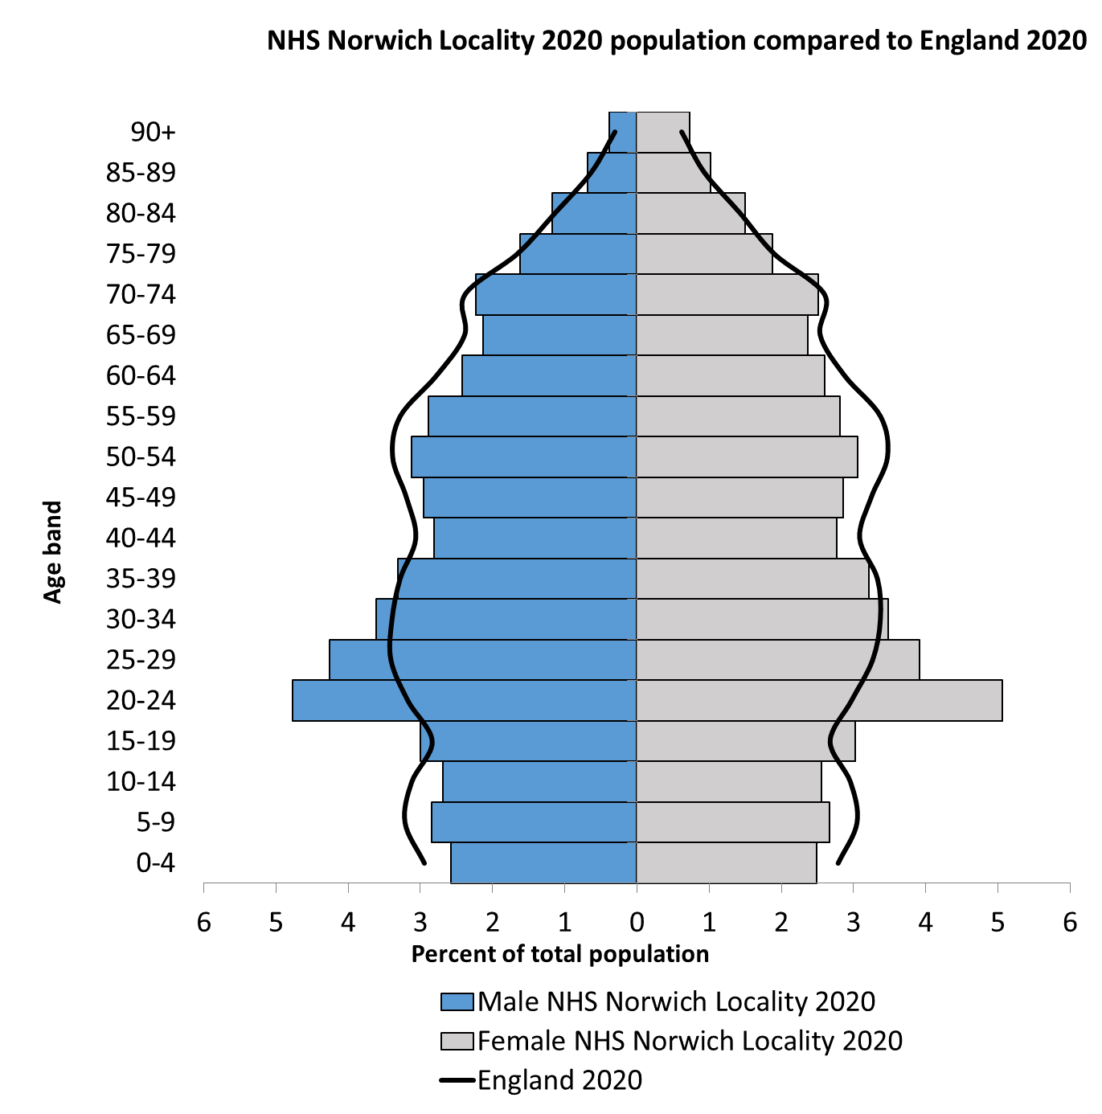
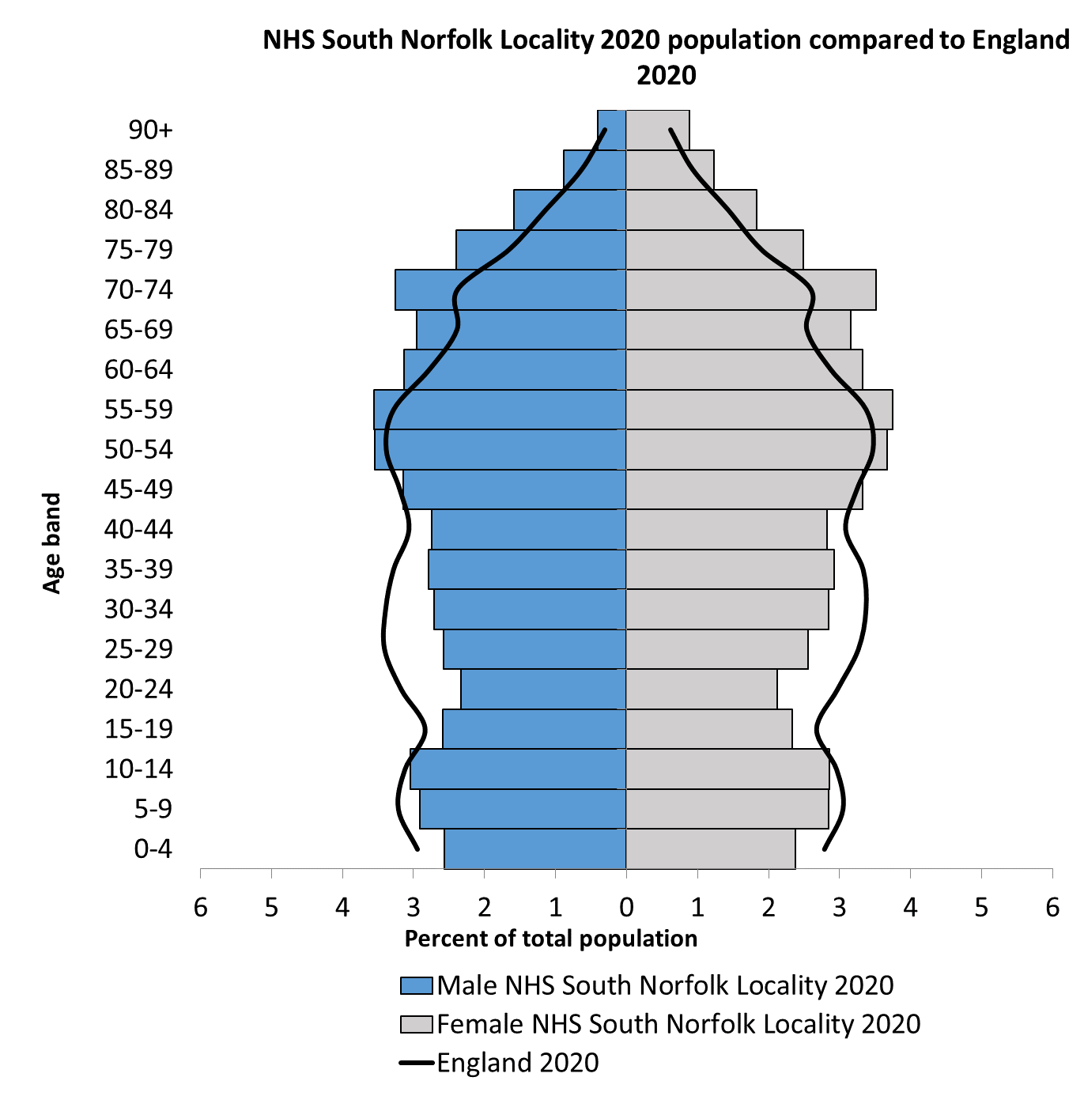
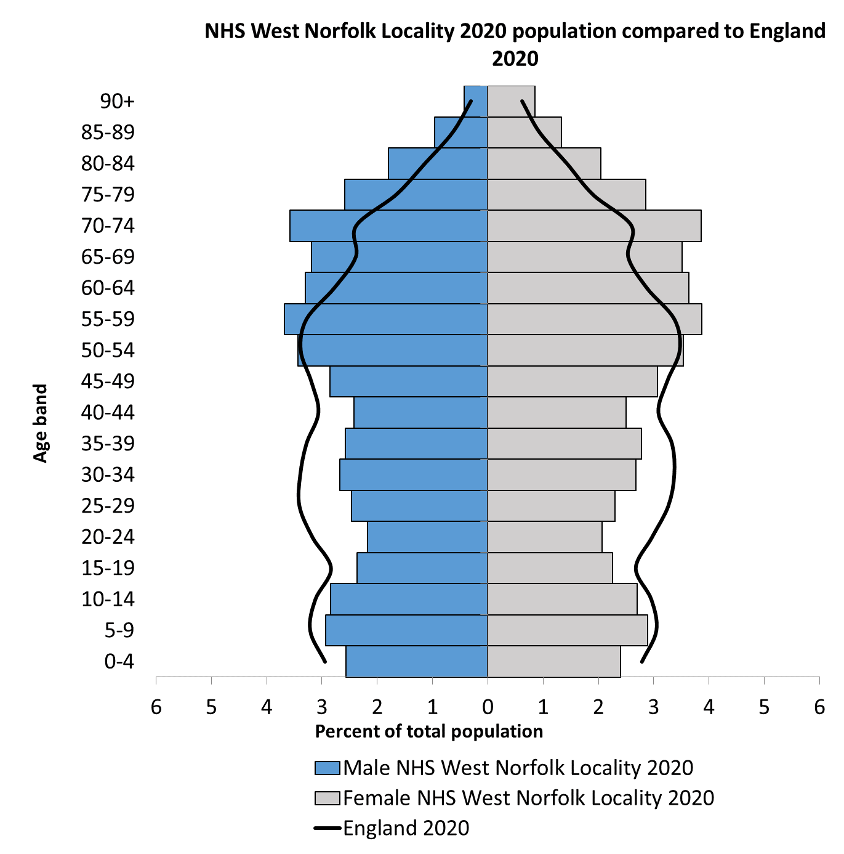
Population structure – NHS locality 2020
The majority of localities across Norfolk and Waveney are older than the England population apart from Norwich. The locality with the oldest population is North Norfolk. The youngest is Norwich.

Slide 12
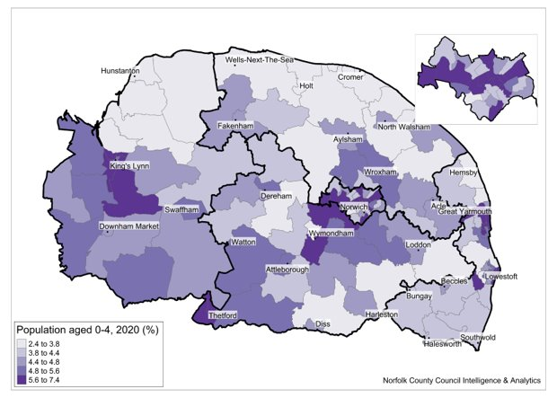
Babies and infants (0-4 year olds)
There are estimated to be a total of 49,700 0–4 year-olds in Norfolk and Waveney in 2020, representing 4.8% of the total population. Numbers vary across the districts from 3,800 in North Norfolk to 7,400 in Norwich.
 | 0-4 | All Ages | % 0-4
Breckland | 7,100 | 141,300 | 5.0%
Broadland | 6,000 | 131,900 | 4.5%
Great Yarmouth | 5,200 | 99,200 | 5.2%
King's Lynn and West Norfolk | 7,600 | 151,200 | 5.0%
North Norfolk | 3,800 | 105,200 | 3.6%
Norwich | 7,400 | 142,200 | 5.2%
South Norfolk | 7,100 | 143,100 | 5.0%
Waveney | 5,500 | 118,600 | 4.6%
Norfolk | 44,200 | 914,100 | 4.8%
Norfolk & Waveney | 49,700 | 1,032,700 | 4.8%
12

Slide 13
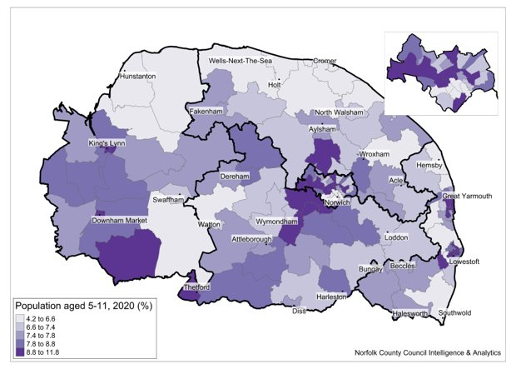
Children (5-11 year olds)
There are estimated to be a total of 80,200 5-11 year olds in Norfolk and Waveney in 2020, representing 7.8% of the total population. Numbers vary across the districts from 6,700 in North Norfolk to 12,400 in King’s Lynn and West Norfolk
 | 5-11 | All Ages | % 5-11
Breckland | 11,300 | 141,300 | 8.0%
Broadland | 9,900 | 131,900 | 7.5%
Great Yarmouth | 8,000 | 99,200 | 8.1%
King's Lynn and West Norfolk | 12,400 | 151,200 | 8.2%
North Norfolk | 6,700 | 105,200 | 6.4%
Norwich | 10,700 | 142,200 | 7.5%
South Norfolk | 11,900 | 143,100 | 8.3%
Waveney | 9,300 | 118,600 | 7.8%
Norfolk | 70,900 | 914,100 | 7.8%
Norfolk & Waveney | 80,200 | 1,032,700 | 7.8%
13

Slide 14
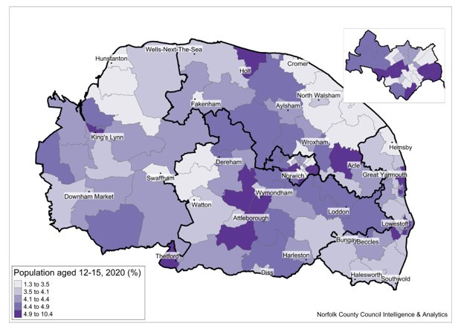
Young People (12-15 year olds)
There are estimated to be a total of 44,300 12-15 year olds in Norfolk and Waveney in 2020, representing 4.3% of the total population. Numbers vary across the district from 3,900 in North Norfolk to 6,800 in South Norfolk.
 | 12-15 | All Ages | % 12-15
Breckland | 6,100 | 141,300 | 4.3%
Broadland | 5,700 | 131,900 | 4.3%
Great Yarmouth | 4,400 | 99,200 | 4.4%
King's Lynn and West Norfolk | 6,600 | 151,200 | 4.4%
North Norfolk | 3,900 | 105,200 | 3.7%
Norwich | 5,600 | 142,200 | 3.9%
South Norfolk | 6,800 | 143,100 | 4.8%
Waveney | 5,200 | 118,600 | 4.4%
Norfolk | 39,100 | 914,100 | 4.3%
Norfolk & Waveney | 44,300 | 1,032,700 | 4.3%
14

Slide 15
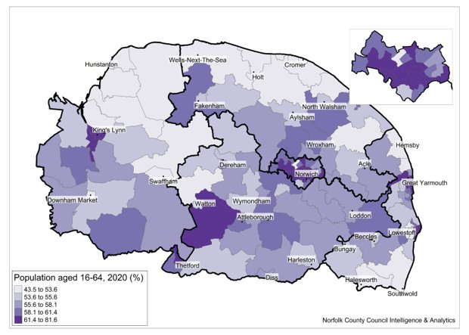
Working Age Adults (16-64 year olds)
There are estimated to be a total of 600,600 16-64 year olds in Norfolk and Waveney in 2020, representing 58.2% of the total population. Numbers vary across the district from 55,600 in North Norfolk to 97,100 in Norwich.
 | 16-64 | All Ages | % 12-15
Breckland | 81,000 | 141,300 | 57.3%
Broadland | 76,200 | 131,900 | 57.8%
Great Yarmouth | 57,000 | 99,200 | 57.5%
King's Lynn and West Norfolk | 84,800 | 151,200 | 56.1%
North Norfolk | 55,600 | 105,200 | 52.9%
Norwich | 97,100 | 142,200 | 68.3%
South Norfolk | 82,800 | 143,100 | 57.9%
Waveney | 66,100 | 118,600 | 55.7%
Norfolk | 534,500 | 914,100 | 58.5%
Norfolk & Waveney | 600,600 | 1,032,700 | 58.2%
15

Slide 16
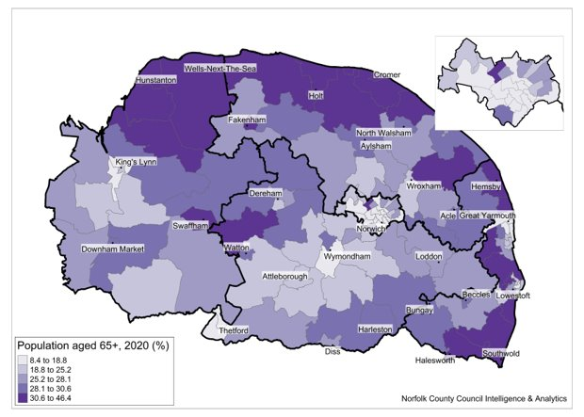
Older People (65+ year olds)
There are estimated to be a total of 257,900 65+ year olds in Norfolk and Waveney in 2020, representing 25% of the total population. Numbers vary across the district from 21,400 in Norwich to 39,900 in King’s Lynn and West Norfolk.
 | 65+ | All Ages | % 12-15
 | 35,700 | 141,300 | 25.3%
Broadland | 34,100 | 131,900 | 25.9%
Great Yarmouth | 24,600 | 99,200 | 24.8%
King's Lynn and West Norfolk | 39,900 | 151,200 | 26.4%
North Norfolk | 35,300 | 105,200 | 33.6%
Norwich | 21,400 | 142,200 | 15.0%
South Norfolk | 34,400 | 143,100 | 24.0%
Waveney | 32,500 | 118,600 | 27.4%
Norfolk | 225,400 | 914,100 | 24.7%
Norfolk & Waveney | 257,900 | 1,032,700 | 25.0%
16

Slide 17
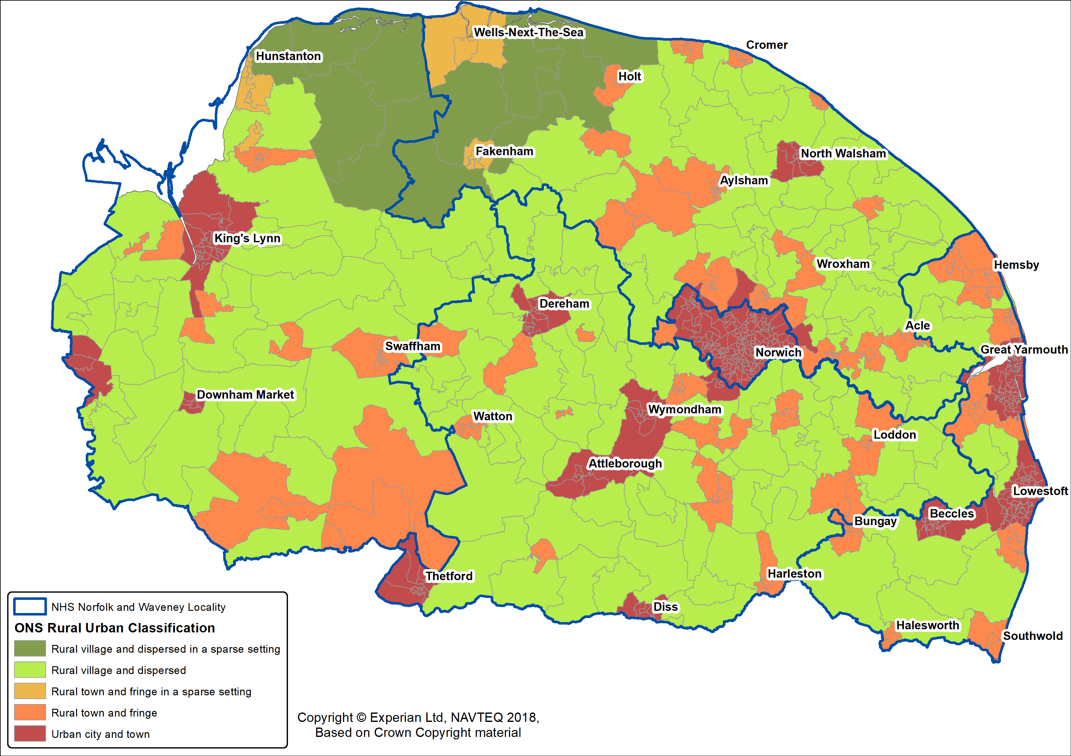
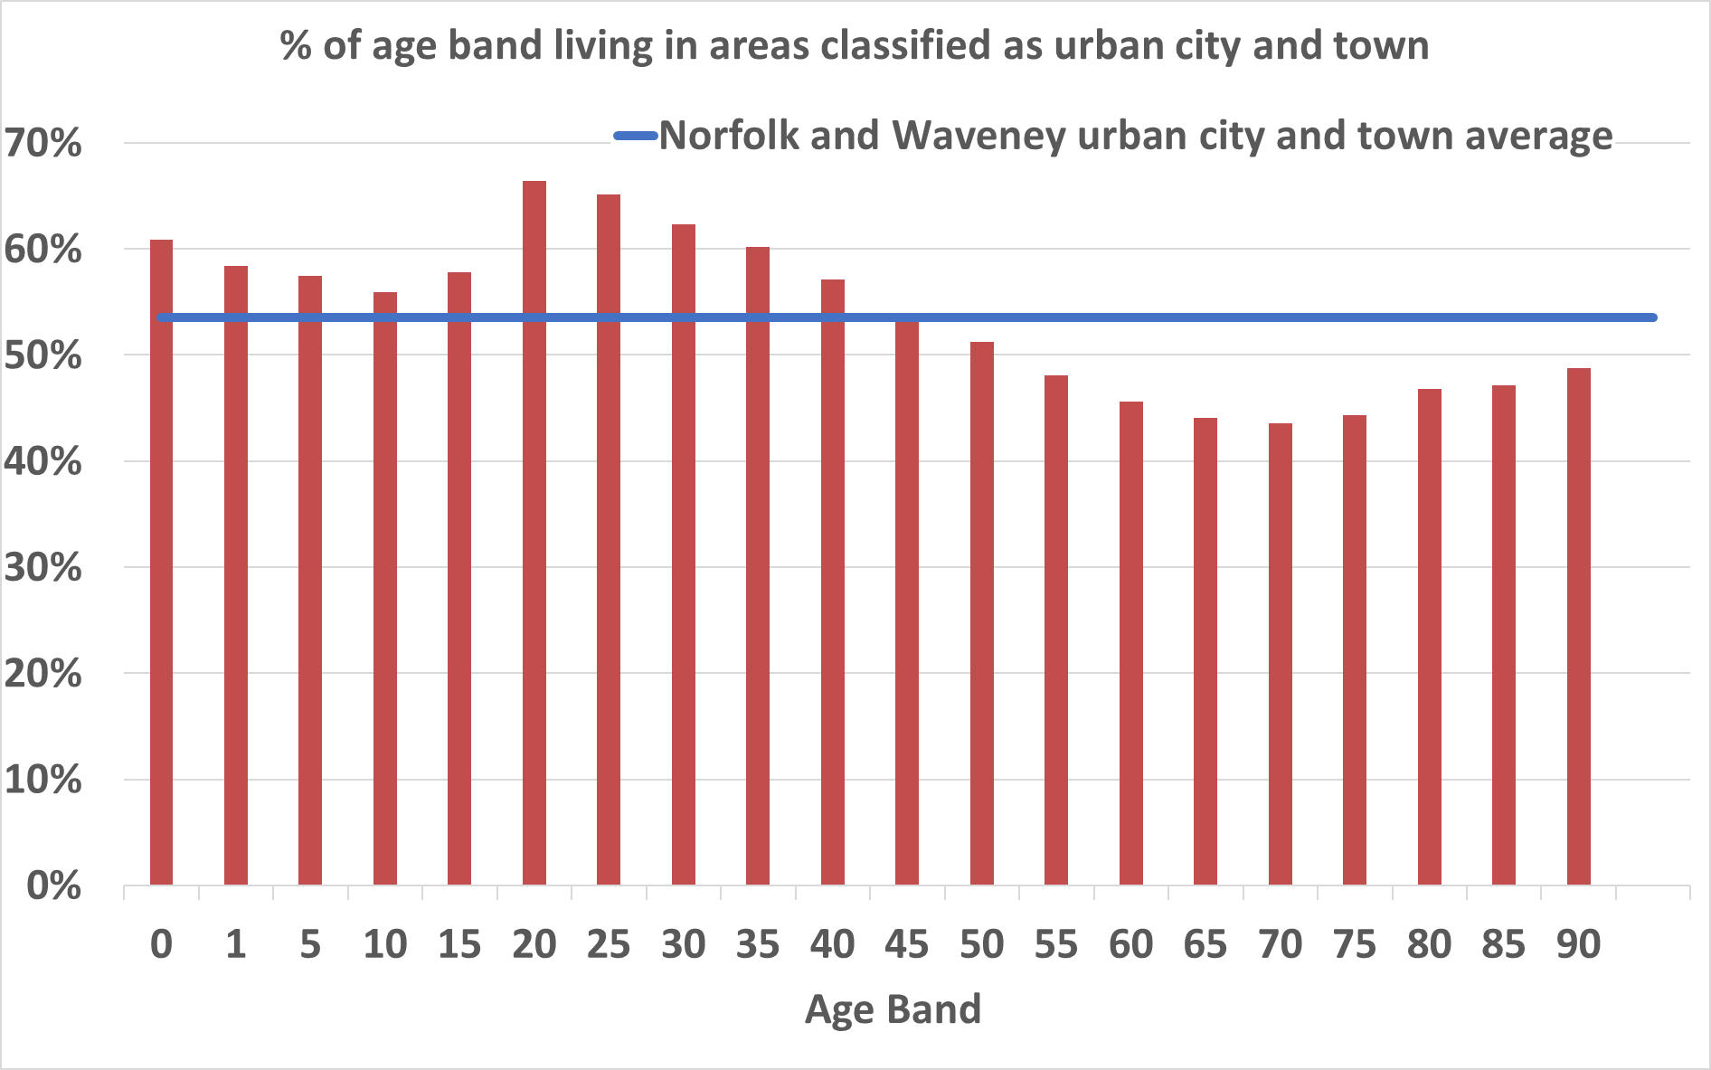
Rural and urban population
More than half of people under 50 live in the areas of Norfolk and Waveney classified as urban city and town. Whereas people aged over 50 are more likely to live in more rural areas.

Slide 18
3. Population Change
This chapter highlights the components of change in the population and what the future population might look like. This is for Norfolk and Waveney, the districts and hospital catchments.
18

Slide 19
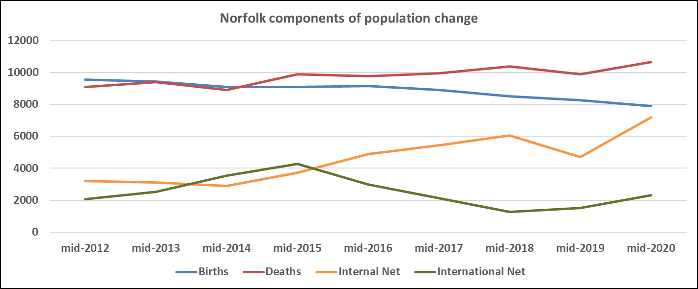
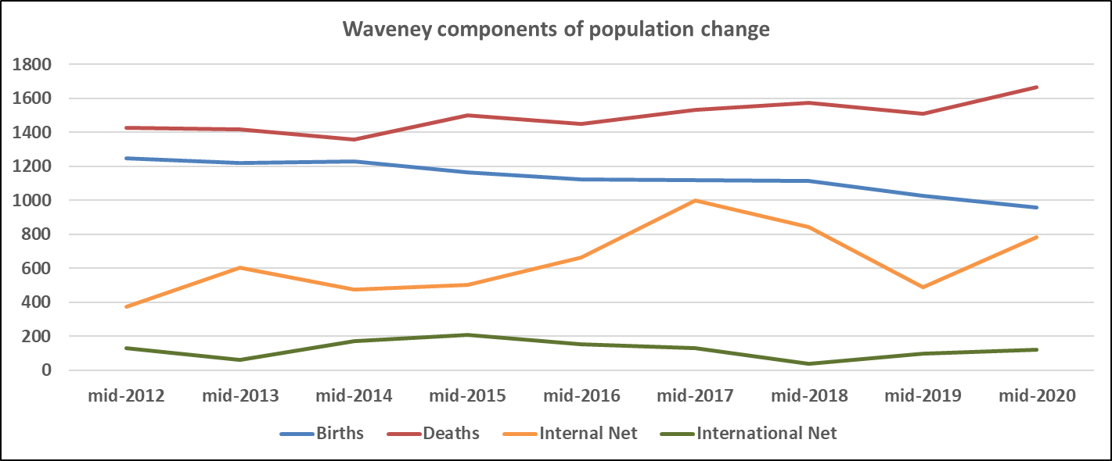
The changing population across Norfolk and Waveney
Norfolk since 2011:
Since mid-2011 the population of Norfolk increased by 54,613 (6.4%) from 859,426 to 914,039.
In the period since 2011 there were 79,809 births and 87,880 deaths in Norfolk. This makes natural change (the balance between births and deaths) -8,071.
In the period since 2011 net internal migration for Norfolk was 41,166.
In the period since 2011 there were 49,679 international in-migrants and 27,140 international out-migrants in Norfolk. This makes net international migration 22,539.
In the period since 2011 changes to special populations (home armed forces, foreign armed forces and the prison population) reduced the population of Norfolk by -1,091.
Norfolk 2020 compared to 2019
Between 2019 and 2020
  the population of Norfolk increased by 6,279 (0.7%) from 907,760 to 914,039. This is slightly more than England (0.5%)
  there were 7,898 births and 10,656 deaths in Norfolk. This makes natural change (the balance between births and deaths) -2,758.
  net internal migration for Norfolk was 7,181.
  there were 5,422 international in-migrants and 3,126 international out-migrants in Norfolk. This makes net international migration 2,296.
  changes to special populations (home armed forces, foreign armed forces and the prison population) reduced the population of Norfolk by -474.
Waveney since 2011
Since mid-2011 the population of Waveney increased by 3,266 (2.8%) from 115,356 to 118,622.
In the period since 2011 there were 10,203 births and 13,436 deaths in Waveney. This makes natural change (the balance between births and deaths) -3,233.
In the period since 2011 net internal migration for Waveney was 5,724.
In the period since 2011 there were 2,464 international in-migrants and 1,355 international out-migrants in Waveney. This makes net international migration 1,109.
In the period since 2011 changes to special populations (home armed forces, foreign armed forces and the prison population) reduced the population of Waveney by -345.
Waveney 2020 compared to 2019:
Between 2019 and 2020
  the population of Waveney increased by 189 (0.2%) from 118,433 to 118,622.
  there were 960 births and 1,667 deaths in Waveney. This makes natural change (the balance between births and deaths) -707.
  net internal migration for Waveney was 781.
  there were 233 international in-migrants and 114 international out-migrants in Waveney. This makes net international migration 119.
  changes to special populations (home armed forces, foreign armed forces and the prison population) reduced the population of Waveney by -7.
19

Slide 20
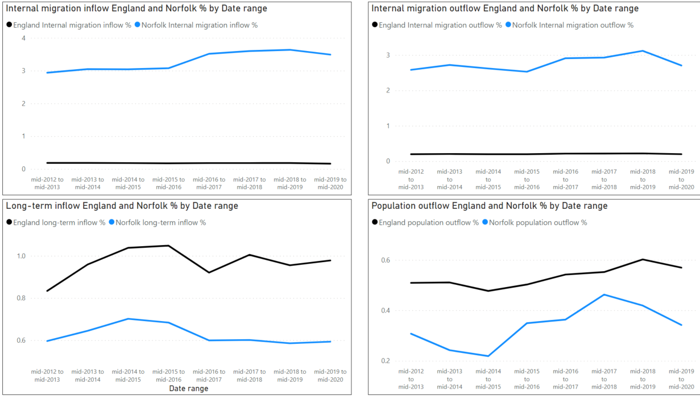
Migration
Migration is the process of people moving from one place to another. This can be from one side of the world to the other, or just moving to a different part of the Country. The reasons for migration can be economic, social, political or environmental. Along with births, migration can contribute large changes to a population. Currently it is contributing to population growth / no impact in Norfolk.
20

Slide 21
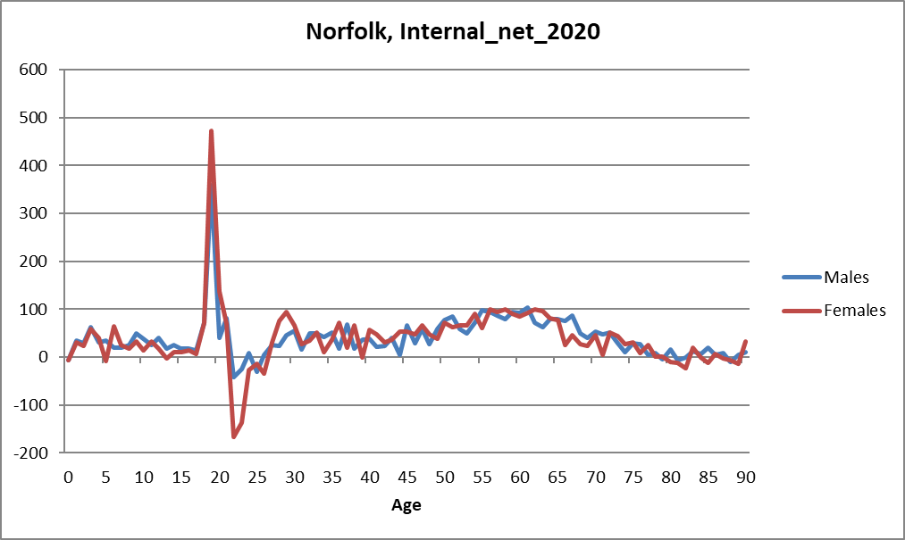
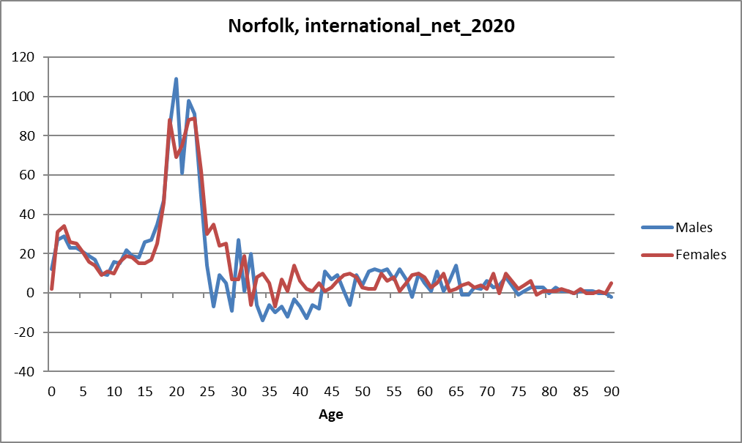
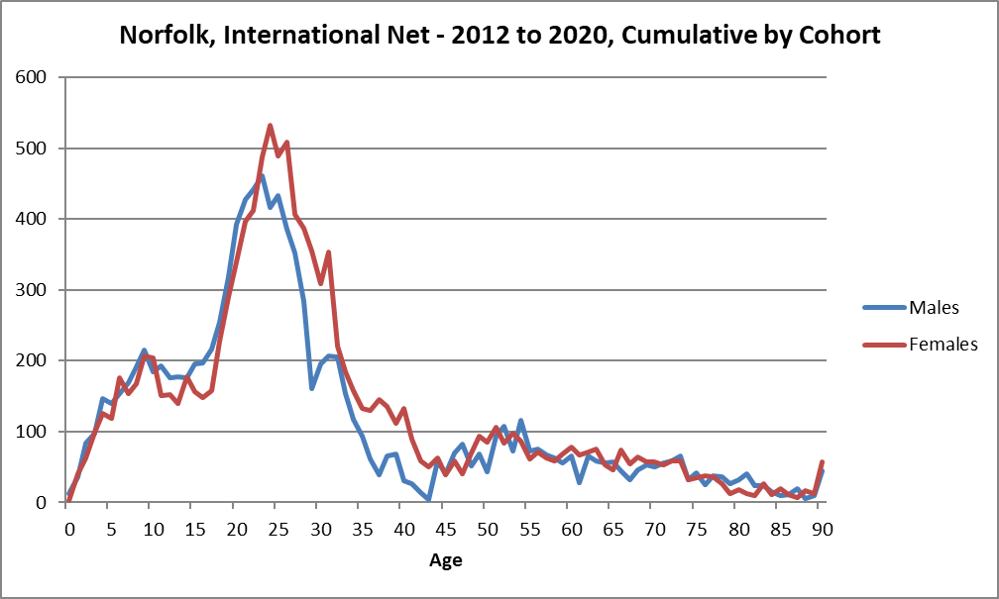
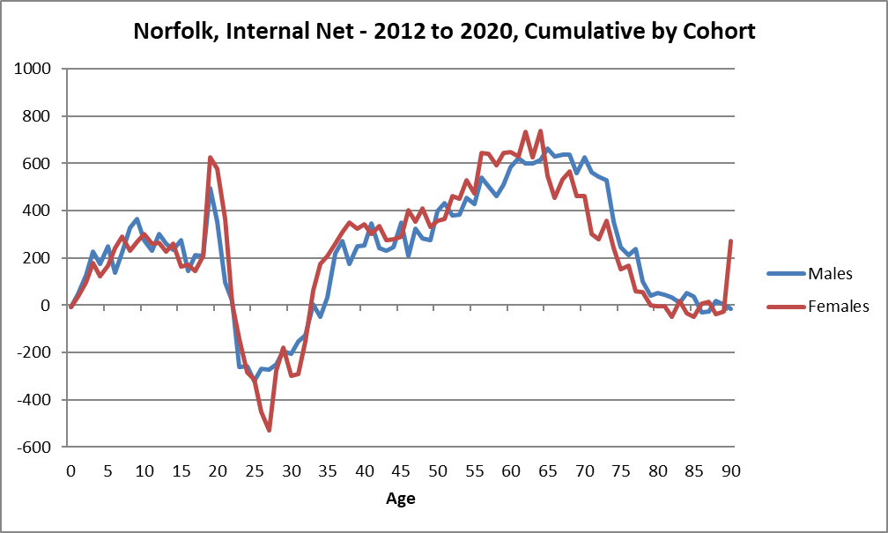
Migration estimates indicate that generally there is a net inflow to Norfolk across all age bands apart from just after higher education
ONS migration data shows that for people resident in the UK there is generally a net inflow to Norfolk until the age of 19/20 (there appears to be a difference between females and males in that the net outflow starts earlier for males) After this there is a net outflow before picking up again in older age bands. This suggests that young people previously resident in Norfolk are leaving having finished their education. This might reflect limited post A-level and higher education and employment and the attractiveness of the bigger metropolitan areas?
There is a net inflow of young people from outside the UK to Norfolk peaking in the early 20s. Does this reflect a different perception of higher education / employment opportunities or targeted overseas recruitment and marketing for students?
21

Slide 22
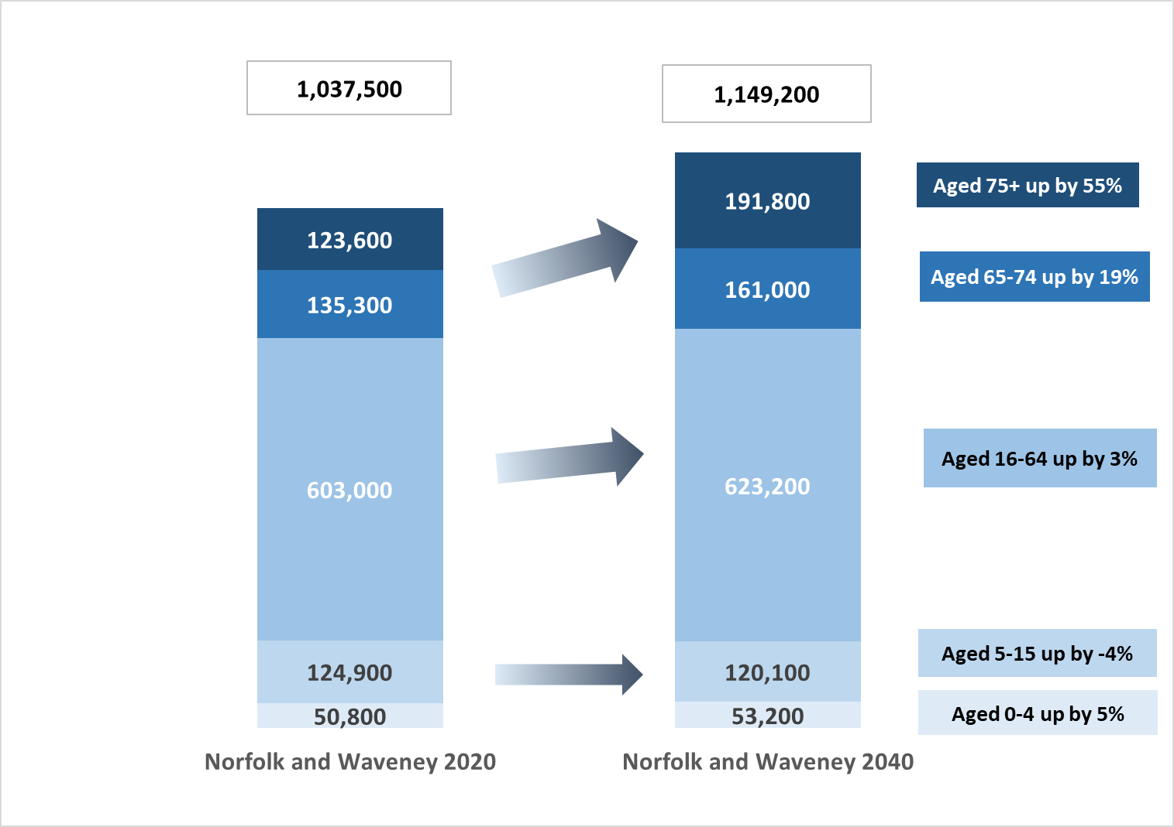
Population Projections for Norfolk and Waveney
For future service planning it is essential that there is a good understanding of the population change taking place within Norfolk and Waveney over the next few decades. Nationally the population is expected to grow, and Norfolk and Waveney is no different.
Norfolk and Waveney’s population is projected to increase by approximately 6.7% between 2019 and 2029, it is currently the 26th largest STP in England (out of 42). This is a projected population increase of over 68,880 spread over the next ten years, 48,100 of this increase is in the population over 65. Norfolk and Waveney has an older population with a proportion of residents 65 years or older making up 25% of the current population. This makes it the 4th oldest STP in the country. The proportion is likely to rise to 28% by 2029.
Between 2020 and 2040 there will be a projected increase of almost 110,000 people living in Norfolk and Waveney.
22

Slide 23
Population change for local areas
2020 resident population estimates
Area | 0-4 | 5-15 | 16-64 | 65-74 | 75+ | Total
Breckland | 7,100 | 22,500 | 75,900 | 18,700 | 17,000 | 141,300
Broadland | 6,000 | 20,600 | 71,200 | 17,500 | 16,600 | 131,900
Great Yarmouth | 5,200 | 16,500 | 52,900 | 13,200 | 11,400 | 99,200
King's Lynn and West Norfolk | 7,600 | 24,600 | 79,100 | 21,000 | 19,000 | 151,200
North Norfolk | 3,800 | 14,000 | 52,100 | 18,400 | 16,900 | 105,200
Norwich | 7,400 | 24,700 | 88,800 | 11,100 | 10,300 | 142,200
South Norfolk | 7,100 | 24,400 | 77,100 | 17,900 | 16,500 | 143,100
Waveney | 5,500 | 19,200 | 61,400 | 16,800 | 15,700 | 118,600
Norfolk and Waveney | 49,700 | 166,500 | 558,600 | 134,600 | 123,200 | 1,032,700
England | 3,239,400 | 10,090,900 | 32,755,800 | 5,598,400 | 4,865,600 | 56,550,100
2040 resident population projections
Area | 0-4 | 5-15 | 16-64 | 65-74 | 75+ | Total
Breckland | 7,800 | 23,200 | 79,500 | 23,700 | 27,800 | 162,000
Broadland | 6,700 | 21,600 | 74,400 | 20,300 | 25,700 | 148,700
Great Yarmouth | 5,000 | 15,400 | 52,100 | 15,600 | 17,800 | 105,900
King's Lynn and West Norfolk | 7,500 | 22,900 | 76,400 | 24,400 | 27,900 | 159,100
North Norfolk | 4,000 | 13,300 | 52,100 | 21,300 | 26,000 | 116,700
Norwich | 7,900 | 23,000 | 92,700 | 12,800 | 15,000 | 151,400
South Norfolk | 8,300 | 27,400 | 88,200 | 22,800 | 27,200 | 173,800
Waveney | 5,900 | 18,600 | 62,400 | 20,200 | 24,400 | 131,600
Norfolk and Waveney | 53,200 | 165,500 | 577,700 | 161,000 | 191,800 | 1,149,200
England | 3,297,400 | 9,866,600 | 33,466,800 | 6,855,300 | 7,671,800 | 61,157,900
Estimated change in persons 2020 to 2040
Area | 0-4 | 5-15 | 16-64 | 65-74 | 75+ | Total
Breckland | 720 | 740 | 3,580 | 4,960 | 10,770 | 20,770
Broadland | 750 | 1,000 | 3,130 | 2,780 | 9,120 | 16,780
Great Yarmouth | -180 | -1,120 | -860 | 2,430 | 6,420 | 6,690
King's Lynn and West Norfolk | -150 | -1,650 | -2,780 | 3,430 | 8,960 | 7,810
North Norfolk | 240 | -710 | 0 | 2,900 | 9,140 | 11,570
Norwich | 550 | -1,620 | 3,930 | 1,690 | 4,690 | 9,250
South Norfolk | 1,170 | 2,990 | 11,090 | 4,810 | 10,700 | 30,760
Waveney | 410 | -560 | 980 | 3,370 | 8,760 | 12,950
Norfolk and Waveney | 3,510 | -920 | 19,070 | 26,360 | 68,560 | 116,580
England | 57,960 | -224,360 | 711,070 | 1,256,830 | 2,806,230 | 4,607,730
Estimated % change 2020 to 2040
Area | 0-4 | 5-15 | 16-64 | 65-74 | 75+ | Total
Breckland | 10% | 3% | 5% | 26% | 63% | 15%
Broadland | 13% | 5% | 4% | 16% | 55% | 13%
Great Yarmouth | -3% | -7% | -2% | 18% | 56% | 7%
King's Lynn and West Norfolk | -2% | -7% | -4% | 16% | 47% | 5%
North Norfolk | 6% | -5% | 0% | 16% | 54% | 11%
Norwich | 7% | -7% | 4% | 15% | 46% | 7%
South Norfolk | 16% | 12% | 14% | 27% | 65% | 21%
Waveney | 7% | -3% | 2% | 20% | 56% | 11%
Norfolk and Waveney | 7% | -1% | 3% | 20% | 56% | 11%
England | 2% | -2% | 2% | 22% | 58% | 8%

Slide 24
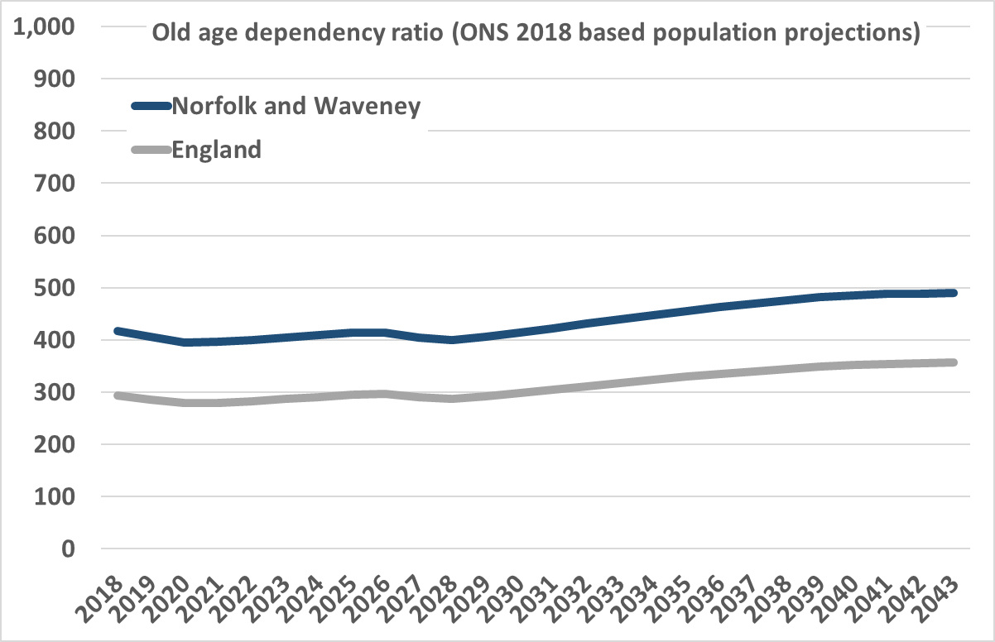
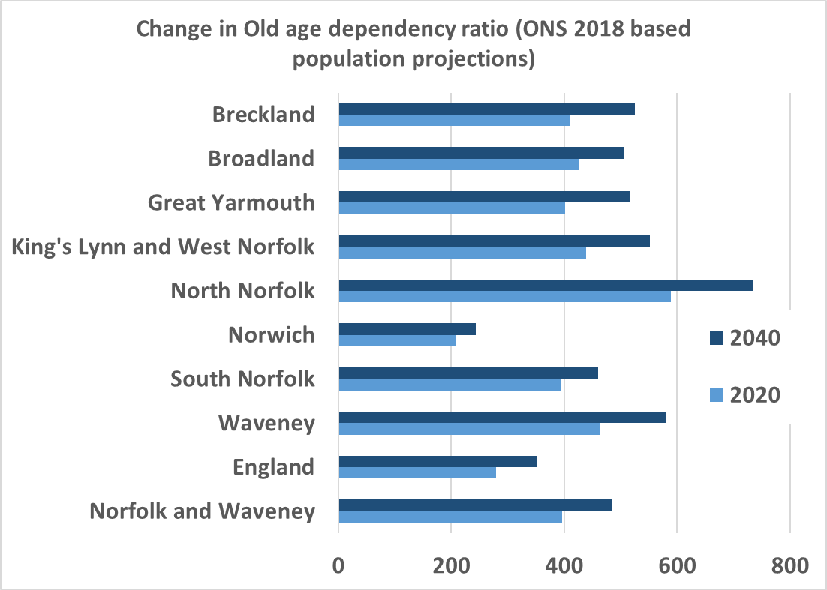
Old age dependency ratio 2020 to 2040
Old age dependency ratio is calculated as the total projected population aged 65 and above divided by the total projected population aged 16-64. Old age dependency ratio can be used to measure the pressure on the working population. The higher the ratio, the more pressure there is on the working age population.
The old age dependency ratio for Norfolk and Waveney is projected to increase slightly faster than England. Across Norfolk and Waveney North Norfolk currently has the 2nd highest old age dependency ratio in England but is expected to the 4th highest by 2040. This is likely to put extra pressure on the working age population and potentially the availability of staff to deliver services.

Slide 25
4. Hospital catchment populations and projections

Slide 26
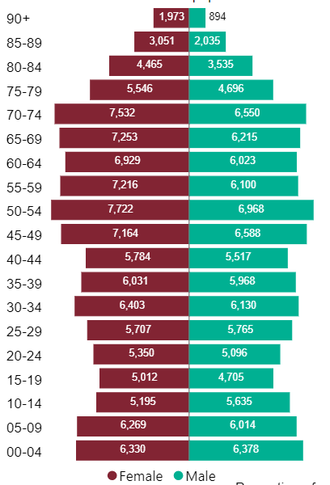
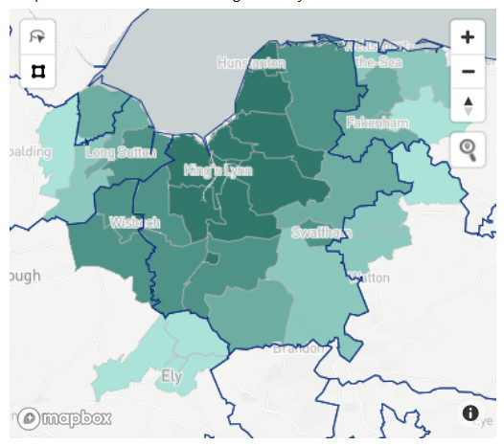
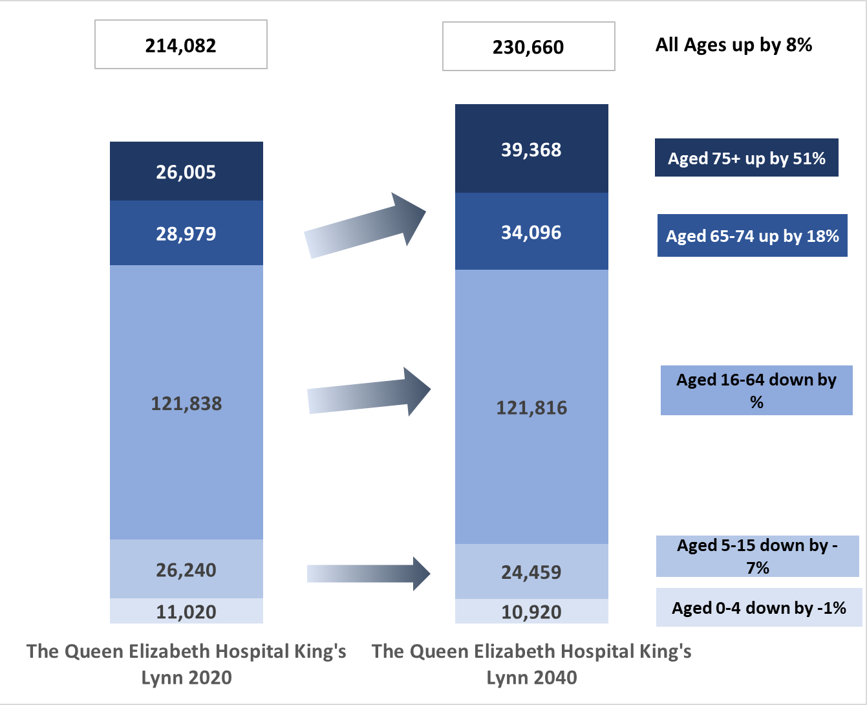
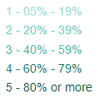
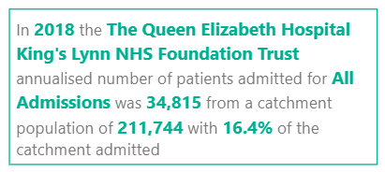
Analysis of hospital catchment populations indicates that for the Queen Elizabeth (QEH) most of the admissions are drawn from within KLWN and some of the surrounding districts. By 2040, the QEH catchment population is expected to increase by about 8% overall (about 16,000 people) with the largest increase in older age groups those aged 75+
Queen Elizabeth Hospital King’s Lynn
Increases in older age groups but zero change or decreasing in working age and younger
Source: https://app.powerbi.com/view?r=eyJrIjoiODZmNGQ0YzItZDAwZi00MzFiLWE4NzAtMzVmNTUwMThmMTVlIiwidCI6ImVlNGUxNDk5LTRhMzUtNGIyZS1hZDQ3LTVmM2NmOWRlODY2NiIsImMiOjh9

Slide 27
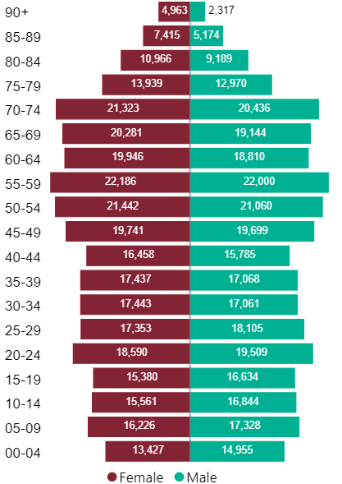
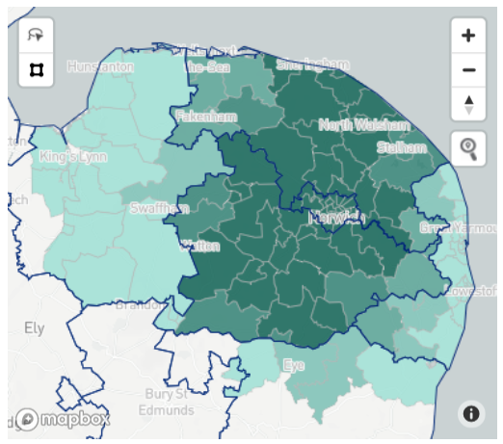
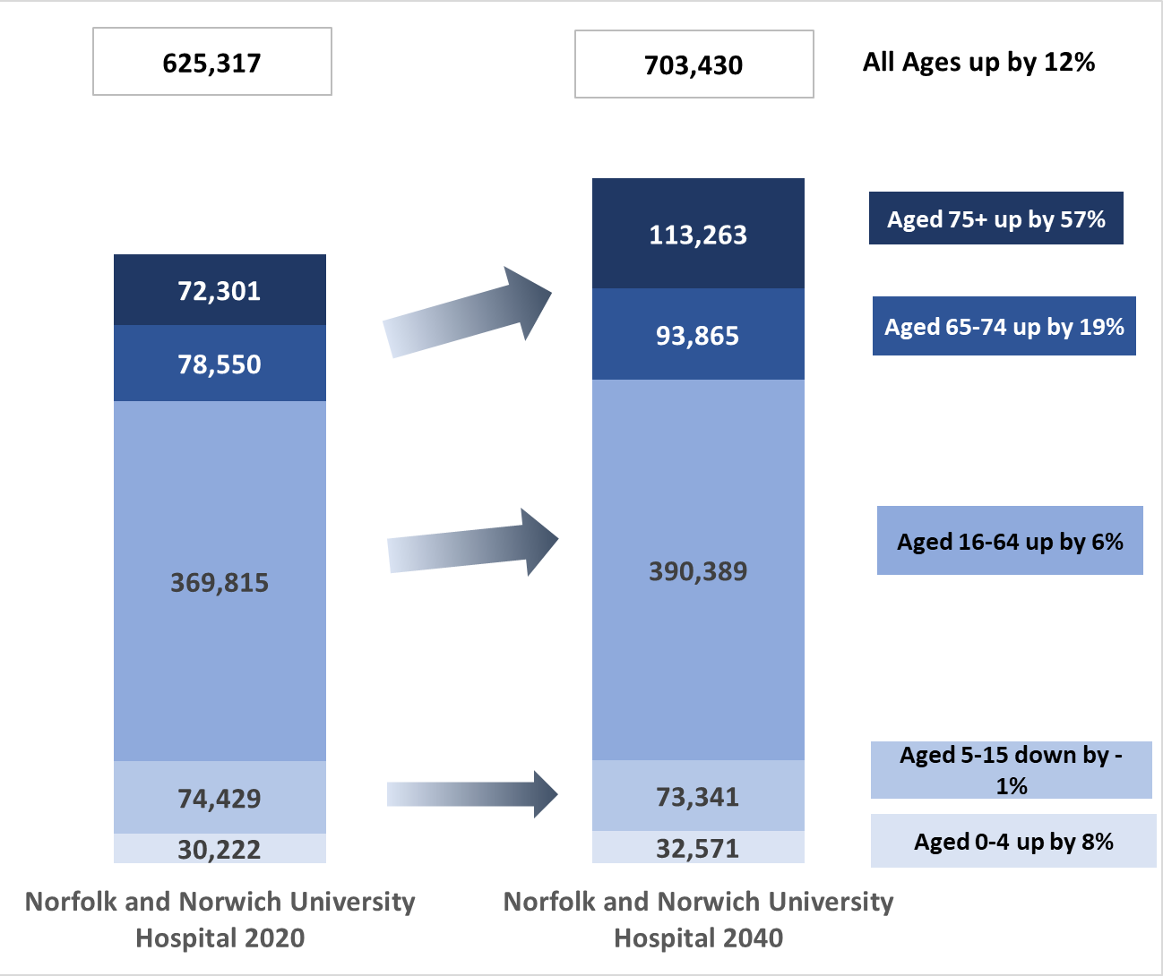
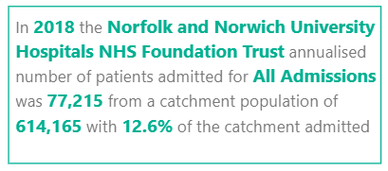
Analysis of hospital catchment populations indicates that for the Norfolk and Norwich University Hospital
(NNUH) admissions are drawn from across Norfolk and Waveney. By 2040 the NNUH catchment population is expected to increase by about 12% overall (about 78,000 people) with the largest increase in older age groups those aged 75+
Norfolk and Norwich University Hospital
Largest increases in older age groups but also some increase in working age and 0-4s
Source: https://app.powerbi.com/view?r=eyJrIjoiODZmNGQ0YzItZDAwZi00MzFiLWE4NzAtMzVmNTUwMThmMTVlIiwidCI6ImVlNGUxNDk5LTRhMzUtNGIyZS1hZDQ3LTVmM2NmOWRlODY2NiIsImMiOjh9

Slide 28
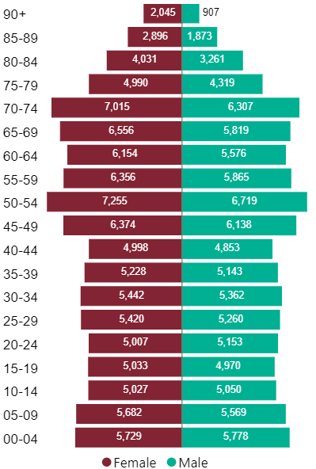
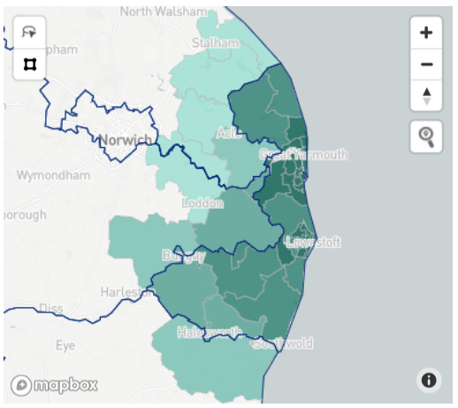
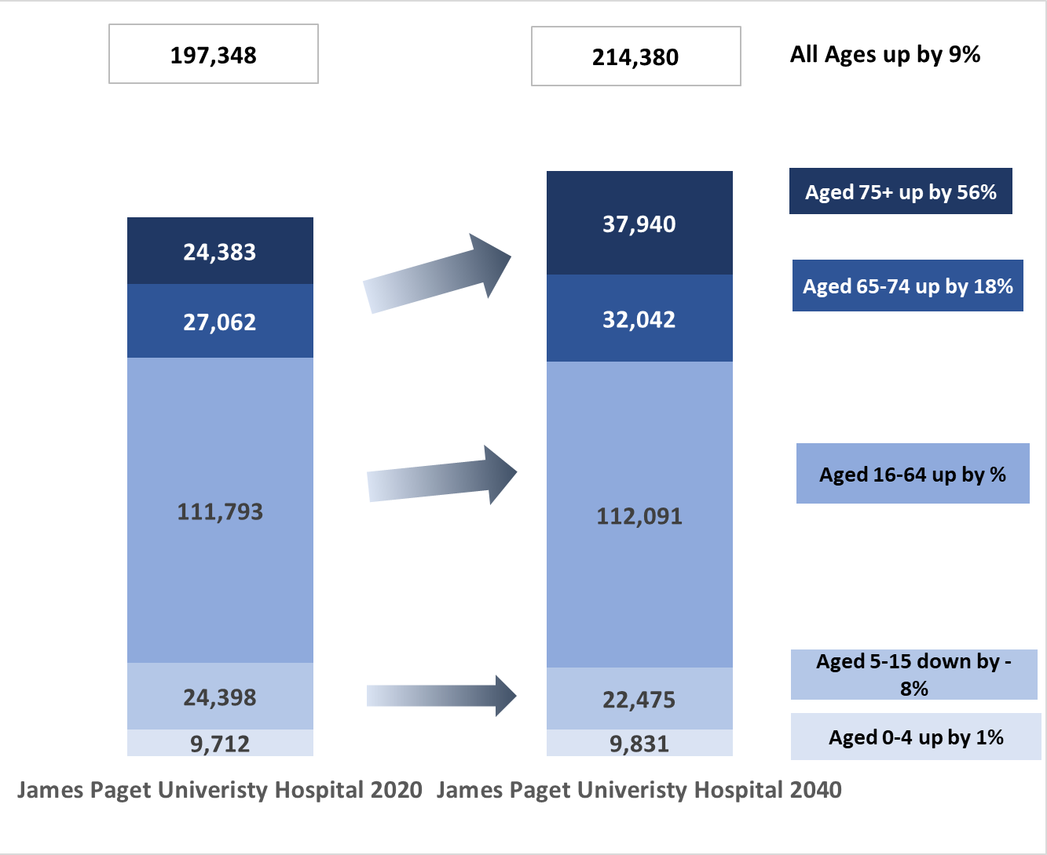
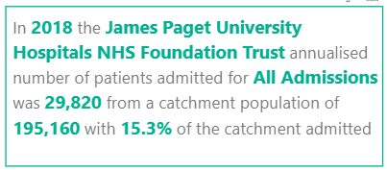
Analysis of hospital catchment populations indicates that for the James Paget University Hospital
(JPUH) most of the admissions are drawn from Great Yarmouth and former district of Waveney and some of the surrounding districts. The JPUH catchment population is expected to increase by about 9% overall (about 17,000 people) with the largest increase in older age groups those aged 75+
James Paget University Hospital
Increases in older age groups but zero change or decreasing in working age and younger
Source: https://app.powerbi.com/view?r=eyJrIjoiODZmNGQ0YzItZDAwZi00MzFiLWE4NzAtMzVmNTUwMThmMTVlIiwidCI6ImVlNGUxNDk5LTRhMzUtNGIyZS1hZDQ3LTVmM2NmOWRlODY2NiIsImMiOjh9

Slide 29
Links
Norfolk Insight: https://www.norfolkinsight.org.uk/
Norfolk’s Story: https://www.norfolkinsight.org.uk/jsna/document-library/norfolks-story/
ONS population estimates: https://www.ons.gov.uk/peoplepopulationandcommunity/populationandmigration/populationestimates
ONS population projections: https://www.ons.gov.uk/peoplepopulationandcommunity/populationandmigration/populationprojections
ONS components of change: https://www.ons.gov.uk/peoplepopulationandcommunity/populationandmigration/populationestimates/datasets/analysisofpopulationestimatestoolforuk
Office of Health Improvement and Disparities Hospital catchment population: https://app.powerbi.com/view?r=eyJrIjoiODZmNGQ0YzItZDAwZi00MzFiLWE4NzAtMzVmNTUwMThmMTVlIiwidCI6ImVlNGUxNDk5LTRhMzUtNGIyZS1hZDQ3LTVmM2NmOWRlODY2NiIsImMiOjh9
29

Slide 30
5. Ethnicity
This chapter details the ethnic breakdown of the Norfolk and Waveney population. Information related to the most recent census (2010) is included together with more recent estimates from the ONS
Potential other sources of information on populations by ethnicity include:
Annual Population Survey
School census
National Immunisation Management System GP practice population data
Geodemographic estimates
INTRAN
30

Slide 31
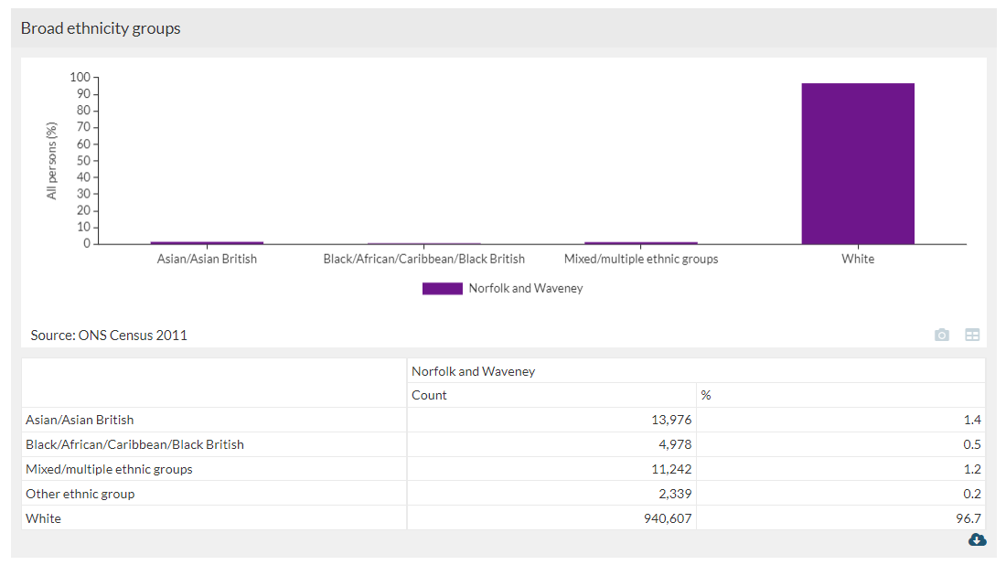
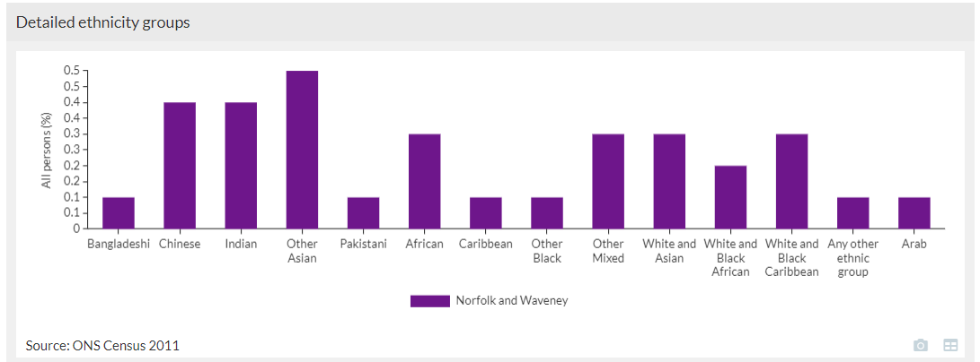
2011 national census – Norfolk and Waveney
The Norfolk and Waveney population is less ethnically diverse than average in England.
Norfolk & Waveney’s ethnic make-up was characterised by a predominantly White 940,607 (96.7%).
The proportion of people with an ethnic group other than White was 3.3%.
The most diverse areas across Norfolk and Waveney are Norwich, Great Yarmouth and Breckland.
There are around 160 languages spoken in Norfolk & Waveney. English is not the first language of around 12,400 school children in the county.
There is potential to use geodemographic models and school census information to understand variation at smaller area.
31

Slide 32
More recent estimates of ethnicity (ONS 2019)
The ONS have produced more up-to-date ethnicity population estimates based on the Annual Population Survey, these are not classed as official statistics on population but can be used as an interim indicator of population change within local authority areas prior to release of the latest census statistics (due in the second half of 2022).
These estimates exclude unknowns but are broadly similar to other recent datasets such as NIMS GP practice register populations. The most diverse areas of Norfolk and Waveney are Norwich Great Yarmouth and Breckland.
Ethnic Group (ONS 2019) | Breckland | Broadland | Great Yarmouth | King's Lynn and West Norfolk | North Norfolk | Norwich | South Norfolk | Waveney | Norfolk | Norfolk and Waveney | England
White British | 89.7% | 97.6% | 87.9% | 90.1% | 98.1% | 82.0% | 90.2% | 96.6% | 90.1% | 91.2% | 78.7%
All Other White | 8.8% | 0.8% | 7.1% | 7.9% | 1.9% | 7.2% | 4.5% | 2.6% | 5.6% | 5.3% | 6.2%
Mixed / Multiple ethnic groups | 0.0% | 0.0% | 1.0% | 0.0% | 0.0% | 0.0% | 2.3% | 0.9% | 0.6% | 0.5% | 1.8%
Asian / Asian British | 0.7% | 1.6% | 2.0% | 0.7% | 0.0% | 6.5% | 3.0% | 0.0% | 2.1% | 1.9% | 8.0%
Black / African / Caribbean / Black British | 0.0% | 0.0% | 0.0% | 1.3% | 0.0% | 2.9% | 0.0% | 0.0% | 0.8% | 0.6% | 3.5%
Other ethnic group | 0.7% | 0.0% | 2.0% | 0.0% | 0.0% | 1.4% | 0.0% | 0.0% | 0.8% | 0.5% | 1.9%
https://www.ons.gov.uk/peoplepopulationandcommunity/populationandmigration/populationestimates/articles/researchreportonpopulationestimatesbyethnicgroupandreligion/2019-12-04/relateddata
32

Slide 33
Ethnicity estimates from Annual Population Survey - % ethnic minority UK national
Name | 2020-03 | 2020-06 | 2020-09 | 2020-12 | 2021-03
Breckland
Broadland | 4.1 | 3.9 | 3.7 | 3.7
Great Yarmouth
King's Lynn and West Norfolk | 4.5 | 4.1 | 2 | 1.4 | 1.7
North Norfolk |  |  |  |  | 1.3
Norwich | 4.2 | 3.9 | 4.7 | 4.8 | 4.4
South Norfolk | 2.6 | 2.5 | 2.3 | 1.6 | 1.9
Norfolk | 2.5 | 2.3 | 2.2 | 2 | 1.6
Annual population survey suggests that Norwich has the most diverse population, with North Norfolk having the least. The UK average in 2019 was 14.4% (ONS).

Slide 34
Links
NOMIS Annual Population Survey: https://www.nomisweb.co.uk/query/construct/summary.asp?mode=construct&version=0&dataset=17
Norfolk Insight: https://www.norfolkinsight.org.uk/
ONS Ethnicity Estimates based on Annual Population Survey: https://www.ons.gov.uk/peoplepopulationandcommunity/populationandmigration/populationestimates/articles/researchreportonpopulationestimatesbyethnicgroupandreligion/2019-12-04/relateddata
ONS Local Area Migration Indicators: Local area migration indicators, UK - Office for National Statistics (ons.gov.uk)
Asylum and Resettlement data: Asylum and resettlement datasets - GOV.UK (www.gov.uk)
34

Slide 35
6. People with disabilities and vulnerable populations
This chapter includes some of the information available on numbers people with disabilities and vulnerable populations.
35

Slide 36
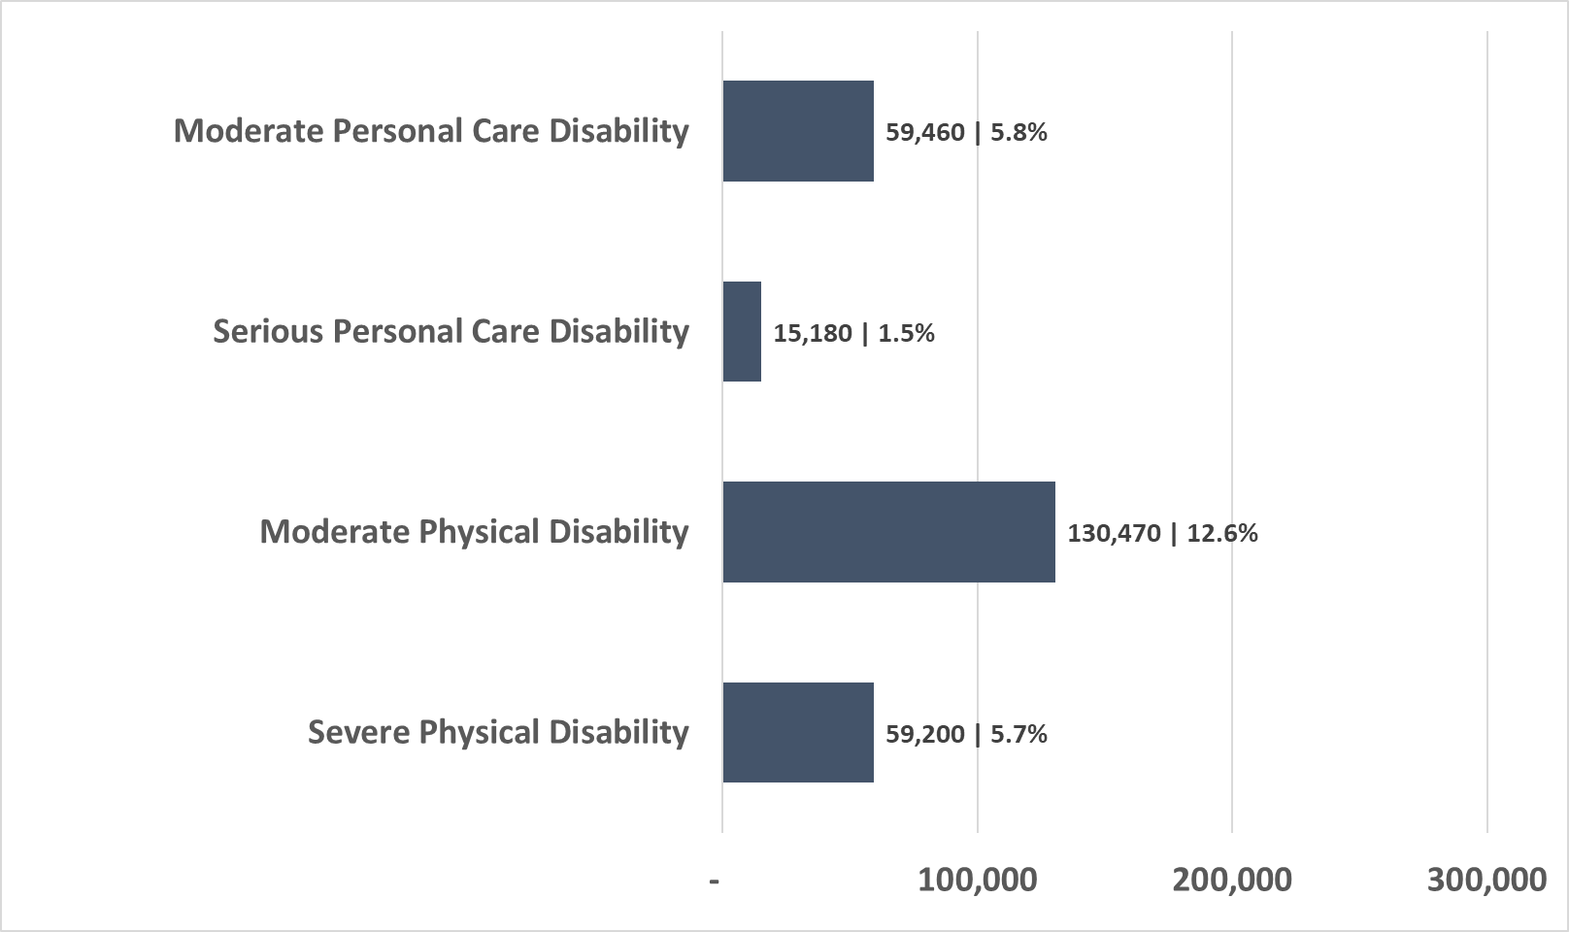
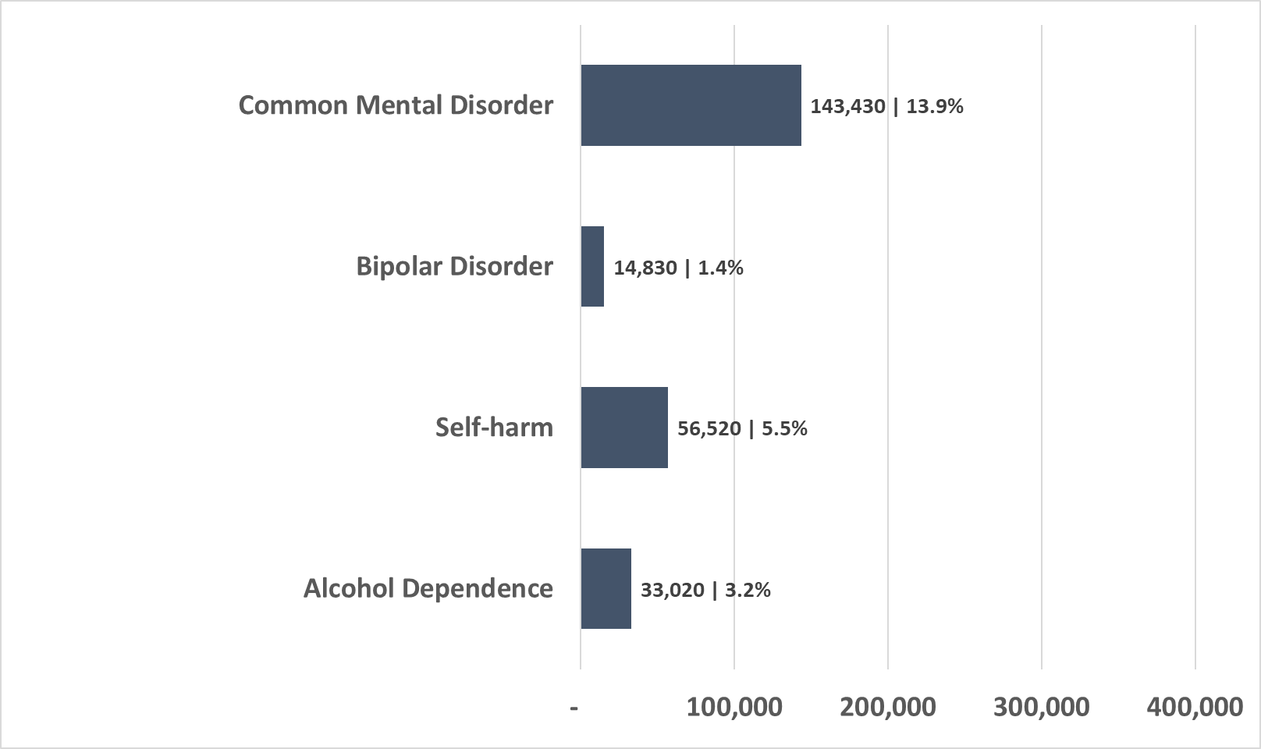
Selected population estimates for people with disabilities and mental health issues
Examples of estimates of numbers of people with physical and personal care disability based on POPPI and PANSI and 2020 ONS mid-year population estimates.
Examples of estimates of numbers of people with selected mental health issues based on adult psychiatric morbidity survey.
For more population estimates for people with disabilities visit:
https://www.pansi.org.uk/
https://www.poppi.org.uk/
For more information visit:
https://digital.nhs.uk/data-and-information/publications/statistical/adult-psychiatric-morbidity-survey
https://academic.oup.com/ije/article/49/2/361/5625684

Slide 37
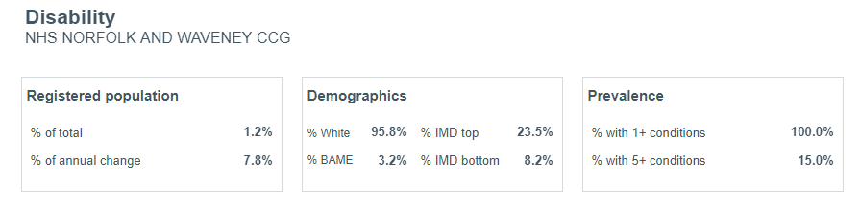
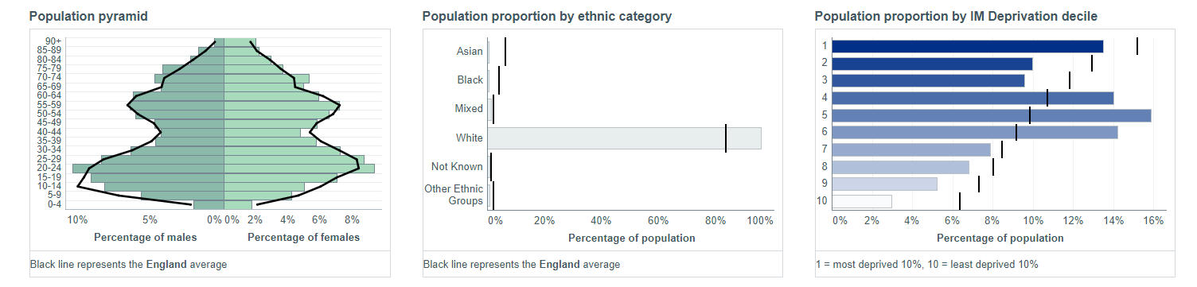
Estimates of people with disabilities based on segmentation information from NHS population and person insight dashboard
Based on the NHS population and person insight dashboard about 1.2% of the registered population has a disability. This is about 13,200 people and includes people with a physical disability, a learning disability and autism. The information might be an underestimate as it is based mainly on national NHS data returns. However, it does provide estimates of the types of associated long term condition co-morbidities.
https://tabanalytics.data.england.nhs.uk/t/viewpoint/views/Segmentation/SegmentSummary

Slide 38
Links
Homelessness by local authority: https://www.gov.uk/government/statistical-data-sets/live-tables-on-homelessness
For more population estimates for people with disabilities visit:
Projecting Adult Needs and Service Information https://www.pansi.org.uk/
Projecting Older People Population Information System https://www.poppi.org.uk/
38

Slide 39
7. Births
This chapter on births details trends, fertility and the variation across Norfolk & Waveney.
39

Slide 40


Birth Trends
Total live births in Norfolk and Waveney have been just below 70,000 between 2013 and 2019, decreasing from just over 10,000 to just over 9,000 births per year over that period.
The most live births have been in Norwich, and the fewest in North Norfolk
40

Slide 41


General Fertility Rate
The general fertility rate is the number of live births per 1,000 women aged 15-44 years old. In Norfolk and Waveney this has declined from just over 61 births per 1,000 to just over 54 births per 1,000 from 2013-2019. Rates in Norfolk and Waveney have been lower than the England rates since 2013
There is substantial variation among local areas, with highest rates in King’s Lynn and West Norfolk and Great Yarmouth, and lowest rates in Norwich. Part of the reason for the low rate in Norwich is the large student population.
41

Slide 42



General Fertility Rate
The map highlights those communities with the highest general fertility rates. These are located in Great Yarmouth, King’s Lynn and Lowestoft with some in the rural areas of West Norfolk. Across Norfolk and Waveney the general fertility rate is lower than England. In line with England the birth rate decreases as deprivation decreases. The likely reason for the lowest rate in the least deprived area is due to the location of university of East Anglia in this decile
https://www.localhealth.org.uk/#bbox=522639,357728,156061,94156&c=indicator&i=t2.fertility&view=map7
42

Slide 43
Links
Live births are taken from Office for National Statistic estimates: Nomis - Official Labour Market Statistics (nomisweb.co.uk)
General Fertility rates are calculated by comparing live births against mid-year population estimates for women aged 15-44 in the same year: Estimates of the population for the UK, England and Wales, Scotland and Northern Ireland - Office for National Statistics (ons.gov.uk)
Locality level general fertility rate and other useful population indicators are available from: https://www.localhealth.org.uk/
43

Slide 44
8. Life Expectancy
This chapter details life expectancy and healthy life expectancy for both men and women in Norfolk.
Life expectancy is a measure of the average time a person is expected to live, based on their year of birth, current age and other demographic factors such as gender. Healthy life expectancy shows the number of years a person can expect to live in good health.
Life expectancy gives context to healthy life expectancy figures by providing information on the estimated length of life. The two indicators are extremely important summary measures of mortality and morbidity in a population.
44

Slide 45


Life Expectancy at birth
Life expectancy at birth measures the average number of years a person would expect to live if current death rates remain constant. Current data for the period 2018-2020 show that life expectancy for both men and women in Norfolk & Waveney was higher than England at about 79.9 years and 83.8 years, respectively.
For much of the decade prior to the pandemic, up to 2019, Norfolk had been experiencing a slowdown in improvement of life expectancy year on year. Similar to what has been seen in England.
45

Slide 46




Variation in Life Expectancy 2015-2019
Life expectancy varies by neighbourhood in Norfolk and Waveney. The maps below show the variation in life expectancy at birth, at MSOA level across Norfolk and Waveney, for the period 2015-19.
Lighter areas depict localities with higher life expectancies, for example Eaton (83.6 for males, 87.5 for females). Darker areas show areas with lower life expectancy, for example Yarmouth Parade (72.4 for males, 79.3 for females). Great Yarmouth and King’s Lynn have the lowest life expectancy in Norfolk and Waveney and are also some of the most deprived local areas; in contrast Eaton has one of the highest, is also one of the least deprived areas in Norfolk and Waveney.
There are 14 MSOAs across Norfolk and Waveney with male life expectancy in the lowest quintile listed above
There are 8 MSOAs across Norfolk and Waveney with female life expectancy in the lowest quintile listed above

Slide 47

Deprivation and inequality in life expectancy at birth 2017-2019
The steepness of the slope represents the inequality in life expectancy that relates to deprivation in Norfolk; if there was no inequality the line would be horizontal. The life expectancy gap between the most deprived areas of Norfolk and the least deprived areas is 7.4 years for men and 4.4 years for women. The steeper the line, the greater the level of inequality in life expectancy as a result of deprivation.

Slide 48

Change in life expectancy gap between most and least deprived between 2012 and 2019
In terms of absolute life expectancy difference between most and least deprived 10% of the population the gap is 8.6 years for males and 6.8 years for females (2017-19). This has increased since 2012 for females but remained similar for males.

Slide 49


Contributors to inequality in life expectancy 2015-2017
Life expectancy least deprived
Life expectancy most deprived
The coloured bars on the charts indicate difference in life expectancy if the death rate for that cause was the same as in the least deprived areas of Norfolk and Waveney. The bigger the bar, the greater the potential for improvement. For example, if the male death rate for cancer was the same in the most deprived areas as in the least deprived, people in the most deprived areas would live around a year longer. Males in the least deprived quintile have a life expectancy of almost 83, and deaths from circulatory diseases reduces the life expectancy by a year and a half for those from the most deprived quintile. For females in the least deprived quintile have a life expectancy of almost 86 years, and deaths from cancer reducing the life expectancy for the most deprived quintile by more than a year.
Higher death rates for each cause for this mean that cumulatively males from the most deprived quintile have a life expectancy six years lower than those from the least deprived. The difference is nearly five years for women. This gap is different to that in the slope index of inequality because it is comparing areas from the most deprived local quintile, rather than national.

Slide 50


Healthy Life Expectancy
Healthy life expectancy measures the average number of years a person would expect to live in generally good health. So, for example, a man may have a life expectancy of 80 years, but his healthy life expectancy may only be 65 years. This means the last 15 years of his life will be lived in poorer health.
Healthy life expectancy in Norfolk is lower than for England at about 62.7 years for males and about 62.4 years for females and has decreased over the last few years. This means that the period that people spend in ill health in Norfolk is getting longer and is 17.4 years for males and 21.7 years for females.
Norfolk Male Life Expectancy 80.1 years 2017-19
Norfolk Female Life Expectancy 84.1 years 2017-19
50

Slide 51
Links
ONS Life Expectancy Estimates: https://www.ons.gov.uk/peoplepopulationandcommunity/healthandsocialcare/healthandlifeexpectancies/datasets/lifeexpectancyestimatesallagesuk
Fingertips: https://fingertips.phe.org.uk/
Life expectancy segmentation tool: https://analytics.phe.gov.uk/apps/segment-tool/
51

Slide 52
9. Deaths
This chapter details deaths occurring in Norfolk and where possible Waveney. This includes total deaths, leading causes of death and trends in early deaths from selected conditions (those under 75). Here we have included trends up to 2019 to show leading causes of death just prior to COVID19.
52

Slide 53



Total Deaths Norfolk and Waveney
Between 2009 and 2019 there were about 11,000 deaths a year from all causes in Norfolk & Waveney.
The number of deaths has been increasing and there are now slightly more male deaths than female deaths. The number of deaths is greater than the number of births.
The age standardised mortality rates for males and females have been consistently lower than England and have been gradually changing in line with England. There was an increase in 2020 with the deaths associated with COVID19
Deaths in 2020
Male = 6,383
Female = 6,319
Total = 12,702
53

Slide 54


Trends in leading causes of death for Norfolk and Waveney to 2019
The leading causes of death based on Office for National Statistics sub-categories. If we look at deaths considering the number of people and their age, we see changes in death rates. Trends in age standardised mortality rates from leading causes of death between 2010 and 2019 show:
the death rates from heart disease (ischaemic heart disease) and stroke (cerebrovascular disease) have reduced by about 40% since 2010
the death rate from lung cancer has continued to decline (for men) but the death rate from breast and prostate cancer has remained about the same
there has been a doubling of the death rate from Dementia
the death rate due to liver disease has gradually increased
Female age standardised rates
Male age standardised rates
54

Slide 55



Variation in total mortality rate
There were around 11,500 deaths in Norfolk and Waveney in 2019, lower than the England average. Great Yarmouth and Norwich had the highest all cause mortality rates, and Broadland and North Norfolk the lowest. The map illustrates areas with higher age-standardised death rates before COVID-19.
55

Slide 56


Norfolk and Waveney Males: leading causes of death for specific age groups naturally differ. But prior to COVID19, circulatory conditions, respiratory conditions and cancer are in the top five causes of death across most age groups. These conditions are also distributed in the top 20 long term conditions and account for some of the highest numbers of avoidable admissions
*
*
* Values suppressed due to small numbers
Norfolk and Waveney Males (average deaths in Norfolk per year for each cause)
England Males (average deaths in England per year for each cause)
This is the average for the three years 2017, 2018, 2019 prior to COVID19
56

Slide 57


Norfolk and Waveney Females: the leading causes of death for specific age groups naturally differ. But prior to COVID19, circulatory conditions, respiratory conditions and cancer are in the top five causes of death across most age groups. These conditions are also distributed in the top 20 long term conditions and account for some of the highest numbers of avoidable admissions
*
*
* Values suppressed due to small numbers
Norfolk and Waveney Females (average deaths in Norfolk per year for each cause)
England Females (average deaths in England per year for each cause)
This is the average for the three years 2017, 2018, 2019 prior to COVID19
57

Slide 58


Including COVID19 males: Across Norfolk and Waveney the leading causes of death for specific age groups for 2020. COVID19 was the 3rd leading cause of death for males in 2020
*
*
* Values suppressed due to small numbers
Norfolk and Waveney Males
England Males
This is for 2020 and includes COVID19
58

Slide 59


Including COVID19 females: Across Norfolk and Waveney the leading causes of death for specific age groups for 2020. COVID19 was the 4th leading cause of death for females in 2020
*
*
* Values suppressed due to small numbers
Norfolk and Waveney Females
England Females
This is for 2020 and includes COVID19
59

Slide 60



Premature mortality
Premature mortality is a high-level indicator of the overall health of a population, being correlated with many other measures of population health: there are significant differences between the premature death rates in different areas, reflecting a wide range of underlying differences between these populations.
The rate of deaths for people under the age of 75 was significantly lower than in England but higher than in the East of England up to the end of 2019 in Norfolk and Waveney. Norwich and Great Yarmouth had a significantly higher rate of deaths compared to the national average.
60

Slide 61


All deaths considered preventable
The basic concept of preventable mortality is that deaths are considered preventable if, in the light of the understanding of the determinants of health at the time of death, all or most deaths from the underlying cause (subject to age limits if appropriate) could mainly be avoided through effective public health and primary prevention interventions.
There were around 1,900 preventable deaths per year in Norfolk and Waveney in 2016-18, this was lower than the England average but above the East of England average. The map illustrates areas with higher age-standardised rates.
61

Slide 62


The risk factors making the biggest contribution to mortality were tobacco, high blood pressure, diet and high blood glucose. These also make a significant contribution to morbidity along with high body mass index (or obesity), alcohol, drug use and occupational risks.
Risk factors attributed to YLDs or deaths cannot be summed together. In addition, these risk factors are connected, and individuals often have more than one risk factor. Prevalence of multiple risk factors is higher in men, the White ethnic group, lowest income households, most deprived areas, and people with long term health conditions.
Inequalities in risk factor prevalence contribute to inequalities in ill health and mortality. In 2019, smoking prevalence remained much higher than average in some groups, for example, people in manual occupations (23.2%), people with a long-term mental health condition (25.8%), deprived areas (16.9%), and the Mixed ethnic group (19.5%). The prevalence of ‘increasing or higher risk’ drinking was greatest in the highest household income group at 34.8%. The prevalence of obesity in adults was higher in the most deprived than least deprived areas, and there were wide inequalities in the proportion of adults meeting recommended level of physical activity and fruit and vegetable consumption.
Sourced from https://fingertips.phe.org.uk/static-reports/health-profile-for-england/hpfe_report.html#detailed-analysis-and-charts-5

Slide 63
Links
Civil registration dataset: https://digital.nhs.uk/services/data-access-request-service-dars/dars-products-and-services
Fingertips mortality profile: https://fingertips.phe.org.uk/profile/mortality-profile
NOMIS mortality data for leading cause of death: https://www.nomisweb.co.uk/home/release_group.asp?g=23
ONS deaths: https://www.ons.gov.uk/peoplepopulationandcommunity/birthsdeathsandmarriages/deaths
63

