Slide 1
Infant Feeding Survey Results
431 Respondents
Notes:
NNUH = 67.99%
JPUH = 18.46%
QEH = 14.49%
2021 = 34.57%
2020 = 26.68%
2019 = 19.49%
Before 2019 = 19.26%

Slide 2
Themes (QEH)
Regardless of whether birthing people intend to breast or bottle feed it is important to ensure famillies remain informed and supported throughout the antenatal period as their pregnancy develops and infant feeding options may change. Some respondents highlighted that sharing their intentions meant the end of information and/or support rather than an ongoing conversation.
"I was only asked if I was breast or bottle feeding and wasn't really given any further information about either option."
Realistic information, advice and support regarding breast, bottle, combi and supplemetary feeding antenatally which recognises the challenges of feeding would have been helpful for many respondents. Specific gaps identified were expressing, tandem nursing, feeding twins, tongue tie, as well as knowing how often to feed a newborn baby, when to wake them for feeding / how long in between feeds, how to make up a bottle, what is a good latch, what to expect in terms of milk flow and the common signs of feeding problems/challenges. For many reasons postnatally this information can be forgotten and/or change in appropriateness due to complications/changes in childbirth and feeding plans so it is important to continue providing non-judgmental information, advice and support regarding breast, bottle and combi feeding to all birthing people, with some respondents sharing the pressure they felt to breast feed. Amongst birthing people with previous feeding experience it was felt that they received less information and/or support, as assumptions made rather than recognition that their current journey may be very different.
"It seemed that as soon as I said breastfeeding they were happy with my answer"
"I wanted to bottle feed and I felt so much pressure to breast feed I changed my mind"
"It felt as soon as I said I was going to be bottle feeding no one wanted to know myself or my baby. As a first time mum I felt I was left on my own." compared to
"It was lovely to be told by a student nurse that a fed baby is what matters, this was after I shared my feelings about breast feeding and the bad experience with my first son".

Slide 3
Themes (QEH)
The importance of non-judgmental advice and support when birthing people are experiencing issues/challenges in feeding their baby, to enable them to understand and explore other feeding methods/options e.g. using shield, pump.
Need for consistency in feeding information, advice and support across midwives, doctors and other health care professionals to reduce "confusing and conflicting advice". There was strong appreciation of the Infant Feeding Team, NICU and other knowledgeable staff recognising their helpfulness and understanding of different and appropriate feeding methods. The importance of improving awareness and understanding of infant feeding across the workforce, particularly in relation to the signs/symptoms of tongue tie, was noted given the sometimes limited availability of the Infant Feeding Team.
Value of initial practical support particularly from midwifes, for example teaching techniques/positions, and regular visits to ask how feeding is going so that birthing people do not feel they have to 'chase' support. The importance of the following characteristics was frequently quoted non-judgmental, friendly, helpful, encouraging, thoughtful, knowledgeable, supportive, reassuring and understanding.
Benefit of supporting birthing people as much as possible to ensure latch and feeding correctly before discharge and ensuring that information given on how and where to access ongoing support at home including local orgs/groups and where to meet other breastfeeding parents.
There were some comments about QEH's policy of only treating babies for tongue tie until 6 weeks and how this can exclude famillies particularly those with a late diagnosis and who are unable to travel to Norwich. There were also comments about the lack of follow up support after a tongue tie procedure.

Slide 4
Themes (NNUH)
Informed consent and decision making
BFI audit highlighted lack of informed decision making around top up feeds
Information sharing about FF is poor e.g. implications when deciding to mix feed or provide a top up when in hospital
Antenatal education on breastfeeding can be poor so this does not support making informed choice to breastfeed
Antenatal Education
Families don’t realise during pregnancy but they can be unprepared especially around realistic expectations of breastfeeding
Lots of comments about not feeling prepared, relying on internet groups for their questions.
Many people wished they had been told about tongue tie before their baby was born so they would know what to look out for and could push for help sooner.
Support
Lack of continuity of care was mentioned several times. Mix of having to explain experience and problems to lots of different people and conflicting information depending on who is supporting.
Many people commented that they felt signposting to support should be improved.
People who formula fed felt that they were given less support at hospital and those breastfeeding were prioritised.
Many people commented on the Infant Feeding Teams being stretched, it’s interesting that service users knew this.
Peer supporters praised and more joined up working between hospital, community, volunteers, health visitors mentioned.
Many people commented that they wished the support was proactive rather than reactive. So rather than just solving problems empowering people with information and reaching out to check in on people.
Could peer supporters make phone calls or offer Zoom drop ins after 1 month, 2 months??

Slide 5
Themes (NNUH)
Partners
Several people mentioned it was important to value partners when educating and supporting breastfeeding.
Other themes...
Is our infant feeding and breastfeeding support culturally aware/culturally safe? Is our infant feeding and breastfeeding support ready to support those with additional needs and disabilities?
Please don’t assume just because we have had a baby before or breastfed before we won’t need help or support this time. Different baby, different circumstances all provide challenges
Please don’t assume that just because we have breastfeeding established in the first 28 days that everything will be fine from there
Please make us feel listened to, this may seem like a minor concern or not a concern at all to you - but if it was important enough for us to ask then please be supportive.
Please be respectful in how you speak and care for us - we might be feeling vulnerable and want to do our best.
For many of us breastfeeding is really important and lots of emotions are tied up in our success. Sometimes we can be made to feel really pressured to breastfeed.

Slide 6
Themes (JPUH)
Antenatal Education
Uninformed about the challenges that could occur when breastfeeding
Felt left to trawl through websites and leaflets with limited support
No information given on bottle feeding
Lack of information on expressing and colostrum harvesting
Second time parents and beyond felt uninformed and unsupported
During Pregnancy
Most families felt supported in their decision to breastfeed
A family who chose to bottle feed did not feel supported in their decision
While families felt supported to breastfeed they felt uninformed about breastfeeding
Families who were consultant led report not being asked about their choice of feeding method
Ward 11
Families only sometimes felt supported in their breastfeeding journey
Lack of time with staff, particularly on weekends
Not seeing the feeding specialists
Formula being pushed
Some families report great support and staff with plenty of time

Slide 7
Themes (JPUH)
Feeding Challenges at home
Only two families report being offered a referral to an NHS feeding specialist
Families did know where to seek support and a lot sought external support in the form of Baby café,volunteer groups and IBCLCs.
Those that accessed external support, some of which was NHS led, found it excellent
Support given at tongue tie clinic also excellent
Some families felt after receiving support for jaundice and feeding plans they were left to it
Families report conflicting information from Health Care Practitioners as hard to deal with in the postnatal period.
Families want to be able to access more face to face support both during and after delivery along with more information on what is normal and what is not normal with breastfeeding to enable them to identify problems much sooner.

Slide 8
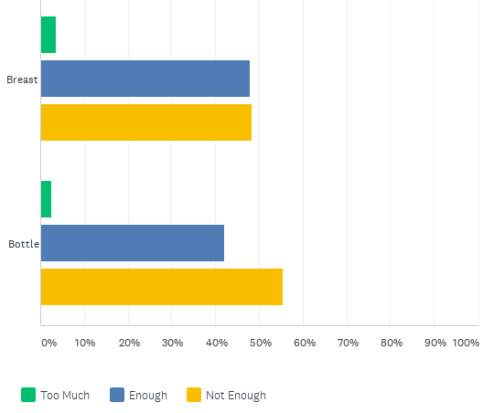
During pregnancy, how much information did you receive regarding breast and bottle feeding?
Notes:
All Responses - similar pattern/trend if filtered by each hospital for births in 2021 and 2020.

Slide 9
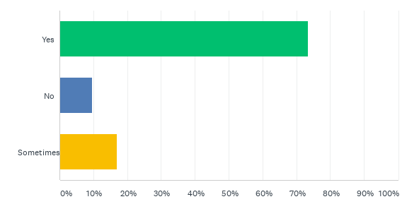
During pregnancy, did you feel supported in your feeding choices?
All Responses
Notes:
2021 & 2020 Births
NNUH - Yes = 74.38%, No = 10% and Sometimes = 15.63%.
QEH - Yes = 65.12%, No = 6.98% and Sometimes = 27.91%.
JPUH - Yes = 77.55%, No = 14.29% and Sometimes = 8.16%.

Slide 10
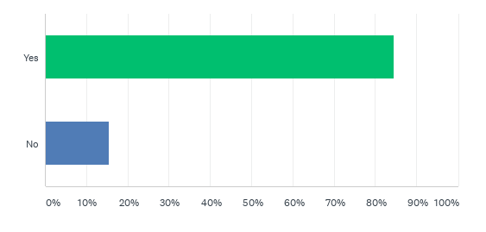
Did you stay on a postnatal ward after the birth of your baby?
All Responses
Notes:
2021 & 2020 Births
NNUH - Yes = 82.10%, No = 17.90%
QEH - Yes = 93.02%, No = 6.98%
JPUH - Yes = 92%, No = 8%

Slide 11
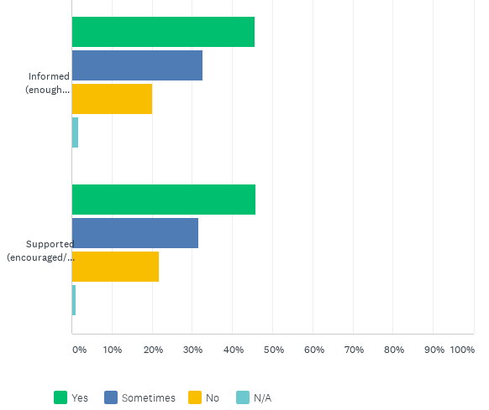
Once your baby was born, did you feel well informed and supported in your feeding decisions while on the postnatal ward?
All Responses
Informed (enough information)
Supported (encouraged/given practical advice etc)
Notes:
2021 & 2020 Births
NNUH:
Informed - Yes = 45.90%, Sometimes = 34.43%, No = 17.21%
Supported - Yes = 40.98%, Sometimes = 34.43%, No = 23.77%
QEH:
Informed - Yes = 52.78%, Sometimes = 27.78%, No = 19.44%
Supported - Yes = 58.33%, Sometimes = 30.56%, No = 8.33%
JPUH:
Informed - Yes = 44.19%, Sometimes = 34.88%, No = 20.93%
Supported - Yes = 48.84%, Sometimes = 25.58%, No = 25.58%

Slide 12
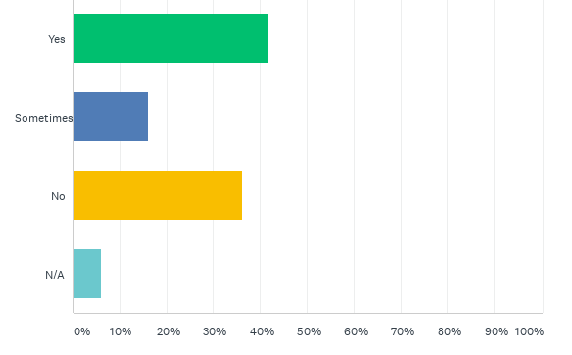
While on the postnatal ward did you feel you received/could receive the same amount of support overnight (compared to during the day)?
All Responses
Notes:
2021 & 2020 Births
NNUH - Yes = 40.16%, Sometimes = 16.39%, No = 35.25%
QEH - Yes = 50%, Sometimes = 16.67%, No = 27.78%
JPUH - Yes = 48.84%, Sometimes = 11.63%, No = 30.23%

Slide 13
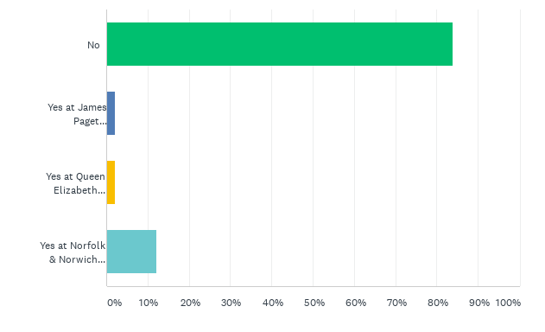
Did your baby spend time in a Neonatal Intensive Care Unit (NICU)? (Select all that apply)
2021 & 2020 Births
Notes:
All Responses:
No = 83.95%
Yes at JPUH = 2.11%
Yes at QEH = 2.11%
Yes at NNUH = 12.11%

Slide 14
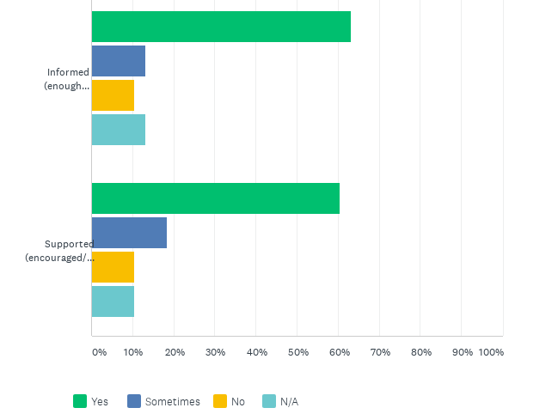
Did you feel well informed and supported in your feeding choices for your baby while on NICU?
2021 & 2020 Births
Informed (enough information)
Supported (encouraged/given practical advice etc)
Notes:
QEH Comments:
"I had been supported during our immediate stay at the Rosie in cambridge. Once we move back to the QE I was not asked about how feeding/ expressing was or if I needed help."
"Only spent one morning on NICU ward but were under NICU care on castlacre ward. Lots of advice given but was often conflicting."
"It wasn't made clear to me whether my baby would need a feeding tube, but in the end he did not need one."

Slide 15
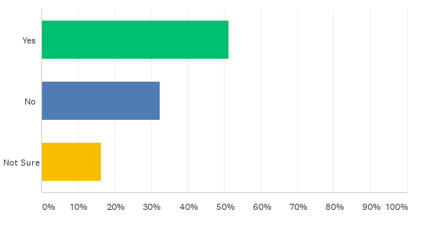
Did you feel you were given consistent information from all Health Care Professionals about feeding your baby (however you chose) when on NICU?
2021 & 2020 Births
Notes:
2021 & 2020 Births
QEH - Yes = 33.33%, No = 33.33% and Not Sure = 33.33%
“Everybody had differing advice and favourite techniques when feeding and winding.”
"No information given."
JPUH - Yes = 75%, No = 25% and Not Sure = 0%
NNUH - Yes = 50%, No = 35.71% and Not Sure = 14.29%

Slide 16
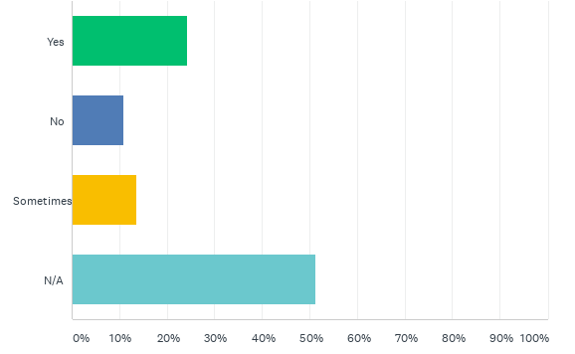
If your baby had top up feed during their stay on NICU did you feel supported in moving to breastfeeding your baby once at home?
2021 & 2020 Births
Notes:
2021 & 2020 Births
QEH - Yes = 33.33%, No = 16.67%, Sometimes = 0% and N/A= 50%
“I was allowed to go and stay with my babies in NICU to establish breastfeeding before they went home.”
JPUH - Yes = 50%, No = 0%, Sometimes = 0% and N/A= 50%
NNUH - Yes = 17.86%, No = 10.71%, Sometimes = 17.86% and N/A= 53.57%

Slide 17
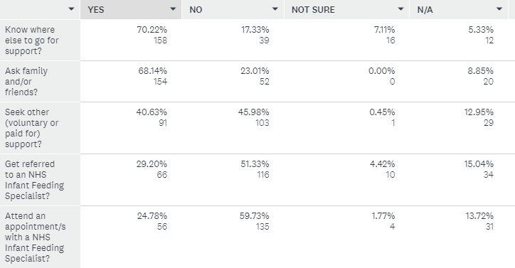
If you experienced challenges in feeding your baby once at home, did you…
2021 & 2020 Births
Notes:
Same order for all responses.

Slide 18
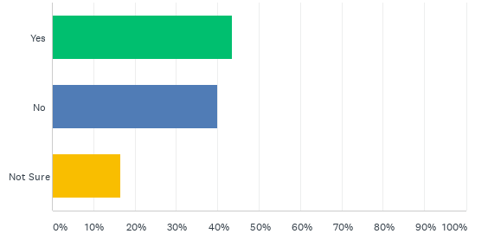
Did you feel you were given consistent information from all Health Care Professionals regarding postnatal feeding support once at home?
All Responses
Notes:
2021 & 2020 Births
QEH - Yes = 52.78%, No = 33.33% and Not Sure = 13.89%
JPUH - Yes = 55.56%, No = 31.11%, and Not Sure = 13.33%
NNUH - Yes = 41.78%, No = 40.41%, and Not Sure = 17.81%

Slide 19
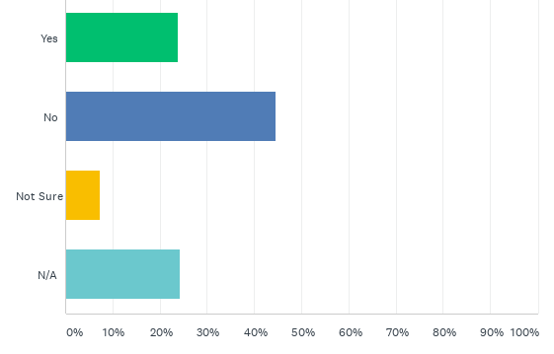
Did you feel you were given consistent information from all Health Care Professionals regarding Tongue Tie?
All Responses
Notes:
2021 & 2020 Births
QEH - Yes = 45.95%, No = 18.92% and Not Sure = 5.41%
JPUH - Yes = 35.56%, No = 33.33%, and Not Sure = 6.67%
NNUH - Yes = 20.41%, No = 50.34%, and Not Sure = 5.44%

Slide 20
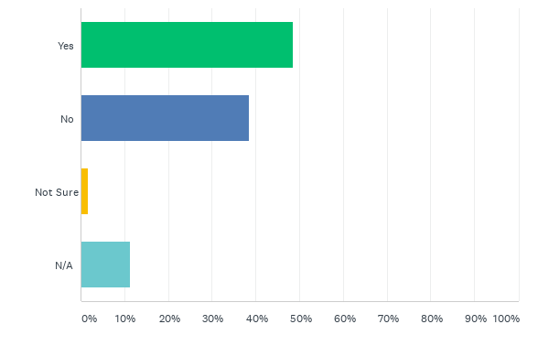
Did anyone speak to you about the possibility of your baby having a Tongue Tie?
All Responses
Notes:
2021 & 2020 Births
QEH - Yes = 54.05%, No = 29.73% and Not Sure = 0%
JPUH - Yes = 53.33%, No = 33.33%, and Not Sure = 0%
NNUH - Yes = 48.30%, No = 43.54%, and Not Sure = 1.36%

Slide 21
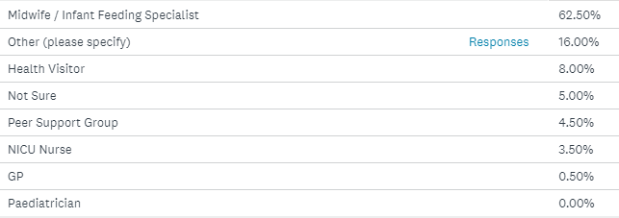
If yes, who was this?
All Responses
Notes:
Other e.g. Lowestoft and Waveney Breastfeeding Support, Friend, Midwifery Support Worker, Lactation Consultant, Clinic, Breastfeeding Norfolk.
2021 & 2020 Births
Midwife / Infant Feeding Specialist
Other (please specify)
Health Visitor
NICU Nurse
Not Sure
Peer Support Group
GP
Paediatrician

Slide 22
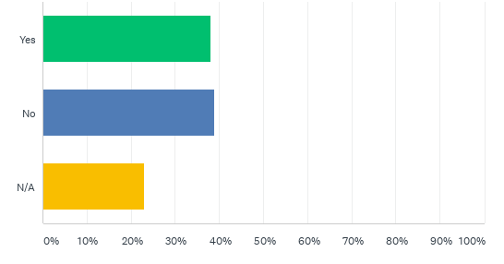
Was your baby diagnosed with Tongue Tie at a clinic (NHS or Private)?
All Responses
Notes:
2021 & 2020 Births
Yes = 37.84% and No = 39.29%

Slide 23
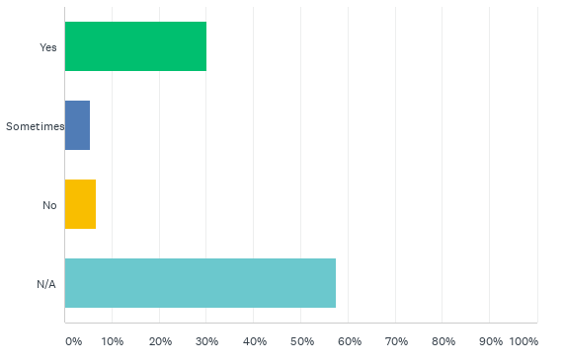
Did you feel supported following your babies Tongue Tie diagnosis at a NHS Tongue Tie clinic?
All Responses
Notes:
2021 & 2020 Births
Yes = 30%, Sometimes = 5.91% and No = 6.36%

Slide 24
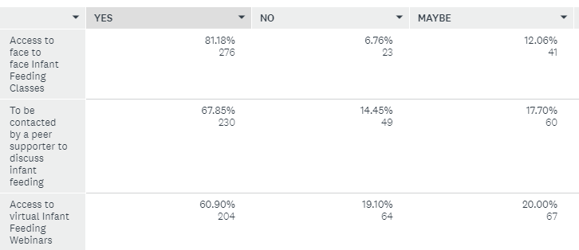
During pregnancy would you have liked...
All Responses
Notes:
Same order for 2021 and 2020 births.

Slide 25
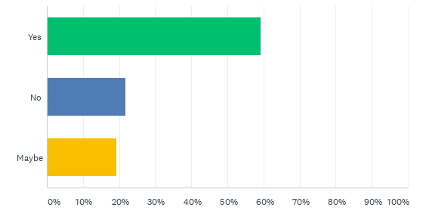
If your baby required additional milk for medical reasons would you be interested in talking about donor breastmilk. (This milk will have been screened and checked to ensure it is safe for your baby)
All Responses

Slide 26
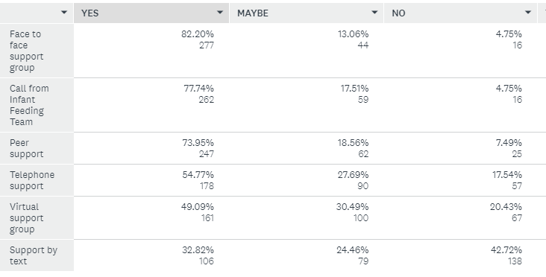
After your baby's birth (postnatally) what support would you have liked to help you with feeding your baby?
All Responses
Notes:
Value of physical/face to face support alongside online resources.

