Slide 1
Patient Safety Partners Recruitment Pack
November 2022

Slide 2
We’re Recruiting Patient Safety Partners
Could you be a voice for service users and patients across the Norfolk & Waveney Integrated Care System (ICS)?
We are seeking motivated and interested individuals who are committed to contributing to safe and effective care to enhance patient experience and improve patient outcomes.
PSP’s will be renumerated for their work and receive a payment of £75 for a half day and £150 for a full day of their involvement and input.
For further information please email:
christopher.turner8@nhs.net
Call: 07717646195

Slide 3

Welcome
Thank you for your interest in becoming a Patient Safety Partner within the Norfolk and Waveney Integrated Care System.
In June 2021, the new ‘Framework for Involving Patients in Patient Safety’ was published by NHS England. This framework sets out approaches and standards that help to make a positive difference to how patient safety is viewed and managed in the NHS.
A key part of the framework introduces Patient Safety Partners; empowering patients and their carers to be involved in their own safety, as well as being partners alongside staff in improving patient safety in NHS organisations.

Slide 4
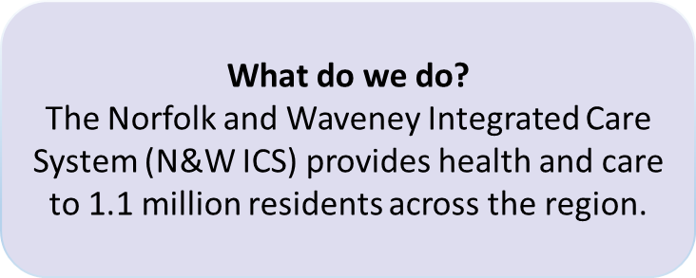
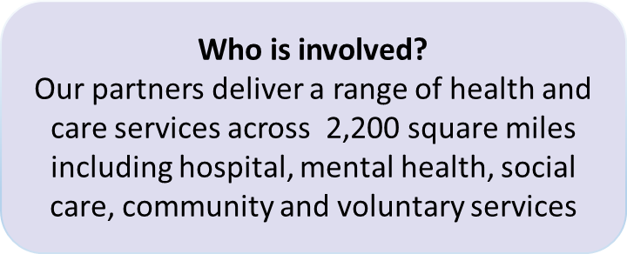
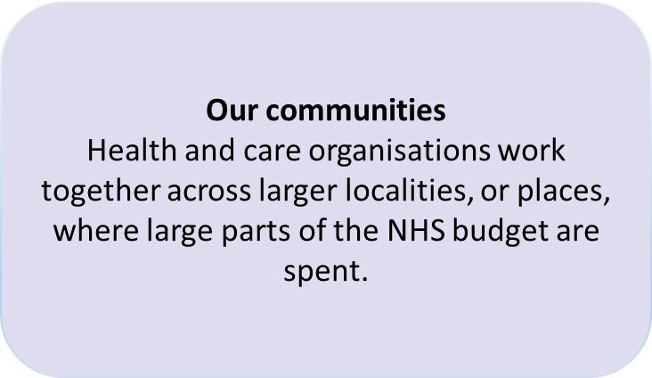
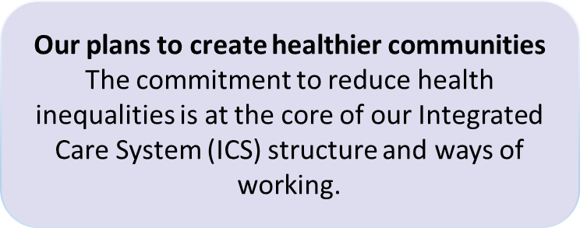
Norfolk & Waveney Integrated Care System

Slide 5
Which Providers are seeking Patient Safety Partners?
We are seeking 6 Patient Safety Partners to work with us across three areas of our Healthcare partnerships and take part in patient safety related areas of work.

Slide 6

What work would you be involved in?
The following are examples of work you would be involved with;
  Membership of Quality and Safety Committees
  Review and analysis of safety related information
  Involvement in patient safety-related projects
  Participation in investigation oversight groups
The roles attract an involvement payment at certain meetings and reimbursement for reasonable expenses.
The main role of the patient safety partner is to ensure that the patient voice is heard within our organisation, with the core purpose of improving safety and quality.
The role is for an 12-month fixed period.

Slide 7

What are we looking for?
Skills and Experience
Candidates will need to have a genuine commitment to developing and improving the safety of health services along with an understanding of patient safety. The ideal candidate will have personal or lived experience relating to local NHS healthcare services.
As an advocate of patient safety, there is a requirement that candidates will have the confidence to communicate well verbally with senior leaders over strategic issues and provide a patient carer or lay perspective. They will be willing to challenge as a ‘critical friend’.
Time Commitment
The time commitment for each Patient Safety Partner will be dependent on the areas of work that they are involved with, and can be discussed during our discussions. We aim to be as flexible as possible.

Slide 8

What are we looking for?
Diversity and Equality of Opportunity
Norfolk and Waveney Integrated Care Board values and promotes diversity and is committed to equality of opportunity for all. To help us understand if we are achieving this, we ask you to fill out an equal opportunity monitoring form as part of the application process. Please let us know if you have support needs so that we can understand how we can support you to participate fully.
We particularly welcome expressions of interest from:
People living in the most deprived areas that Norfolk and Waveney Integrated Care System covers.
People with protected characteristics as listed in the Equality Act (2010). These are: age, disability, gender reassignment, marriage and civil partnership, pregnancy and maternity, race.
The successful Patient Safety Partners will be required to attend a number of meetings, some of these may be face to face while others will be held remotely via Microsoft Teams.

Slide 9

How we will support you?
Training and Support
Successful candidates will:
Be fully supported in their role and will be provided with ongoing supervision and support. We will ensure that you are supported to develop within your role, in areas such as decision making. We will ensure that your views and feedback are heard and responded to.
Need to be willing to receive training in patient safety and attend other mandatory training sessions relevant to the role. A range of learning and development opportunities are also available to Patient Safety Partners.

Slide 10
How will we pay you?
Expenses and Renumeration
Patient Safety Partners will be paid in line with the national involvement payments developed by NHS England. This includes involvement payments of £150 per day or £75 per half day when supporting certain areas such as strategic level Committees and key decision making groups.
For other working groups including policy development, reasonable out of pocket expenses are covered.
Each Patient Safety Partner’s remit will include a mix of formal Committees and working groups or project work. The details will be agreed with each Patient Safety Partner, and it is anticipated that the role will evolve over time.
Involvement payments are seen by HMRC, the Job Centre and insurance companies as income. So, this has implications for interested candidates as Patient Safety Partners may have to pay tax or declare income that can affect their benefit or insurance pay-outs. Norfolk and Waveney has a responsibility to advise successful candidates that they should declare the income to HMRC, their insurance company or the job centre, as appropriate.

Slide 11

How to Apply
If you are interested in applying for the Patient Safety Partner role, would like to discuss further or require help with the expression of interest process then please contact:
Christopher Turner on 07717646195
Please complete the expression of interest form carefully, we will rely on the information you provide in the form to assess whether you have the skills and experience required for this role.
Please send completed expression of interest forms via email to christopher.turner8@nhs.net, or by posting it to;
    Chris Turner
    Patient Safety Specialist
    Norfolk and Waveney Integrated Care Board
    County Hall
    Martineau Lane
    Norwich, Norfolk NR1 2DH
    Please mark envelope ‘Private and Confidential’

Slide 12

Application Process
All expressions of interest received will be shortlisted by a panel.
Applications will be assessed against the skills and experience required.
Selection will be made on the basis of the content of the expression of interest form.
Informal interviews will be arranged for successful applicants.
Please note that two references will be taken up for successful applicants before starting in the role.
All applications will receive a successful or unsuccessful notification.
The successful notifications will include information about next steps.
Additional Information
We would not expect individual applicants to have all capabilities and skills.
A Disclosure and Barring Service (DBS) check may be required for this role.

Slide 13
Links to Relevant Resources
Patient Safety Partner Expression of Interest Form
Equality and Diversity Form
Patient Safety Partner Role Description
NHS England Framework for Involving Patients in Patient Safety
Link to organisation website: https://improvinglivesnw.org.uk/

