Slide 1
Integrating Health and Care in Sussex ICS
The importance of developing an effective ICS with a clinically and care professionally driven culture - why you are critical to its success
Mike Farrar CBE, FRCGP, FRCP

Slide 2

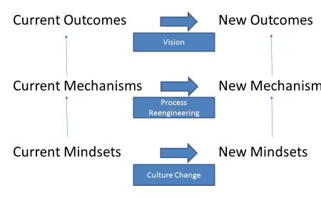
THE CLINICAL AND CARE PROFESSIONAL LEADERSHIP GROUP IN SUSSEX NEED TO OPERATE AT ALL THREE LEVELS
THE KEY REQUIREMENT IS FOR ORGANISATIONAL LEADERS TO UNDERSTAND THAT VISION, PROCESSES AND MINDSETS HAVE TO BE SHARED IF PARTNERSHIPS ARE TO SUCCEED

Slide 3

Vision
Setting out a compelling narrative
Rational and emotional connection and engagement
Appeal through benefits - address both the personal and higher goals and concerns
Consider the eclectic nature of your audience and find ways to connect (eg time frame)
Paint the picture of how it would be when we achieve your vision
Avoid technocratic language or jargon
The power of stories

Slide 4
Creating the Vision
Developing a compelling
new narrative
Accepting the reality that change is needed and that we won’t succeed by doing the same things that we have always done (even more so due to financial and workforce constraints)
Political and managerial courage to lift our heads and find ways to work better
Build a case based on measurement and evaluation but also addresses emotional drivers
Recalibration of our short versus medium and long term focus
Embrace the new era of data and technologically enabled care and that new providers of care are emerging quickly with ‘direct to consumer’ offers
Workforce shortages require a change of approach
Building a new compact with the public built on trust and fairness recognising the shift in power and removal of information asymmetry

Slide 5

Mechanisms
Every system is perfectly designed to get the results it gets
Aligning incentives
Work patterns and workload
Financial flows
Rewards and penalties
Boundaries and hand offs
Now v then
Here v there
Common purpose/partnerships

Slide 6
Developing New Mechanisms
Changing our operating model and business processes
Aligning the financial, regulatory and workforce incentives (recruitment, retention, team working)
Using data to target resources to greatest need (links with registration issues) and ensuring everyone has a shared version of the truth (impacts on behaviours)
Recognising the importance of scale and formal collaboration
Setting standards for the earlier parts of the pathway and being prepared to do this constructively and in a learning context
Disproportionate investment - access to agile capital and public private investment partnerships
Making the adoption of new technology easier
Adopting shared care as a fundamental first step of the pathway with systematic processes to deliver it
Engaging with the community based voluntary and social enterprise sector

Slide 7

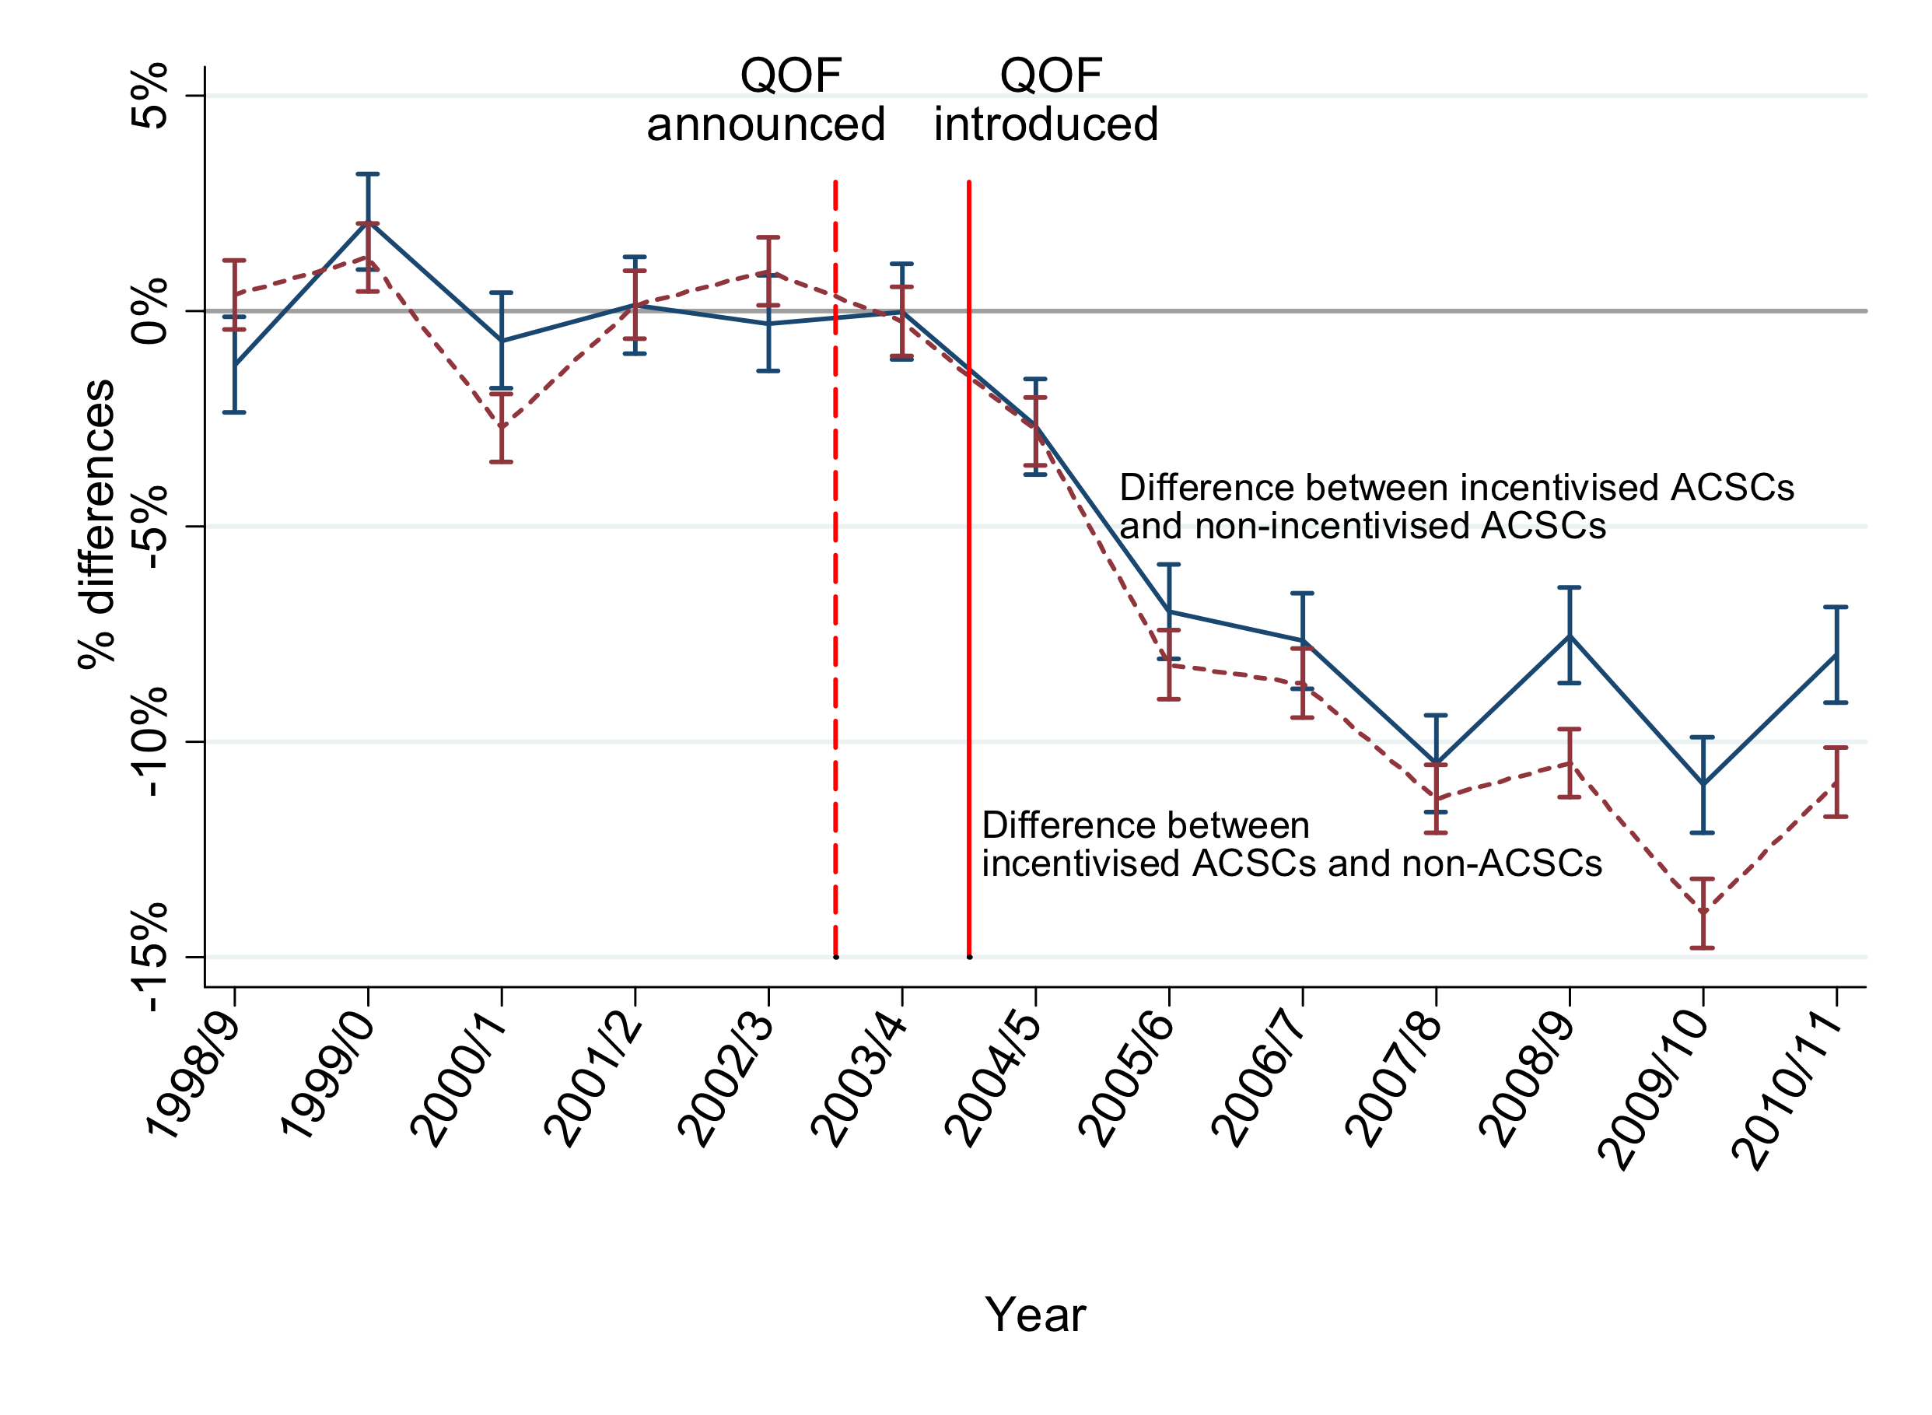
Effect of the Primary Care Quality and Outcomes and Hospitalisation and admissions
This chart shows the impact of introducing quality incentives for primary care clinicians to manage chronic conditions, thereby reducing hospital admissions. But GPs didn’t receive major benefit of this, rather hospitals were the main beneficiaries due to tariffs
NHS UK data
ACSC - Ambulatory Sensitive Conditions
QOF - Quality and Outcome Framework

Slide 8

Mindsets and culture
Sustainable change
Action to reveal them
Listening skills
Non judgemental attitude
Why is the most important question
Review and remind - constant questioning
Honesty and psychological safety
Mindsets start at home ….

Slide 9
Challenge Existing Mindsets
Create a different view of our working world
Challenge the long-standing power base of secondary over primary; specialist over generalist
Remember the principles of holistic care (Alma-Ata declaration) - physical, mental and social - challenge purely biomedical model
Challenge paternalistic and maternalistic approaches to healthcare but develop the ‘meeting of experts’ concept
Clinical and care professional empowerment
We should discriminate based on need…. (Informed by data - if we are really serious about equity and fairness and safe care)
From reactive to proactive; volume to value (eg QOF)
Develop and promote leaders who understand vulnerability, humility and empowerment as tools of great leadership - the keys to system governance & leadership

Slide 10
Learning Series
Forward Schedule
November 10 - Clinical Strategy and Advisory Work - Driving change
November 24 - Data and Intelligence - the state of the art
December 8 - Finances and financial flow
December 22 - Personal resilience and well being
January 19 - Managing up and managing politically
February 2 - Creating high performing teams
February 16 - Meetings and the mystery of how they work

Slide 11
Change Management Project
Applying knowledge into practice
Commitment to apply learning as we go and share learning
After today, selection of a topic or challenge (individual or as a small group)
Define scope and scale and outcomes
Work in practice - record process
Sharing with other course members in small groups
Bringing back learning and reflections to the whole group
Short inputs into our meetings (set up group learning platform)

