Slide 1
Integrating Health and Care in N&W ICS
Leadership Development Programme
Clinical Strategy and Aligning the Clinical Advisory Machinery
Mike Farrar CBE, FRCGP, FRCP

Slide 2
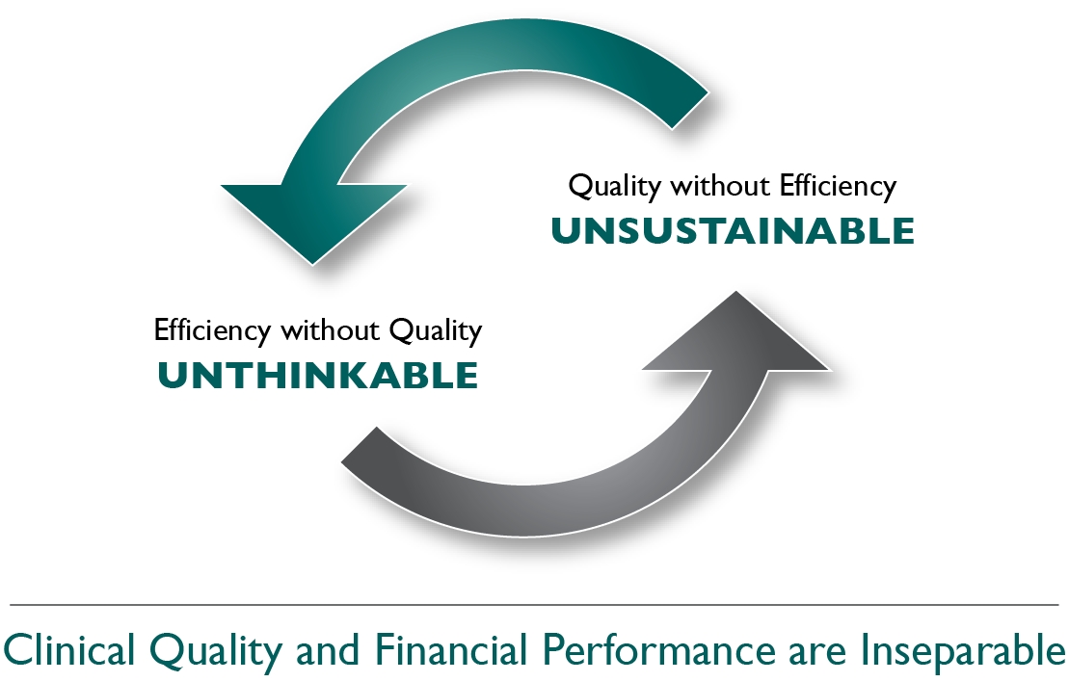
THE FUNDAMENTAL CHALLENGE AT THE HEART OF HEALTH AND CARE SYSTEMS

Slide 3
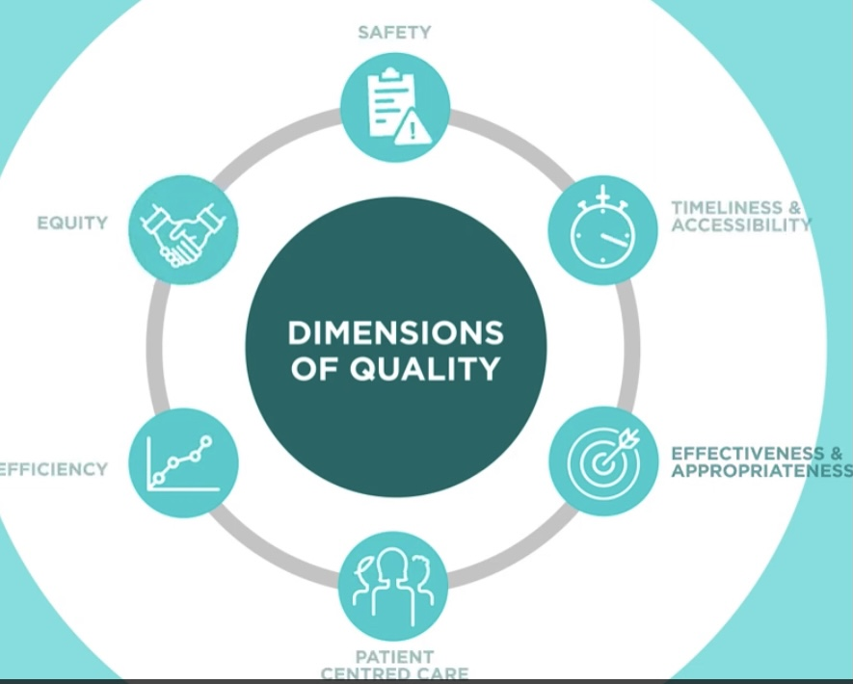
SIX DIMENSIONS OF QUALITY (BERWICK)
RELIABILITY, UNWARRANTED VARIATION
WAITING TIMES ELECTIVE CARE
HEALTH INEQUALITIES
TRIAGING
RISK ASSESSMENT
4.3% v 3.9%
VIRTUAL
NOSOMIAL INFECTION

Slide 4

Aligning Clinical Advisory machinery
Most structures were created to support commissioning processes - but the context for decision making is changing
ICS Boundaries - devolution of budgets (PC, SC, Spec Care)
ICS Clinical Leadership Roles
Reorientation of GP input from CCG to PCN and representation in the new structures more limited amd corporate
Provider Collaboratives taking on responsibility directly
Consistency of pathway delivery
Holistic care enhanced so more attention to physical, social and mental health issues
Multiple morbidity, frailty, complex needs, inequalities all move us away from silos and purely biomedical model of care

Slide 5
CLINICAL STRATEGY DEVELOPMENT AND IMPLEMENTATION
METHODOLOGY AND WORK PROGRAMMES
GOVERNANCE AND DECISION MAKING
PRIORITIES AND OUTCOMES
IMPLEMENTATION
CULTURE AND OPERATING MODEL

Slide 6
CLINICAL STRATEGY DEVELOPMENT AND IMPLEMENTATION
METHODOLOGY AND WORK PROGRAMME
unwarranted variation
site and location - eg Acute service reviews
pathway redesign
demand reduction eg frailty
service transformation
GOVERNANCE AND DECISION MAKING
Collaborative governance eg Committees in Common
Dispute resolution
Scrutiny and transparency
Joint planning
Agreement within ICS on Provider Collaborative leadership
PRIORITIES AND OUTCOMES
elective recovery
urgent care
vulnerable services
inequalities
financial and staffing sustainability
IMPLEMENTATION
Resource
Financial flow and aligned incentives
Workforce and leadership (sponsor Trust or CEO?)
Data, measurement and evaluation
CULTURAL FACTORS AND OPERATING MODEL
clinically driven through aligned clinical advisory machinery
public and service user engagement
effective consultation
partner engagement

Slide 7
Key Quality Priorities – Themes identified through Engagement
Reset and Recovery - Elective surgery waiting times
Access to General Practice services (including lack of equitable access due to disparity in patient digital access/competencies e.g., poor literacy, language difficulties; elderly; Learning Disability; Blind etc)
Onward Care
Improving Stroke and Cardiac Services; including locality issues for Herefordshire/Welsh border patients
[Lack of access to Dental Commissioned Services – currently NHSE commissioned inc. impact on secondary care orthodontic services and antimicrobial prescribing]
Antimicrobial Stewardship
Infection Rates (C. Diff; MSSA; E Coli]
Improving Mental Health Experiences; Suicide Prevention
Tissue Viability; Wound Management – inc. formulary alignment
Safeguarding Children (Herefordshire)
Advance Health Equality in our Communities
H&W ICS PRIORITIES SET BY CLINICIANS LINKED TO QUALITY………
NB – we can’t isolate quality from efficiency (performance) and resource (finance)

Slide 8
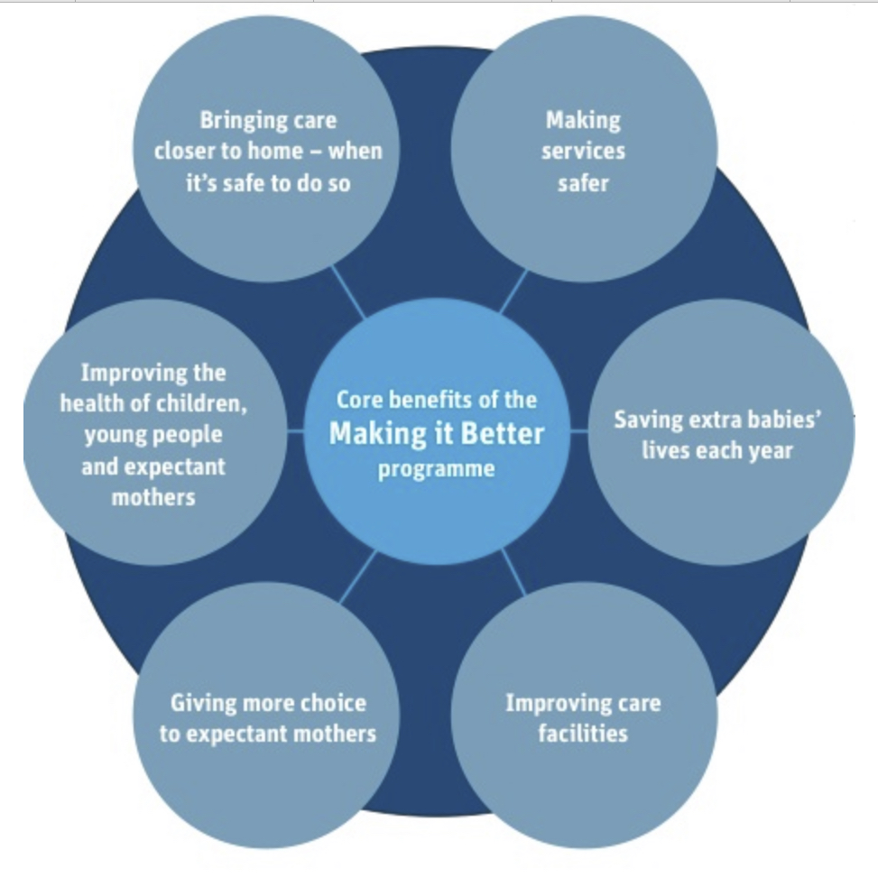
CLARITY AND SIMPLICITY OF KEY MESSAGES AND BENEFITS
MAKING IT BETTER
MATERNITY SERVGCES REVIEW - GREATER MANCHESTER
2012

Slide 9
Making it Better Case Study
Lessons from Major Clinical Service Reviews
Moved from 13 to 8 sites (3 with PICUs) offering consultant led maternity services in GM, including closing Salford Royal site. Added 3 midwifery led units and 1 PICU. Cost £10m. Took 5 years to consult and 5 years to implement. Saving xxx babies lives per year.
Clinically led business case and consultation - safer care, better outcomes,manage staffing shortages, hit quality standards
Robust data and strong resourced programme management (again with major commitment to clinical leadership)
Independent chair of implementation board (mediated between CEOs)
Changes in general leadership over the time period but constant excellent clinical leaders in place throughout
Referred to national review on two separate occasions and won the argument on both occasions

Slide 10
Examples of the evidence-based measures
Acute Myocardial Infarction (AMI)
Antiplatelet on arrival
Fibrinolysis received within 30 minutes of hospital arrival
Referral to Cardiac Rehab
Coronary Artery Bypass Graft (CABG)
Prophylactic antibiotic received within 1 hour prior to surgical incision
Use of internal mammary artery graft
Surgical checklist completed
Dementia (live from January 2011)
Nutrition assessment within 5 days
Cognitive ability assessment within 14 days
Tailored care plan at discharge
First Episode Psychosis (live from January 2011)
Care co-ordinator assigned within 1 day and service user informed within 3 days
Risk assessment within 30 days
Antipsychotic medication review within 6 weeks
Heart failure
ACEI or ARB for LVSD
Smoking cessation advice/counselling
Review by specialist in heart failure
Hip and knee replacement
Prophylactic antibiotic received within 1 hour prior to surgical incision
Prophylactic antibiotic selection for surgical patients
Chemical VTE within 12 hours of surgery end time
Pneumonia
Oxygenation assessment within 24 hours prior to or after hospital arrival
Antibiotic given within 6 hours after hospital arrival
CURB 65 documented
Stroke (live from October 2010)
Admission to a stroke unit within 4 hours of hospital arrival
CT scan within 24 hours of hospital arrival
Aspirin received within 24 hours of hospital arrival
Full list of measures via www.advancingqualitynw.nhs.uk
© Advancing Quality

Slide 11

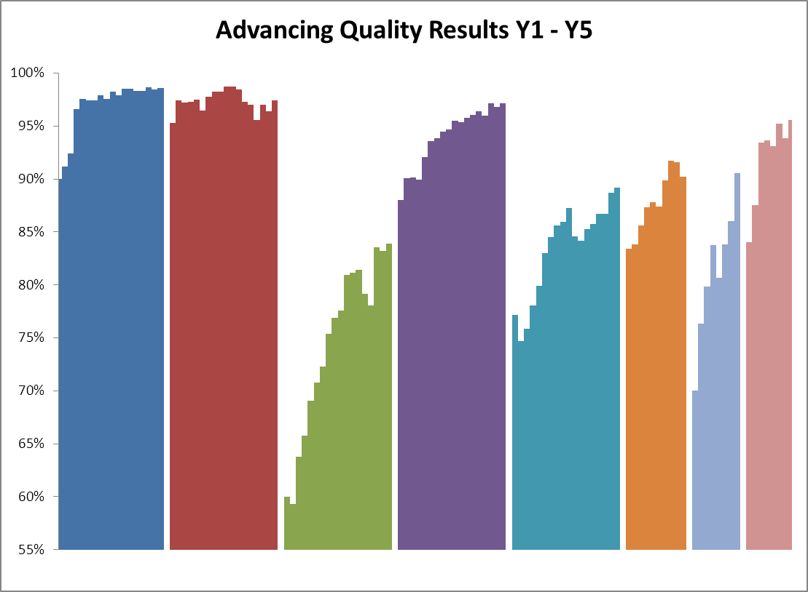
Results Y1 – Y5
The chart shows the quarter on quarter improvements across 32 hospitals in meeting best practice evidence based care through excellence in clinical engagement
Steady improvement, sustained
AMI CABG HEART FAILURE HIP&KNEE PNEUMONIA STROKE DEMENTIA PSYCHOSIS
North West Composite Quality Score over time
Notes:
Composite Quality Score over time

Slide 12
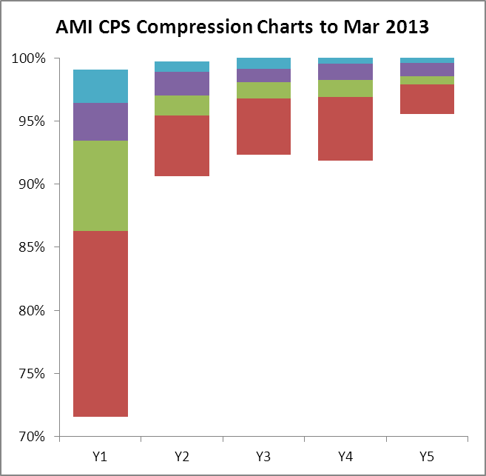
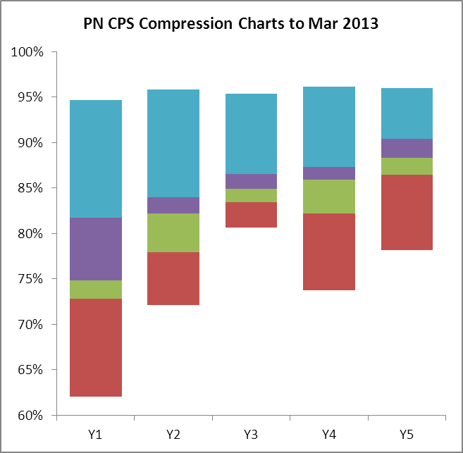
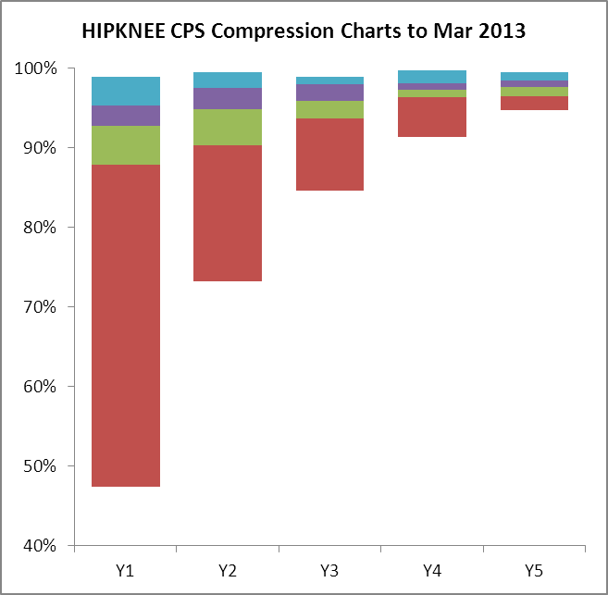
Reducing variation Y1 – Y5 (2008-2013)
AMI CQS compression Y1 –Y5
HK CQS compression Y1 –Y5
PNE CQS compression Y1 –Y5
The Chart shows the reduction in clinical variation in 32 hospitals in North West England whilst showing overall improvements. NEJM published the evaluation that showed around 1000 lives saved from improved pneumonia care and significant savings of £8 for every £1 invested in the programme.

Slide 13
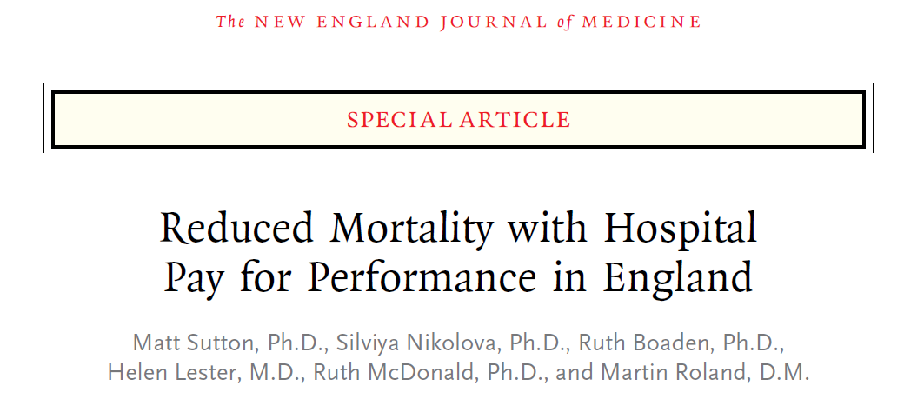
“Risk adjusted, absolute mortality for the conditions included in the pay-for-performance programme decreased significantly with an absolute reduction of 1.3 percentage points and a relative reduction of 6%, equivalent to 890 fewer deaths during the 18-month period.”

Slide 14
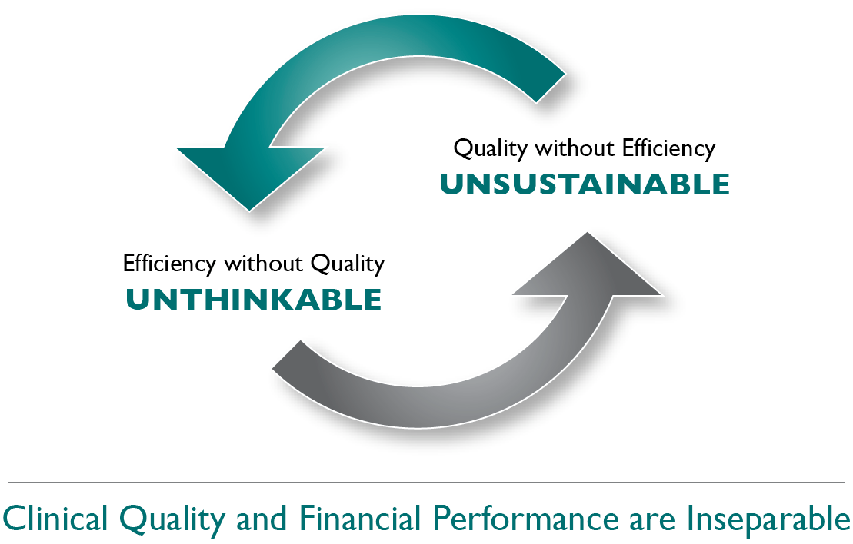
Cost effectiveness:
5,227 QALYs gained (Quality Adjusted Life Years – the number of extra months/years of life of a reasonable quality a person might gain as a result of treatment)
£105 million estimated health gains
Calculated using NICE conservative cost-effective threshold: £20,000 per QALY
Length of stay reduced by 22,802 bed days saving £4.4 million
8-fold return on investment
Researchers acknowledge they have overestimated costs and underestimated the benefits attributable to Advancing Quality
Notes:
Paper: The cost-effectiveness of using financial incentives to improve provider quality: a framework and application (Health Econ. (2013) DOI: 10.1002/hec)
Readmission rates are unchanged.
NICE explanation of QALY: http://www.nice.org.uk/newsroom/features/measuringeffectivenessandcosteffectivenesstheqaly.jsp

Slide 15

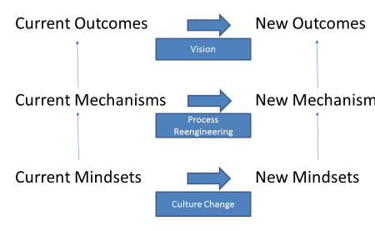
THE CLINICAL AND CARE PROFESSIONAL LEADERSHIP GROUP IN SUSSEX NEED TO OPERATE AT ALL THREE LEVELS
THE KEY REQUIREMENT IS FOR ORGANISATIONAL LEADERS TO UNDERSTAND THAT VISION, PROCESSES AND MINDSETS HAVE TO BE SHARED IF PARTNERSHIPS ARE TO SUCCEED

