Slide 1
Integrating Health and Care in in Norfolk and Waveney ICS
The importance of developing an effective ICS with a clinically and care professionally driven culture - why you are critical to its success
Mike Farrar CBE, FRCGP, FRCP

Slide 2
Provider Collaboration - why does this matter

Slide 3

Developing Effective Provider Collaboratives
Why this matters
Provider Collaboration is a fundamental component of the ICS operating model and culture (New Govt wrestling this as they consider the reform of ICSs)
ICSs will only deliver their promised value by creating structures, processes and incentives that enable providers to work together vertically (at place) and horizontally (across the ICS footprint and beyond)
Emerging Provider Collaboratives will be the vehicle to take on crucial responsibilities on behalf of the ICB such as elective recovery, reducing unwarranted clinical variation, financial balance and stability, demand management, reducing inequalities, workforce planning, clinical reconfiguration and pathway redesign etc.
Provider Collaboratives taking responsibility for finite pots of money for a given population are key to moving away from the purchaser provider split and enabling transformation, innovation and improved productivity for every pound we spend
Most successful integrated care systems internationally are built on a strong form of Provider Collaborative and ownership of the challenges by providers

Slide 4

Provider Collaboration is Not Easy
Most provider collaboration needs clarity of purpose and then O/D plus technical support
Context analysis - what is the role of the Provider Collaboratives in the new system
What form should your collaboration take ?
Developing behaviours and incentives to underpin a successful collaboration
Identifying and developing the Collaborative work programme
Governance and decision making (in collaboration and at Practice/Trust/department level)
The role of the Collaboratives(s) in the local ICS operating model
Delegations, accountabilities and capabilities

Slide 5
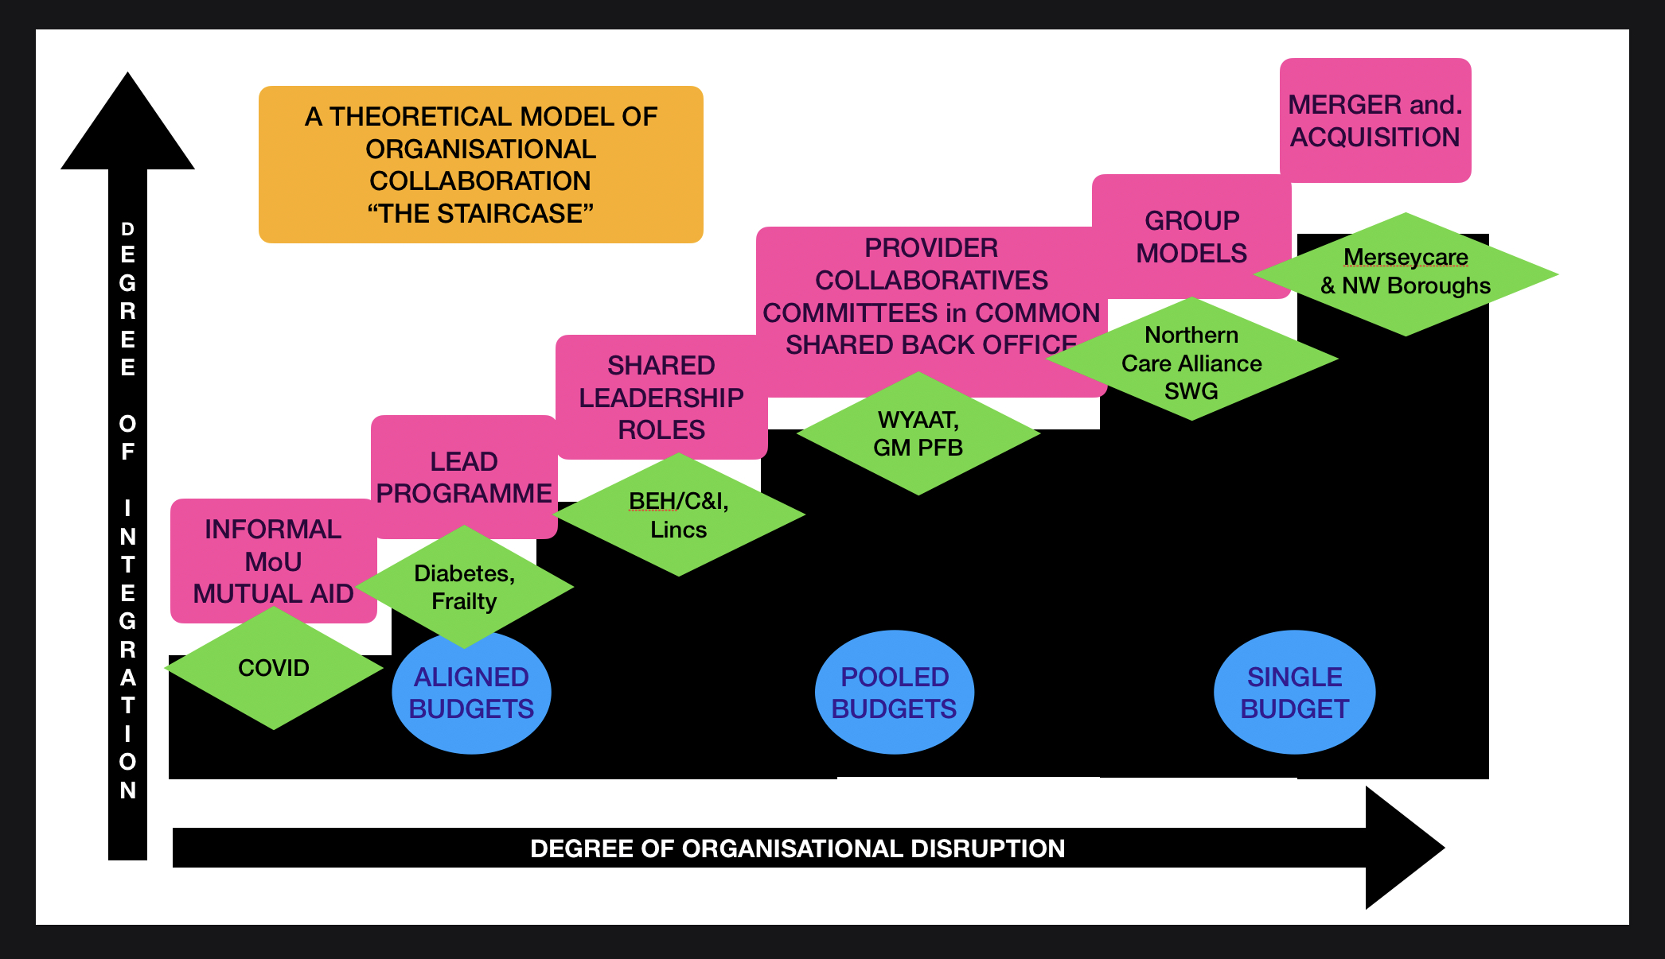

Slide 6
Provider Collaborative Model
Anticipated Benefits - illustrative
Standardised care across the county
Targeted care on those with greatest need
Admission avoidance based on shared data (interoperable and accessible)
Workforce recruitment and retention, aligned remuneration, market management of temporary staffing
Earlier diagnosis and focused complex care
Better use of estate
Shared financial risk - oversee shifting resource safely without impediment
Technology and innovation investment (inwards)
Maintaining grip on individual Trust commitments and contributions
Easy and speedy implementation

Slide 7
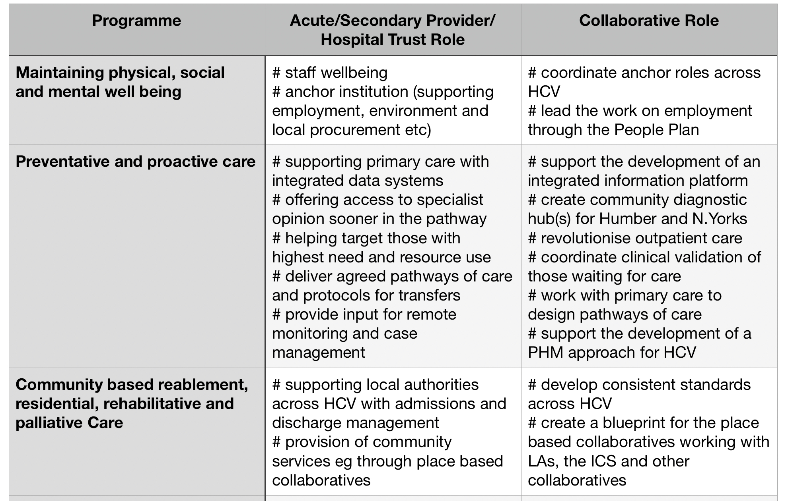

Slide 8
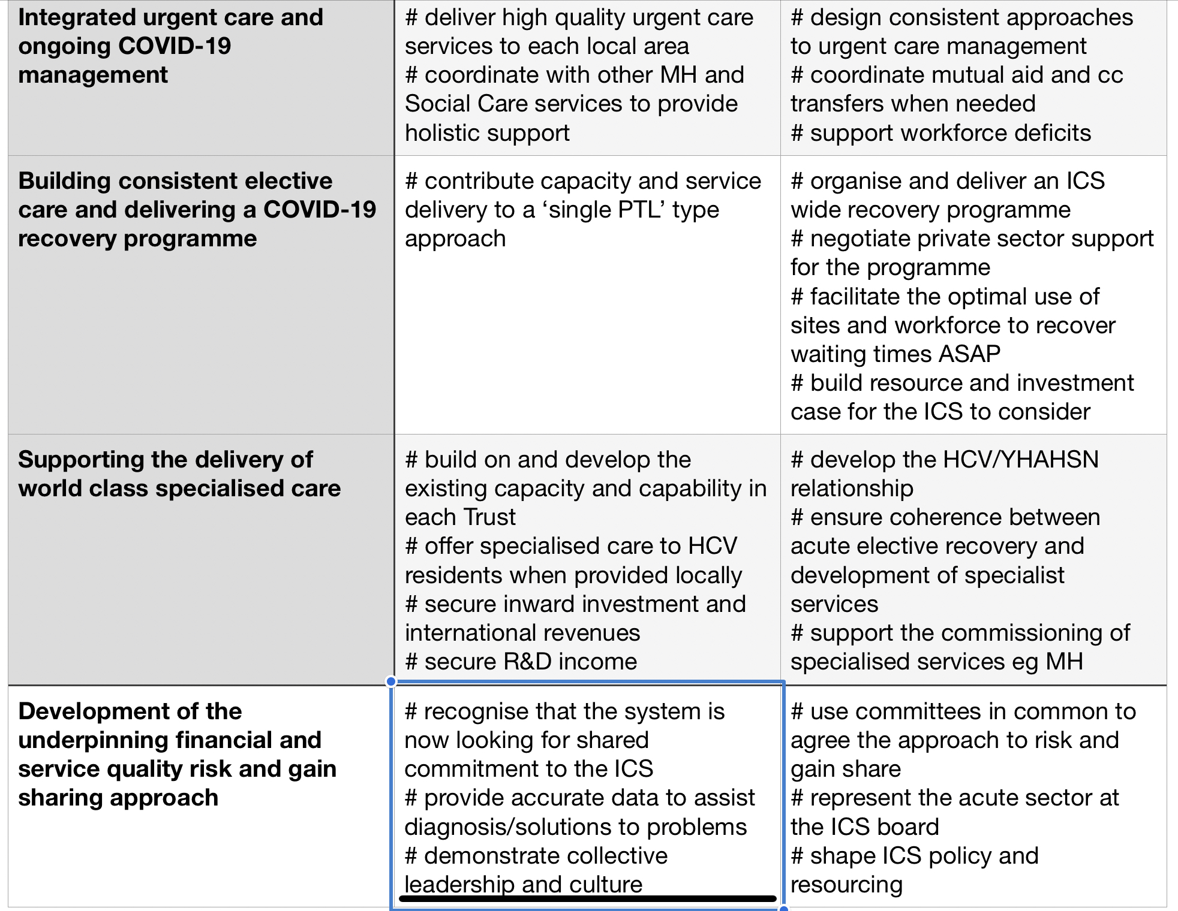

Slide 9
Part 2 - How?
Making sure that PFB understands it’s responsibilities, risks and approach
How is PFB going to deliver its role - all (60mins)
- Working through PFB and working in localities - joint planning
- Shared strategy
- Standardising care
- ERF
- Optimising sites
- Optimising workforce
- adopting innovation at pace
- wider contributions - anchor institutions, R&D

Slide 10
Part 3 - With what?
Making sure that PFB understands the capacity and capability this entails
Capacity and capability - (60mins)
- resources
- governance - making decisions, relationships with Trust Boards
- quality improvement
- data and insight
- clinical engagement
- financial risk management
- shared accountability
Influence and Representation - PFB and the ICS

Slide 11
CLINICAL SERVICE PLANNING PROCESS
Other spec com
OUT PATIENTS
Primary care
SERVICES FOR CLINICAL CHANGE PLANNING
ICP/SERVICES
ICP/SERVICES
ADMISSION
CLINICAL SYNERGIES
ASSOCIATED SPECIALTIES
CLINICAL SYNERGIES
ASSOCIATE SPECIALITIES
FIXED POINT
services
Regional
FIXED POINT services Local
NIHR
Com services
SERVICES FOR CLINICAL CHANGE PLANNING
DISCHARGE
AHSN
LA Social Care
DIAGNOSTIC SERVICES
CRITERIA FOR PLANNING
#SITE; #ACCESS; #EFFICIENCY; #TRUST ASPIRATIONS; #WORKFORCE; #STANDARDS

Slide 12
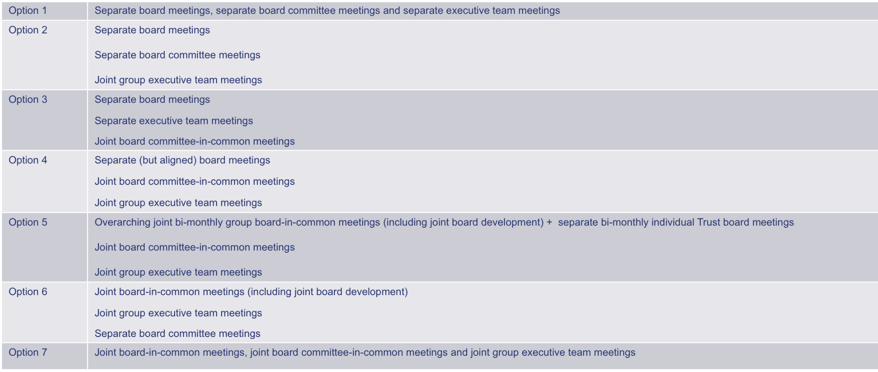
LEGAL OPTIONS FOR FORMAL COLLABORATION
NI TRUSTs CAN DESIGN AND IMPLEMENT A BESPOKE ARRANGEMENT TO MEET ITS OWN NEEDS AND CULTURE

Slide 13
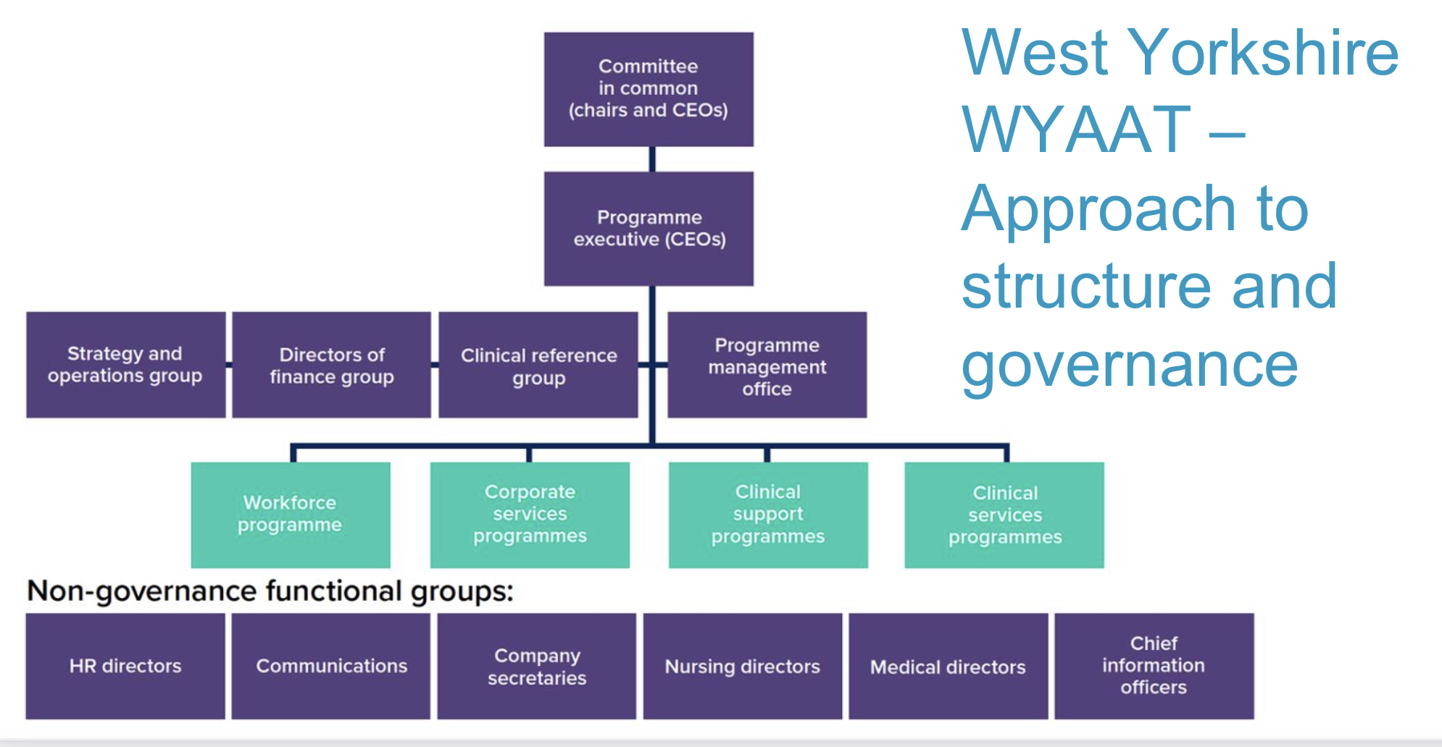

Slide 14
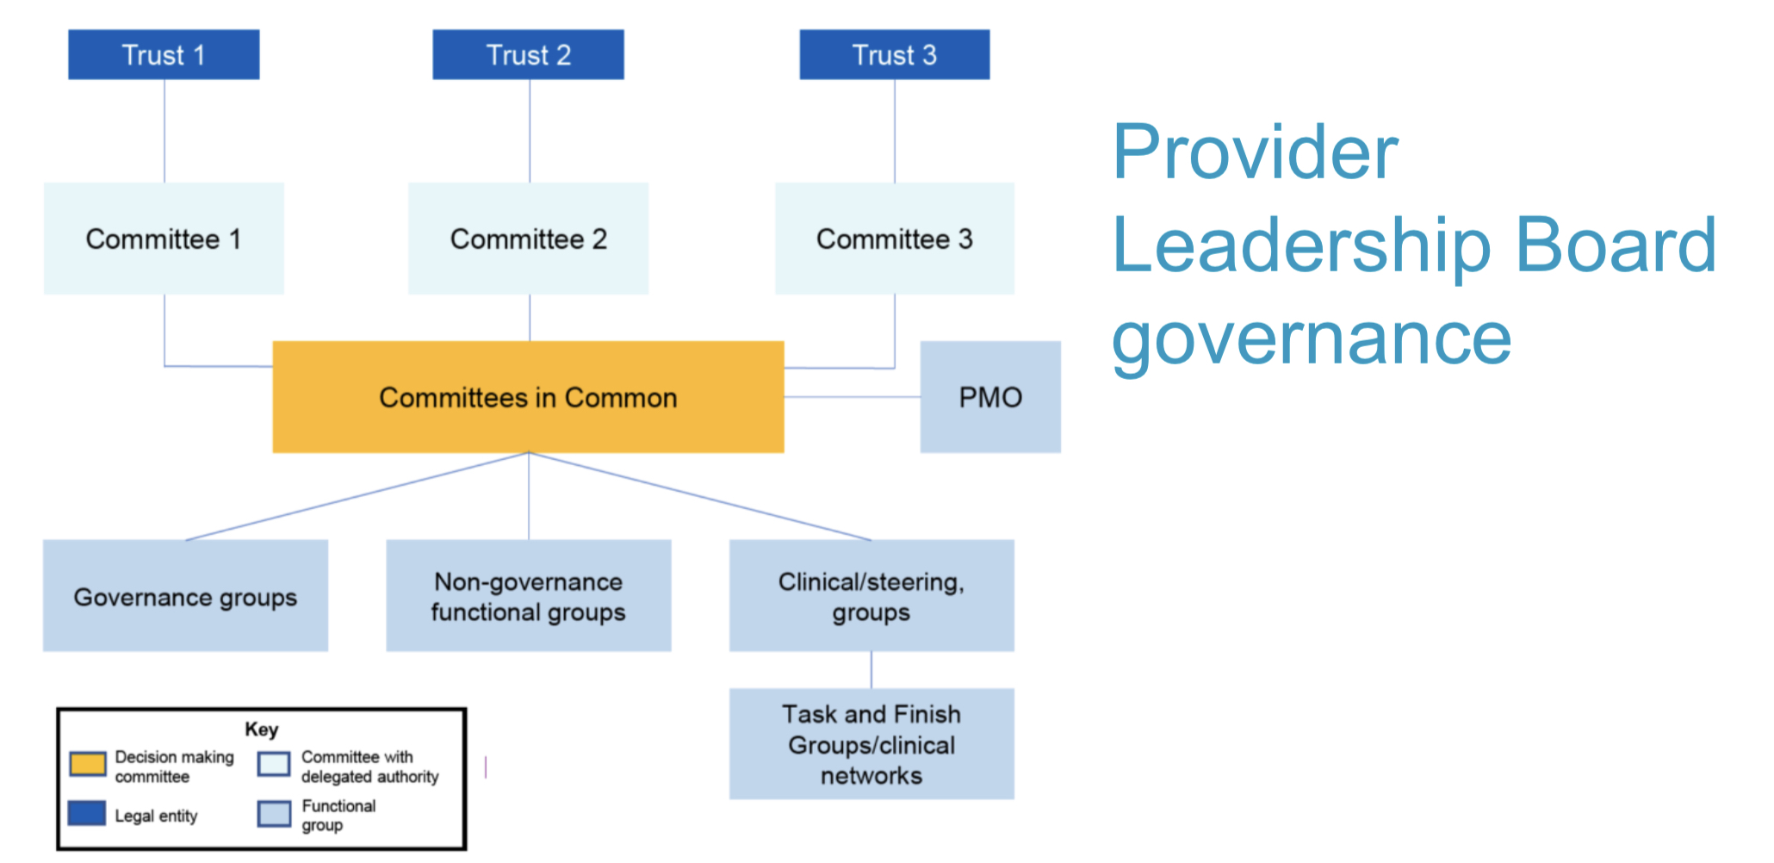

Slide 15

BEST PRACTICE EXAMPLES
NENC
CMAST
WYAAT
MANCHESTER LCO
BOSTON PARTNERS NETWORK
LINCOLNSHIRE GROUP MODEL
SOUTH WARWICKSHIRE GROUP
NATIONAL CENTRE OF EXCELLENCE FOR SPORT AND EXERCISE MEDICINE

