Slide 1
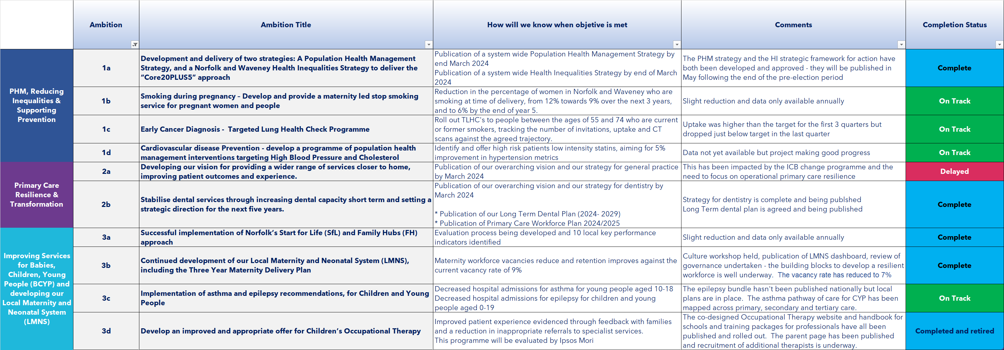
JFP Year One 2023/24
Ambitions and Objectives 1-3 ‘At a Glance’

Slide 2
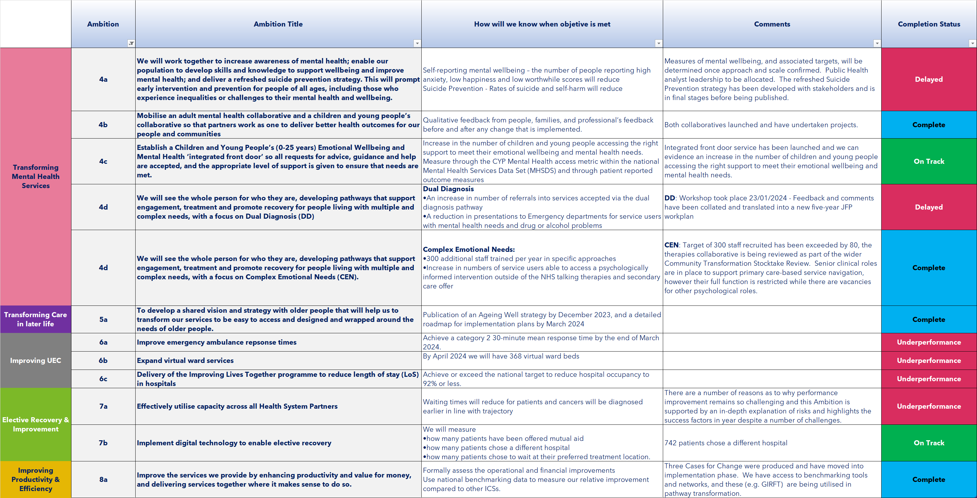
JFP Year One 2023/24
Ambitions and Objectives 4–8 ‘At a Glance’

